Slide 1
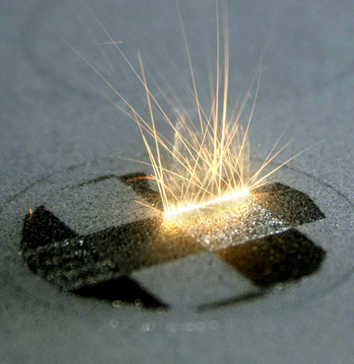
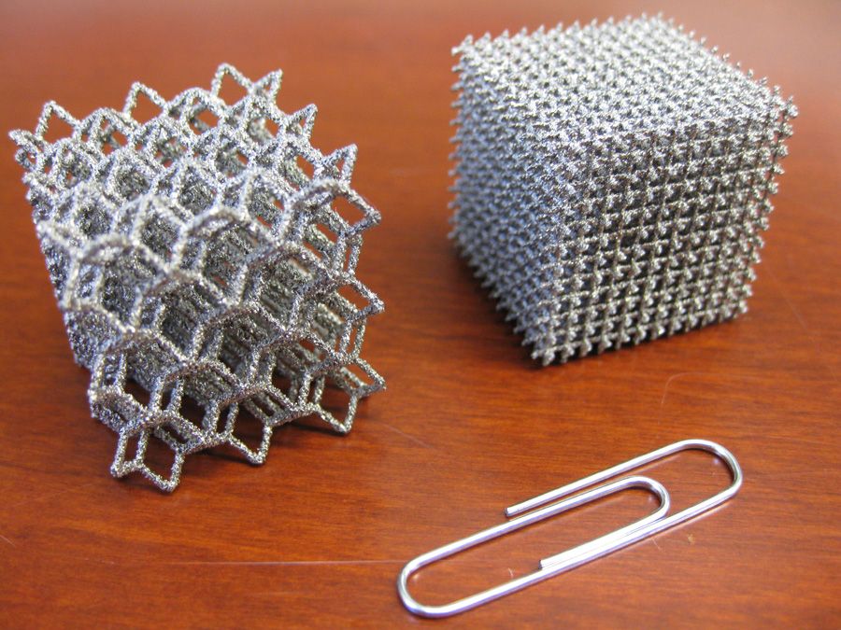
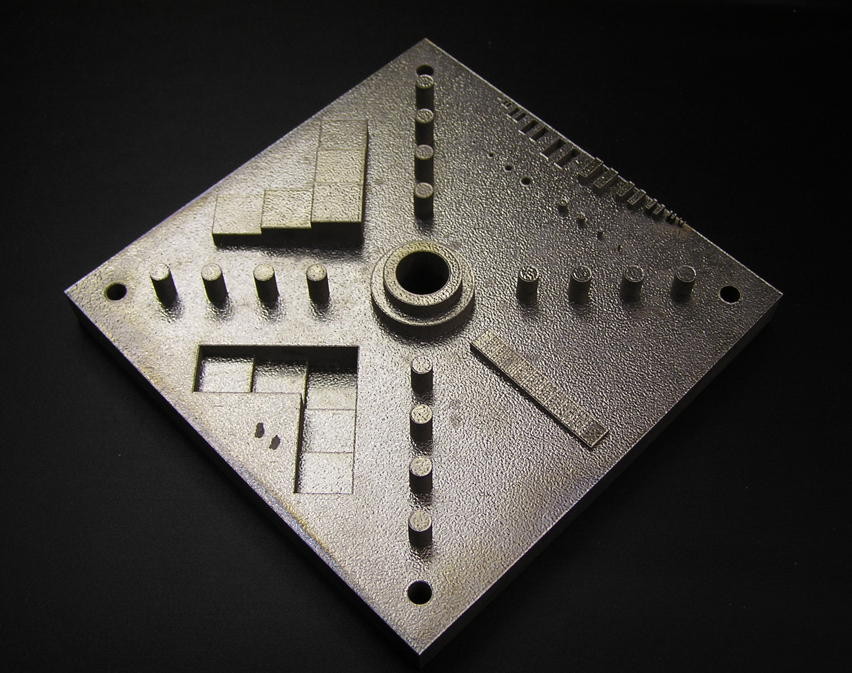
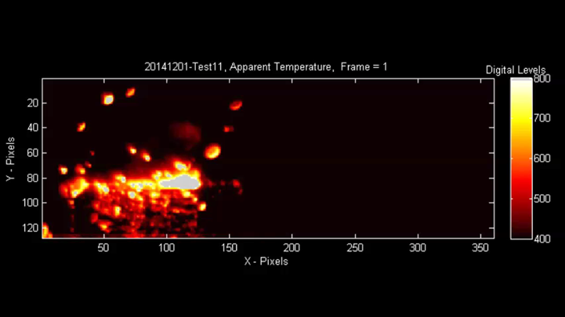
Government Perspective on Additive Manufacturing Standards
Kevin Jurrens
Intelligent Systems Division
Engineering Laboratory
National Institute of Standards
and Technology
U.S. Department of Commerce

Slide 2
Role of Additive Manufacturing Standards
Standards can be used for (among others):
specifying requirements
communicating guidance
documenting best practices
defining test methods and protocols
documenting technical data
accelerating the adoption of new technologies
Certifying bodies (e.g., FAA, FDA, NASA) typically reference publicly available standards in their procedures
Standards development in the U.S. is conducted through voluntary participation and consensus
Companies and agencies must participate to impact the priorities and content of standards

Slide 3
Current Challenges in AM Standards Landscape
Growing list of standards development organizations (SDOs) relevant to AM standards
Scopes of SDOs have evolved
High risk of duplication of efforts and overlapping content
Potential for inconsistencies (or even contradictions)
Conflicting standards create ambiguity and confusion

Slide 4
Many Examples of Difficult, Time-Consuming Standards Harmonization
ASTM/ISO harmonization of AM terminology standard
Wireless sensors and sensor networks: very complex, multi-year, multi-organization effort
International and U.S. machine tool standards
Existed in parallel for many years
Increased costs for U.S. industry
Sellers had limited market penetration due to conformance to multiple standards
Higher costs to buyers due to unique requirements (added tests) of multiple standards
Complete harmonization took about 20 years
Roller coaster industry standards recently in the news
The AM Industry has the opportunity to avoid this challenge

Slide 5
Vision for AM Standards
Integrated and cohesive set of AM Standards – to be used all over the world
Consistent, non-contradictory, non-overlapping
Common roadmap and organizational structure for AM standards
Use and build upon existing standards, modified for AM when necessary
Standards committees work together and follow a common standards development plan
Resulting standards are usable and acceptable for future users of all types (novice and expert)

Slide 6
Additive Manufacturing Standards Structure
General AM Standards
Terminology
Data Formats
Qualification Guidance
System Performance & Reliability
Round Robin Test Protocols
General Top-Level
AM Standards
General concepts
Common requirements
Generally applicable
Design Guides
Test Methods
Test Artifacts
Safety
Inspection Methods
etc.
Feedstock Materials
Process / Equipment
Finished Parts
Material Category-Specific
Process Category-Specific
All Finished Parts
Metal Powders
Ceramic Powders
Material
Jetting
Powder Bed Fusion
Mechanical Test Methods
Category AM Standards
Specific to material category or process category
Photopolymer Resins
Polymer Powders
Binder Jetting
Directed Energy Deposition
NDE/NDT Methods
Post-Processing Methods
Metal Rods
Polymer Filaments
etc.
Material Extrusion
Sheet Lamination
Bio-Compatibility Test Methods
Chemical Test Methods
etc.
Vat Photopolymerization
Material-Specific
Process-Material-Specific
Material-Specific
Titanium
Alloy Powders
Steel Rods
Powder Bed Fusion
with Nylon
Material Extrusion with ABS
Titanium Alloy
Paper
Sand
Nylon Powder
Nickel-Based Alloy Powders
Nylon
ABS
Aluminum Alloy
Specialized AM Standards
Specific to material, process, or application
Directed Energy Deposition with Titanium Alloy
Powder Bed Fusion with Steel
Nickel-Based Alloy
etc.
ABS Filament
etc.
etc.
Application-Material-Specific
Application-Process- Material-Specific
Application-Material-Specific
Aerospace
Medical
Aerospace
Medical
Aerospace
Medical
Automotive
etc.
Automotive
etc.
Automotive
etc.

Slide 7
NIST Perspectives on AM Standards
NIST Roles:
identify and address (consensus) needs and priorities
conduct measurement science research to develop the technical basis for standards
serve on standards committees
coordinate, facilitate, communicate
NIST Motivations:
High quality, technically accurate standards
Usable and high impact standards that meet stakeholder needs
Integrated and cohesive set of standards: consistent, non-contradictory, non-overlapping
No duplication of effort
Use of existing standards, modified for AM when necessary

Slide 8
Recommended Actions - SDOs
Establish clearly defined scope statement for each committee
Use common terminology whenever possible – this is essential for the industry
Create organizational and technical liaisons between committees for communication, coordination, and collaboration
Organizational liaisons: At least at highest levels (committee chairs and administrators) to allow knowledge of procedures, activities, and strategies
Likely to be observing member of committee (not voting member)
Technical liaisons: Contributing to individual work items, providing technical input to avoid specific contradictions and duplications of effort.
Formal comments on work item drafts should coordinate and reflect views of the entire committee the liaison represents.
Significant cross-pollination across committees at all levels is preferred
Consider how the standards of each SDO align with and use the AM standards organizational structure proposed by ASTM / ISO

Slide 9
Recommended Actions - AMSC
Identify and convene stakeholders relevant to AM standards
Establish agreement on vision and guiding principles for development of AM standards
Define and document consensus needs and priorities for AM standards (i.e., Standardization Roadmap)
Provide mechanisms for coordination, communication, and cooperation among AM standards bodies, regulatory agencies, and users
Facilitate interactions with SDOs to coordinate development of standards based on the identified needs and priorities

Slide 10
Expected Outcomes of this Meeting
Kick-off Phase 2 of AMSC!
Engage with new participants, new industry sectors, and new application areas
Address known gaps in current Standardization Roadmap
Establish basis for V2 of AM Standardization Roadmap
What is missing?
What changes are needed?
What are your priority needs?
Your contributions are essential for establishing consensus on AM standards needs and priorities!

Slide 11
Summary
Motivations/Vision for AM standards:
High quality, technically accurate standards
Usable and high impact standards
Integrated and cohesive set of standards: consistent, non-contradictory, non-overlapping (prevent future standards harmonization!)
No duplication of effort
Recommended actions are provided for SDOs and AMSC
Efforts are needed to enhance communication, coordination, and collaboration among AM users, standards bodies, and regulatory agencies
NIST will continue to support AM standards development through its measurement science research
Your help and contributions for AMSC Phase 2 are very important and much appreciated!

Slide 12
Contact Information
Kevin Jurrens
Intelligent Systems Division
kevin.jurrens@nist.gov
(301) 975-5486
National Institute of Standards and Technology (NIST)
100 Bureau Drive, MS 8220
Gaithersburg, MD 20899
www.nist.gov/el/isd

