Slide 1
America Makes
The National Additive Manufacturing Innovation Institute
Smart Collaboration – Leveraging a rich knowledge base to gain competitive advantage in the additive manufacturing industry: AMSC Overview
John Wilczynski
NCDMM
Technology Director, America Makes
john.wilczynski@ncdmm.org
September 7, 2017

Slide 2
America Makes Is…
an impartial convener of Additive Manufacturing and 3D Printing stakeholders
a coordinator of technical and workforce information and data
an activation catalyst through high value, high difficulty, high impact collaborative projects

Slide 3

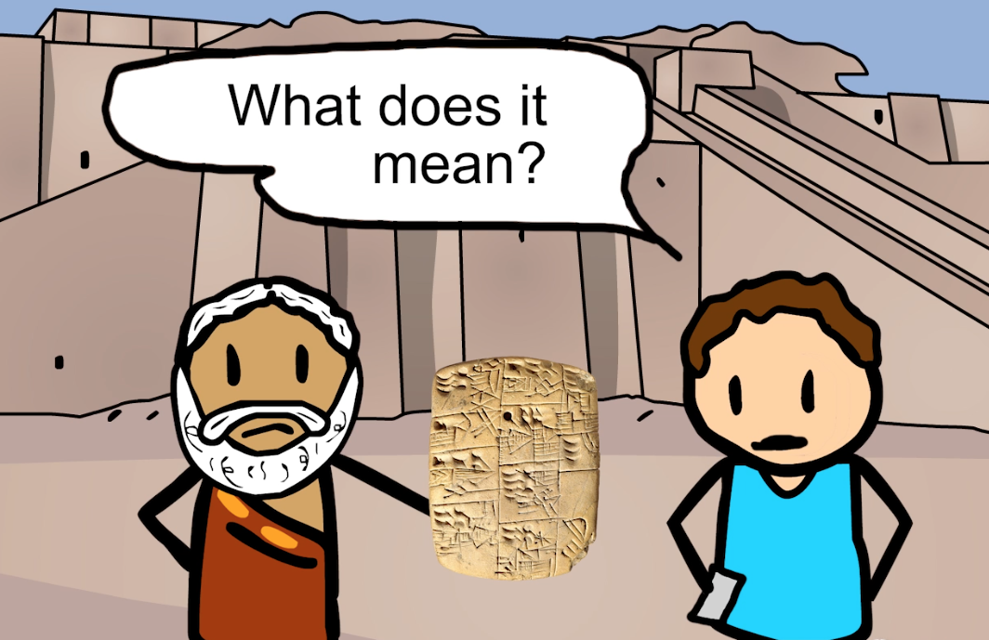
America Makes Is…Coordinator
Everything is Based on Language and Communication
Successful innovation needs common language, context and communication

Slide 4
Technology Roadmap
America Makes developed the Additive Manufacturing Technology Roadmap to identify measurable and meaningful challenges that, when met, promote inquiry, knowledge-sharing, and technical advancements across the industry.
To create this Roadmap, America Makes held in-person workshops and activities where members engaged in a series of methodologies to generate and categorize industry needs. Working in teams, they documented hundreds of needs statements and identified affinities among them that ultimately converged on a curated set of project concepts.

Slide 5
Standards/Schemas/Protocols – CTE Objectives
Development and dissemination of a complete set of consensus based standards and protocols for additive manufacturing.
Development of standards associated with terminology, design, data formats, materials, processes, test methods, etc.
Standards and protocols for raw materials, process/equipment, finished parts, and AME integration/interoperability that may also be tailored further based on material specific needs, process specific needs, and/or application specific needs.
Areas of interest for this technology area include NIST Measurement Science for Additive Manufacturing initiatives, DARPA Open Manufacturing initiatives related to standards/schema/protocol development, alignment with Standards Development Organizations activities, etc.

Slide 6
AMSC Purpose and Objectives
To coordinate and accelerate the development of industry-wide additive manufacturing standards and specifications, consistent with stakeholder needs, and thereby facilitate the growth of the additive manufacturing industry
AMSC’s charter does not include developing standards or specifications; rather, the hope is to help drive coordinated activity among SDOs

Slide 7
Phase 2 Goals
Discuss needs of other industries (e.g., automotive/heavy equipment, energy, industrial & commercial machinery)
Expand discussion of other materials (e.g., polymers)
Identify potentially overlooked gaps
Provide an update on gaps already identified
Target Date for Publication of Roadmap Version 2.0 end of June 2018

Slide 8



When America Makes
America Works
AmericaMakes.us
@AmericaMakes
/AmericaMakes

