Slide 1
Additive Manufacturing Wargame II Updated Slide Review
As of March 27, 2017

Slide 2
Wargame Overview
This Business Model Wargame II is a follow-up to the initial Business Model Wargame held at the Lockheed Martin Center for Innovation in 2016.
The purpose of the Wargame is to address the business model aspects of additive manufacturing (AM) for production and sustainment, and lay the ground work for future life cycle considerations involving AM capabilities.
The Wargame will create a simulation which will address the AM ecosystem to include partnering, intellectual property, data rights, contracting issues, business risks, legal concerns and liability, and will document those business models on a business canvas.
The scope includes the commercial aspects of the transaction, communication, and Government – industry - academia relationships.

Slide 3
Scenario
This is the prequel to the original Additive Manufacturing Business Model Wargame (AM BM WG) scenario that formed the basis of the 2016 AM BM WG.
The DoD issued a request for proposal (RFP) to develop and acquire a reconnaissance light-weight (RLW) drone capable of being deployed by a 2-person team in austere environments. The timeline defined by DoD is aggressive. DoD requires the awardee to produce a prototype within 6 months and the first production unit within a year after contract award(ACA).
Most of the performance capabilities required by DoD can be performed by commercially available systems, but some of the reconnaissance features will have to be developed jointly by the Government/Industry team and some of the capabilities will be provided by the Government team which cannot share the base technology with the drone manufacturer.
ACME Inc., an original equipment manufacturer(OEM), has been awarded a contract to design, develop, and manufacture 1,000 units.
Commercial Logistics Support(CLS) from ACME may be negotiated.

Slide 4
Team Compositions
Roles | Team 1–Buy-Out | Team 2–Loaner | Team 3 – CLS | Team 4 – Netflix
Government Co-Lead | Mr. Tom Naguy, Air Force | Lt Col Howie Marotto, USMC | Sam Cooper, Army | CAPT Armen Kurdian, Navy
Industry Co-Lead | Hannah DuMey, Boeing | Teresa Clement, Raytheon | Bill Harris, Lockheed Martin | Jim Regenor, Moog
Facilitator | Ed Morris, America Makes | Dr. Mike Yukis, PSU ARL | Rich Lonardo, Youngstown Business Incubator | Dana Ellis, NCMS
Coordinator | Ashley Mitchell, LMI | Jim Pluta, OPNAV Navy N415 | Stefanie Gaffney, Youngstown Business Incubator | Debbie Lilu, NCMS

Slide 5
Additive Manufacturing Wargame II Moves & Deliverables
As of March 27, 2017

Slide 6
Move Schedule – Day 1
Time | Move | Description | Deliverable
8:00 AM to 8:30 AM | Introductions, Explanation of Game
8:30 AM to 9:00 AM | Assign Teams to Business Model Approaches
9:00 AM to Noon | Move 1 | Deconstruct RFP | Compliance Matrix
Noon to 1:00 PM | Lunch
1:00 PM to 3:00 PM | Move 2 | Strategy | Technical Approach, Schedule, Statement of Work, Technical Data Package, Acquisition Strategy, Life Cycle Sustainment Plan
3:00 PM to 3:30 PM | Break
3:30 PM to 5:00 PM | Move 3 | Revenue model | Business Model Canvas
5:00 PM | Adjourn

Slide 7
Move Schedule – Day 2
Time | Move | Description | Deliverable
8:00 AM to 8:30AM | Review, Q&A, Launch teams
9:00 AM to Noon | Move 4 | Assess to value proposition | Contract
Noon to 1:00PM | Lunch
1:00 PM to 2:00 PM | Move 5 | Create out-brief | Out-brief presentation
2:00 PM to 2:15 PM | Break
2:15 PM to 3:30 PM | 4 Out-briefs
3:30 PM to 4:00 PM | Wrap-up
4:00 PM | Adjourn

Slide 8
Move 1 – Deconstruct RFP
Create a compliance matrix, jointly agreed to by the Government and Industry team members that shows all requirements of the RFP, and how they will be complied with.
Acceptable at this point to show some requirements may need to be negotiated (yellow) or not met (red).
Initial assertions identified; can be determined later.
We should expect to see some “discovery” in this process.
Expect multiple revisions that want to be retained.

Slide 9
Team ____________ – Move 1: Compliance Matrix
Government and Industry
Government and Industry
Industry
Government
No. | Requirement | How compliance achieved | How well | Comments
Stoplight
(red, yellow, green)

Slide 10
Move 2: Strategy
Develop technical approach, schedule, and statement of work assuming that there are no technology related constraints.
Determine content of a Technical Data Package (or packages).
Establish assertions and restrictions.
Possible that there might be several TDP’s that vary over the term or phase of the contract
Determine content of an Acquisition Strategy and Life Cycle Sustainment Plan.

Slide 11
Team ____________— Move 2: Technical Approach

Slide 12
Team ____________— Move 2: Timeline
UAV 1 Delivered
UAV 1000 Delivered
Award
Schedule
Year 1 | Year 2 | Year 3
ACME sustainment
Demonstration & Evaluation
Start organic sustainment
Tasks
Develop, design, manufacture
Demonstration, evaluation, qualification
Production
Production sustainment
Organic sustainment
*Timeline pictured above is an example and may differ based on the Team's Sustainment Plan

Slide 13
Team ____________— Move 2: Statement of Work

Slide 14
Team ____________– Move 2: Technical Data Package
Requirement No. | Technical Data Description | Type of media | Source | Restrictions
 | CAD Models/Drawings
 | Associated Lists
 | Specifications
 | Standards
 | Performance Requirements
 | Quality Assurance (QA) Provisions
 | Software Documentation
 | Packaging Details

Slide 15
Team ____________— Move 2: TDP Discussion Points
Where will the technical data be stored?
How will the TDP be transported and secured?
How will updates and configuration management be handled?
What guidelines will be imposed on use?
Will the TDP be available to the Government?
If so, under what conditions:
Government already purchased access
Government will need to purchase access
Government can “lease” temporary access
Government will not have access.

Slide 16
Acquisition Strategy
Business Model
What is the value proposition for the Government?
What are the contracting strategies or contract types? What are issues that need to be address & how are you addressing them? (e.g., ‘Liability’ may be an issue, but don’t just say “We will address ‘Liability.’” What is your solution?)
What are the metrics against which the success or failure of the model will be evaluated?
Risk Management
Technical risks
Programmatic risks
Address what your mitigation measures are, or contingencies
Intellectual Property
How will the Government manage I.P.?
Who will own it
What are the appropriate level of data rights
Show a matrix or table of points in the acquisition cycle and what data rights and data packages the Government needs to have
Required Test Activities
Incentive Opportunities
Competition
(Move 3: Business Model Canvas; Move 4)
(Move 4: Contract Administration)
(Move 1: Compliance Matrix)
(Move 4)
(Move 1, Move 2: Strategy and TDP)
(Move 1, Move 2)

Slide 17
Life Cycle Sustainment Plan
Template TBD

Slide 18
Move 3: Complete Revenue Model
Populate with data and values from prior moves as required:
Value proposition
Schedule
Resources
Establish cost and revenue approaches/structures (menu selections).
Identify partners, customer relationships, segments and channels.
You may add or subtract questions from the canvas, as needed for time purposes.

Slide 19
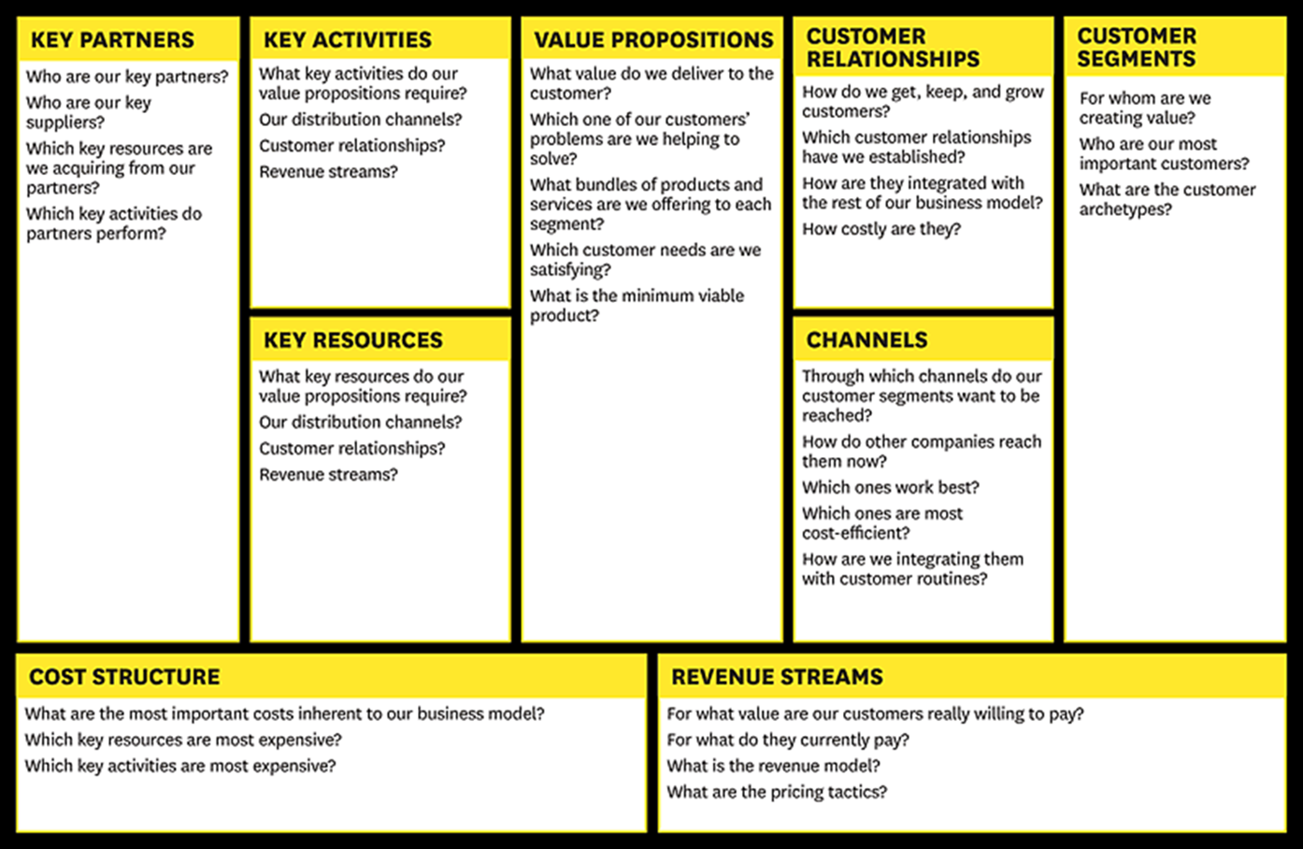
Move 3: Business Model Guide

Slide 20
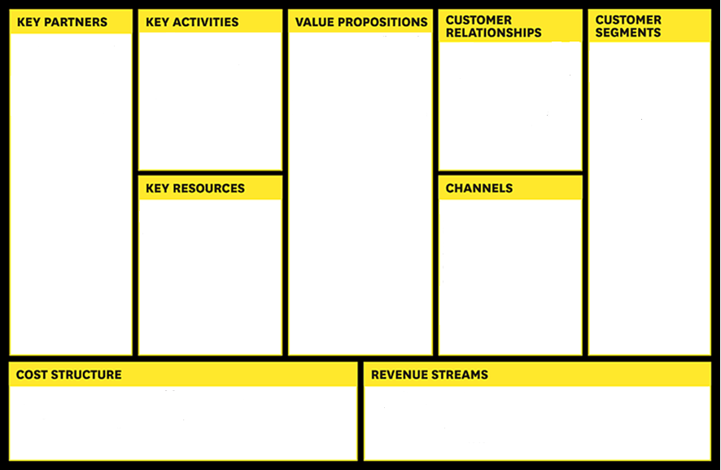
Team ____________– Move 3: Business Model Canvas

Slide 21
Move 4: Assess to Value Proposition
Have the prior moves met government and industry needs?
Negotiate any open items on the compliance matrix.
We should expect that there may be an impasse that can’t be overcome because of the value proposition.
Risk Management.

Slide 22
Team ____________— Move 4: Contract Administration
Technical Approach | Terms and Conditions | Assertions | Warranty | Liability

Slide 23
Move 5: Outbrief
Briefing Outline
Business Case / Model
Team Composition
Team Assumptions
Deliverables and Results
Move 1: Compliance Matrix
Move 2: Technical Data Package
Move 3: Business Model Canvas
Move 4: Contract Administration
Challenges
Final Thoughts

Slide 24
Cost Comparisons
 | Qty | ACME COTS | AM MFG / Repair | ACME IP | MTBF – Flights | ACME Engineering Design (Hours) | ACME Engineering cost per hour | Engineering Cost per unit (@3000 units) | Mfg Cost | Mfg Utilization | Post-Processing (hours) | Technician cost per hour | BOM Cost
Electronics
CPU | 1 | x |  |  |  |  |  |  | $382.80 |  |  |  | $ 382.80
GPS Antenna | 1 | x |  |  |  |  |  |  | $198.00 |  |  |  | $ 198.00
Data Link | 1 | x |  |  |  |  |  |  | $1,247.40 |  |  |  | $ 1,247.40
User Control Unit | 1 | x |  |  |  |  |  |  | $1,973.40 |  |  |  | $ 1,973.40
GFE ISR package
Propulsion
Propeller | 4 |  | x | x | 20 | 150 | $235.00 | $11.75 | $50.00 | 90% | 5 | $150.00 | $ 972.22
Motor | 4 | x |  |  |  |  |  |  | $2,376.00 |  |  |  | $ 9,504.00
Drive train | 4 |  | x | x | 75 | 100 | $235.00 | $7.83 | $60.00 |  |  |  | $ 240.00
Battery | 2 | x |  |  | 350 |  |  |  | $792.00 |  |  |  | $ 1,584.00
Structural
Strong Box | 1 |  | x | x | 150 | 300 | $235.00 | $23.50 | $100.00 | 80% | 10 | $150.00 | $ 1,625.00
Boom Arms | 4 |  | x | x | 30 | 125 | $235.00 | $9.79 | $80.00 | 87% | 7 | $150.00 | $ 1,417.82
Shroud | 1 |  | x | x | 35 | 150 | $235.00 | $11.75 | $150.00 | 83% | 8.5 | $150.00 | $ 1,455.72
ACME Internal Cost |  |  |  |  |  |  |  | $64.62 |  |  |  |  | $ 20,600.36
ACME Profit (50%) |  |  |  |  |  |  |  |  |  |  |  |  | $ 10,300.18
Total Cost |  |  |  |  |  |  |  |  |  |  |  |  | $ 30,900.54

Slide 25
Questions?
Comments?

