Slide 1
Additive Manufacturing Business Model Wargame II Team Read-Ahead
DRAFT
As of March 17, 2017

Slide 2
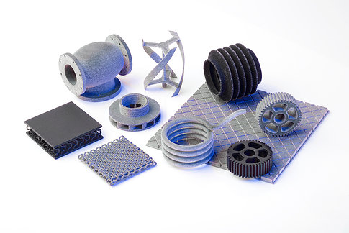
Content
Wargame Overview
Scenario
Wargame Assumptions
Business Models / Teams
Team Composition
Move Schedule
Deliverables

Slide 3
Wargame Overview
This Business Model Wargame II is a follow-up to the initial Business Model Wargame held at the Lockheed Martin Center for Innovation in 2016.
The purpose of the sponsoring Additive Manufacturing Business Model Working Group is to address the business model aspects of additive manufacturing for sustainment and production consistent with public private partnership principles in parallel to additive manufacturing technical community efforts.
Scope includes the commercial aspects of the transaction, communication, and Government – industry - academia relationships. The DoD roadmap published in 2016 confirms to need for this focus.
The scenario for Wargame II has been expanded to include the life cycle platform considerations to further develop the necessary business environment to support the continued adoption of Additive Manufacturing (AM) capabilities to benefit the Warfighter in parallel to technology focus.

Slide 4
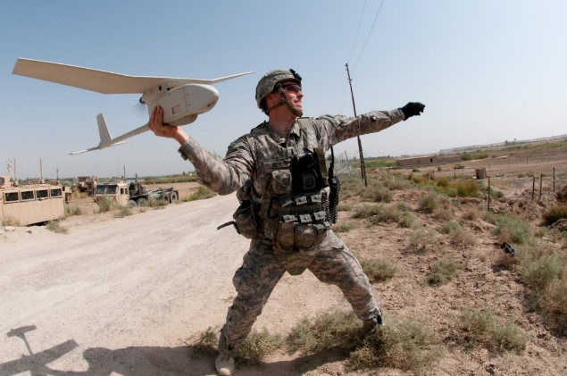
Scenario
This is the prequel to the original AM BM WG scenario that formed the basis of the 2016 AM BM WG.
The DoD issued an RFP to develop and acquire a light-weight reconnaissance drone capable of being deployed by a 2-person team in austere environments. The timeline defined by DoD is aggressive. DoD requires the awardee to produce a prototype within 6 months and the first production unit within a year after contract award. Most of the performance capabilities required by DoD can be performed by commercially available systems, but some of the reconnaissance features will have to be developed jointly by the Gov't/Industry team and some of the capabilities will be provided by the Gov't team which cannot share the base technology with the drone manufacturer.
An OEM, ACME, has been awarded a contract to design, develop, and manufacture 1,000 units and provide sustainment throughout a 3-year period of performance. After the production phase, ACME will support a transition to an organic, DoD managed sustainment activity.

Slide 5
Wargame Assumptions
RFP has been issued based on a commercial design with components that are additively manufactured
A contract has been awarded to ACME (OEM met all requirements by compliance or negotiation)
Initial sustainment will be performed by ACME for the 3 years in which they are delivering RLW drones to DoD; both at their commercial facility for depot level maintenance and at selected field locations around the world, including shipboard.
After ACME has delivered its 1000th RLW, DoD will be providing organic sustainment; including additively manufacturing configuration items originally produced that way by ACME under contract,
All parts identified as potential sustainment items required for 6 month deployments are required to be AM parts by contract
ACME owns the IP for most of the vehicle components
Parts needed to integrate DoD reconnaissance technology to the air vehicle, will be owned by DoD with unlimited data rights
No new AM materials are developed for the UAV and all materials have existing material property data bases established
AM technical issues related to the General Dimension and Tolerances (GD&T) have been resolved to the point that Net Shape printing of components for the UAV is possible
ACME has developed TDPs and build files for all parts made via AM; several different AM machines, both metal & non-metal were used
DoD infrastructure not currently in place to handle organic support scenario is calling for...come up w/a solution but don't just black-box it and say it will be solved

Slide 6
Wargame Assumptions Cont’d
Assume there is a lead Service, but don't try to pigeonhole your problem solution w/in a particular Service's rules & regulations
The 3-year full-rate production run begins after the drone successfully completes developmental & operational test
Since the drone will be slightly modified from the original commercial design, it would ostensibly need FAA certification as well. It is not required for this wargame
Assume requisite funding levels and colors are available. It is not necessary to call out colors of funding, although if the Service reps want to amplify their deliverable by stating what colors of money they think would be appropriate for the various aspects of the wargame, that is completely acceptable.
Type of contract is not an issue - may be fixed price, cost plus, licensing agreements, or any other arrangement / combination so long as it meets the intention of the model
Not bound by subcontractor conditions
New machines will require updates (similar to software updates)
Points of clarification:
It's stated that ACME will support for the first 3 years at their commercial facility and at field locations including shipboard. Are those shipboard locations owned & operated by ACME?
Maybe mention after Q&C that a low-rate initial production run will be used for Operational Test that will last an additional six months. This could be an additional problem for the Government team to solve.
How do we handle cost and revenue? How do we put a price or value on it?

Slide 7
Business Models / Teams
#1 Team Buy-out: Traditional government acquisition
#1A - Gov’t purchases unlimited data rights from Acme
#2A - Gov’t purchases government purpose data rights
#2 Team Loaner: Lease 1000 LWR drones from Acme
Government completes all integration of reconnaissance capabilities
Acme provides government purpose data rights to commercial IP
Government organically sustains LWR drone thru life
#3 Team CLS: Government purchases 1000 LWR drones
Government / Acme work together to integrate reconnaissance capabilities
Acme provides commercial logistics support for drone thru life
#4 Team Netflix: Government purchases 1000 LWR drones from Acme
Government and Acme setup Netflix type of arrangement on “pay as you go” IP arrangement

Slide 8
Team Compositions
Name | Organization | Discipline

Slide 9
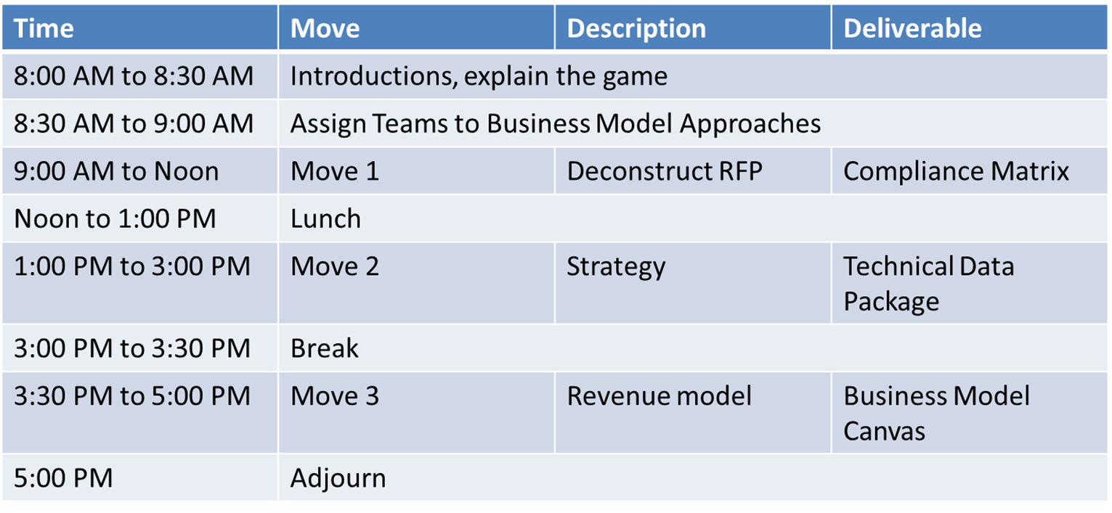
Move Schedule – Day 1

Slide 10
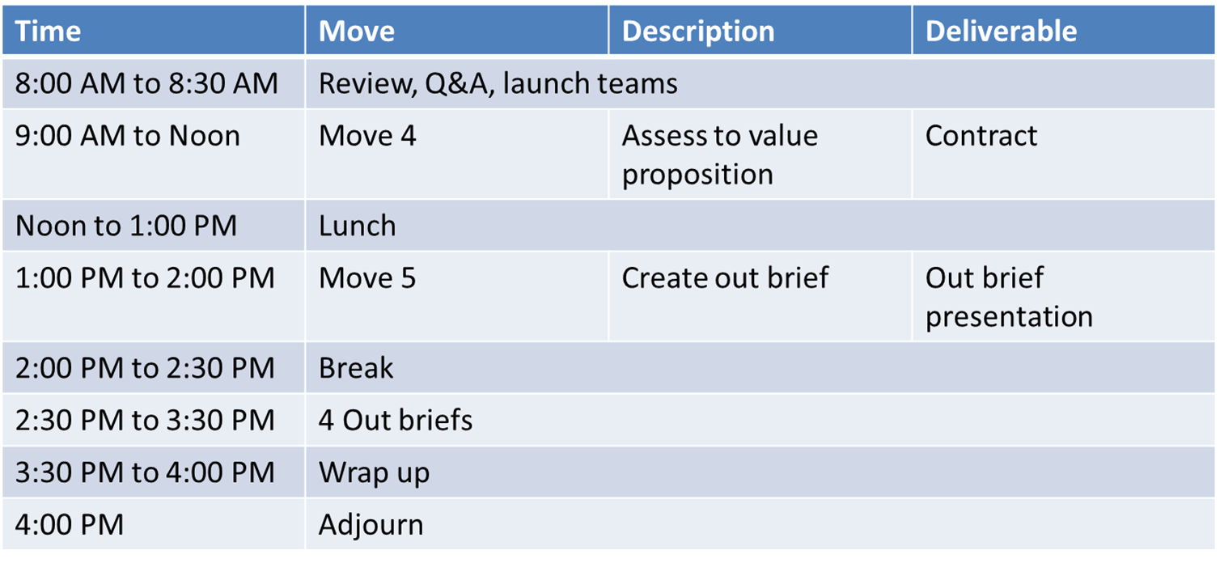
Move Schedule – Day 2

Slide 11
Move 1 – Deconstruct RFP
Create a compliance matrix, jointly agreed to by the Government and Industry team members that shows all requirements of the RFP, and how they will be complied with.
Acceptable at this point to show some requirements may need to be negotiated (yellow) or not met (red)
Initial assertions identified; can be determined later
We should expect to see some “discovery” in this process
Expect multiple revisions that want to be retained

Slide 12
Deliverables – Move 1: Compliance Matrix

Slide 13
Move 2: Strategy
Develop technical approach, schedule, and statement of work assuming that there are no technology related constraints
Determine content of a Technical data package (or packages)
Establish assertions and restrictions
Possible that there might be several TDP’s that vary over the term or phase of the contract

Slide 14
Move 2: Technical Data Package Template

Slide 15
Move 3: Complete Revenue Model
Populate with data and values from prior moves as required
Value proposition
Schedule
Resources
Establish cost and revenue approaches/structures (menu selections)
Identify partners, customer relationships, segments and channels

Slide 16
Deliverables – Move 3: Business Model Canvas

Slide 17
Move 4: Assess to Value Proposition
Has the prior moves met government and industry needs?
Negotiate any open items on the compliance matrix
We should expect that there may be an impasse that can’t be overcome because of the value proposition.

Slide 18
Deliverables – Move 4: Contract Administration
Technical Approach | Statement of Work | Schedule | Terms and Conditions | Assertions | Warranty | Liability

Slide 19
Move 5: Outbrief
Briefing Outline
Business Case / Model
Team Composition
Team Assumptions
Deliverables and Results
Move 1: Compliance Matrix
Move 2: Technical Data Package
Move 3: Business Model Canvas
Move 4: Contract Administration
Challenges
Final Thoughts

Slide 20
Questions?
Comments?

