Slide 1

2019 Additive Manufacturing
Workshop
Final Report
18 – 19 June 2019
Lockheed Martin Global Vision Center
Crystal City, VA
2121 Crystal Drive
Arlington, VA 22202

Slide 2
Table of Contents
Section | Page
Purpose | 4
Background | 5
Participant Demographics | 7
Additive Manufacturing (AM) Working Groups | 8
Agenda | 10
Working Group (WG) Briefs | 12
Data Standards and Data/Model Sharing WG | 12
Joint AM Model Exchange (JAMMEX) Sub-Group | 14
Technical Data Packages (TDP) Standard Project Sub-Group | 24
Cybersecurity Challenges and Solutions (Blockchain) Sub-Group | 36

Slide 3
Table of Contents
Section | Page
Qualification and Certification Work Group | 44
Database and Common Language Sub-Group | 46
Quality Assurance Sub-Group | 54
Standards Sub-Group | 65
Business Practices Work Group | 75
DoD AM Acquisition Guide Sub-Group | 77
AM Supply Chain Integration Sub-Group | 85
Intellectual Property (IP) Management Sub-Group | 95
Workforce Development Work Group | 107
DoD AM Policy Development Working Group | 122
Summary of Key Next Steps | 131
2019 AM Workshop Final Thoughts | 132
AM Workshop 2020 | 133

Slide 4
Purpose
Follow up to 2016 and 2017 AM Wargames, and 2018 AM Business Model Workshop
To collaborate across government, industry and academia to actively pursue solutions in five foundational topic areas critical to our ability to scale additive manufacturing adoption and execution across DoD
Sponsored by DoD’s Joint Additive Manufacturing Working Group (JAMWG), America Makes Additive Manufacturing for Maintenance and Sustainment Advisory Group and the Additive Manufacturing for Maintenance Operations (AMMO) Working Group.

Slide 5
Background
2016 AM Business Model Wargame
  Purpose was to illuminate required business transactions when the DoD requires critical and non-critical parts to be additively manufactured at a DoD depot or at a 3rd party location in support of an immediate readiness goal. The wargame included five moves, simulating a solicitation to draw out the issues.
  Final Report: https://ammo.ncms.org/resources/?drawer=Resources*AM%20Wargames*2016
2017 AM Business Model Wargame
  Expanded the first wargame scenario to include life cycle platform considerations relevant to the business environment required to support the continued adoption of AM capabilities. Four teams, representing four different business models, dealt with the same scenario involving a need to manufacture repair parts using AM capabilities at the point of use. The four teams were:
  #1 Team “Buy-out”: Traditional government acquisition
  #2 Team “Loaner”: Government leases the end items
  #3 Team “CLS”: Contractor provides commercial logistics support (CLS)
  #4 Team “Net-Flix”: Government and original equipment manufacturer (OEM) set-up a “pay as you go” IP arrangement to allow AM part production in the field
  Final Report: https://ammo.ncms.org/resources/?drawer=Resources*AM%20Wargames*2017

Slide 6
Background (Cont’d)
2018 Business Model Workshop
  The purpose of this workshop was to address five business model aspects of AM for sustainment and production in parallel with ongoing AM technology community efforts.
    Develop an AM Contracting Guide for Navy / DoD
    Information Assurance on 3D Technical Data Packages (TDPs) and Blockchain
    Pathfinder Scenario Study of AM Repair Part
    3D Model Exchange
    AM Intellectual Property Management
Final Report: https://ammo.ncms.org/resources/?drawer=Resources*AM%20Wargames*2018

Slide 7
2019 Participant Demographics
223 people from DoD, other government agencies, Industry, and Academia registered, and were assigned to 13 different work groups ranging from 15-32 members.
Participant Disciplines Included:
  Logistics
  Acquisition
  Engineering
  Legal
  Contracting
  Program Management
  Information Technology & Networking
  Training / Education

Slide 8
2019 AM Working Groups
Data Standards and Data / Model Sharing Work Group
Joint Additive Manufacturing Model Exchange (JAMMEX) Sub-Group
Technical Data Packages (TDP) Standard Project Sub-Group
Cybersecurity Challenges and Solutions (Blockchain) Sub-Group
Qualification and Certification Work Group
Database and Common Language Sub-Group
Quality Assurance Sub-Group
Standards Sub-Group

Slide 9
AM Working Groups (Cont’d)
Business Practices Work Group
DoD AM Acquisition Guide Sub-Group
AM Supply Chain Integration Sub-Group
Intellectual Property (IP) Management Sub-Group
Workforce Development Work Group
DoD AM Policy Development Working Group
Acquisition Sub-Group
Engineering Sub-Group
Logistics Sub-Group

Slide 10
AGENDA
June 18 (Day 1)
7:15 – 8:00 AM Registration/Badging/Continental Breakfast
8:00 – 8:10 AM Welcome and Introductions – Greg Kilchenstein (ODASD Materiel Readiness) / Steve Linder (OUSD Research & Engineering), / Marilyn Gaska (America Makes / Lockheed Martin)
8:10 – 8:40 AM Opening Remarks – Mr. Rob Gold, (OUSD Research & Engineering) / Mr. Ken Watson (DASD Materiel Readiness)
8:40 – 9:40 AM Workgroup Introductory Briefs – Work Group Leaders
9:40 – 10:25 AM Move to Individual Work Group Rooms
10:25 AM – 12:00 Work in Individual Work Groups
12:00 – 1:00 PM Working Lunch
1:00 – 4:00 PM Work in Individual Work Groups
4:00 – 5:00 PM Work Group Day 1 Out Briefs and Q&A – WG/Sub-WG Leaders
5:00 PM Adjourn
6:00 – 8:00 PM No-Host Social at Highline RxR Beer Hall, 2010 Crystal Dr

Slide 11
AGENDA
June 19 (Day 2)
7:15 – 8:00 AM Gather/Continental Breakfast/Coffee
8:00 – 8:15 AM Welcome Back; Plan of the Day – Greg Kilchenstein / Steve Linder / Marilyn Gaska
8:15 – 9:00 AM Individual Work Group Policy Tenet Review and Development
9:00 AM – 12:00 Work in Individual Work Groups
12:00 – 1:00 PM Lunch
1:00 – 3:00 PM Work in Individual Work Groups
3:00 – 4:30 PM Work Group Day 2 Outbriefs and Q&A – WG/Sub-WG Leaders
4:30 – 5:00 PM Wrap-Up – Mr. Rob Gold, Mr. Ken Watson, Steve Linder,
Greg Kilchenstein
5:00 PM Adjourn

Slide 12
2019 Additive Manufacturing
Workshop
Data Standards and Data / Model Sharing Working Group
Co Leads:
CDR Patrick Veith
Kelly Visconti

Slide 13
Data Standards and Data / Model Sharing Working Group
Sub-Working Groups:
JAMMEX (America Makes Project) Sub-Group
  Co-Leads: John Wilczynzski, Joe Fagan
TDP Standards Group
  Co-Leads: John Schmelzle, Tony Delgado
Cybersecurity Sub-Group
  Co-Leads: Dana Ellis, Tim Abbott, Jim Regenor, Al Lowas

Slide 14
2019 Additive Manufacturing
Workshop
JAMMEX (America Makes Project) Sub-Group
Co Leads:
John Wilczynzski
Joe Fagan

Slide 15
JAMMEX Sub-group
Objectives:
Update all stakeholders on status
Gather input/feedback, validate requirements
Develop roadmap of future JAMMEX activities over the next 6-12 months
Capture Service level priorities for “Beyond JAMMEX”

Slide 16
JAMMEX Sub-group
Agenda / Steps to Achieve Objectives:
    Room GVC B
JAMMEX backstory
Provide overview of Releases 1.0 and 2.0
JAMMEX Demonstration
4 Activities designed to map out JAMMEX milestones over the next 6-12 months
Gather Service perspective on potential future upgrades

Slide 17
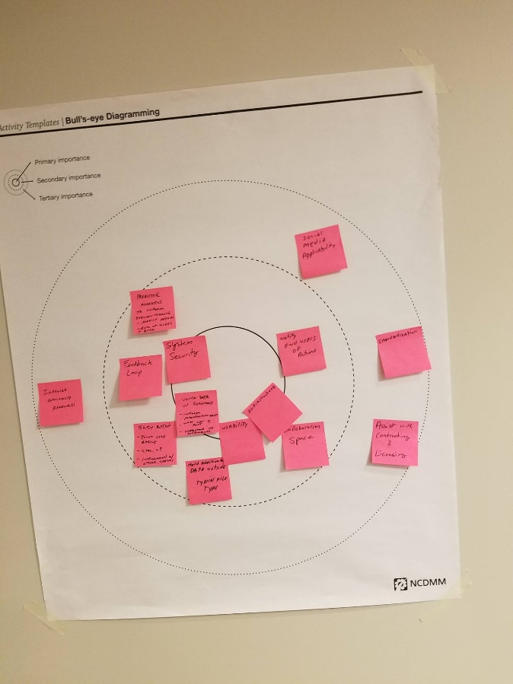
JAMMEX Sub-group
JAMMEX Future State
JAMMEX 1yr/5yr
  AI/VR/AR inform decision making
  50% reduction of out of stock parts
  Local inventory tracking
  Distributed manufacturing enabled through qualified vendor network
  Joint Service Data Exchange is connected to all services
DO/BE Exercise
Prioritization
Concept Posters

Slide 18
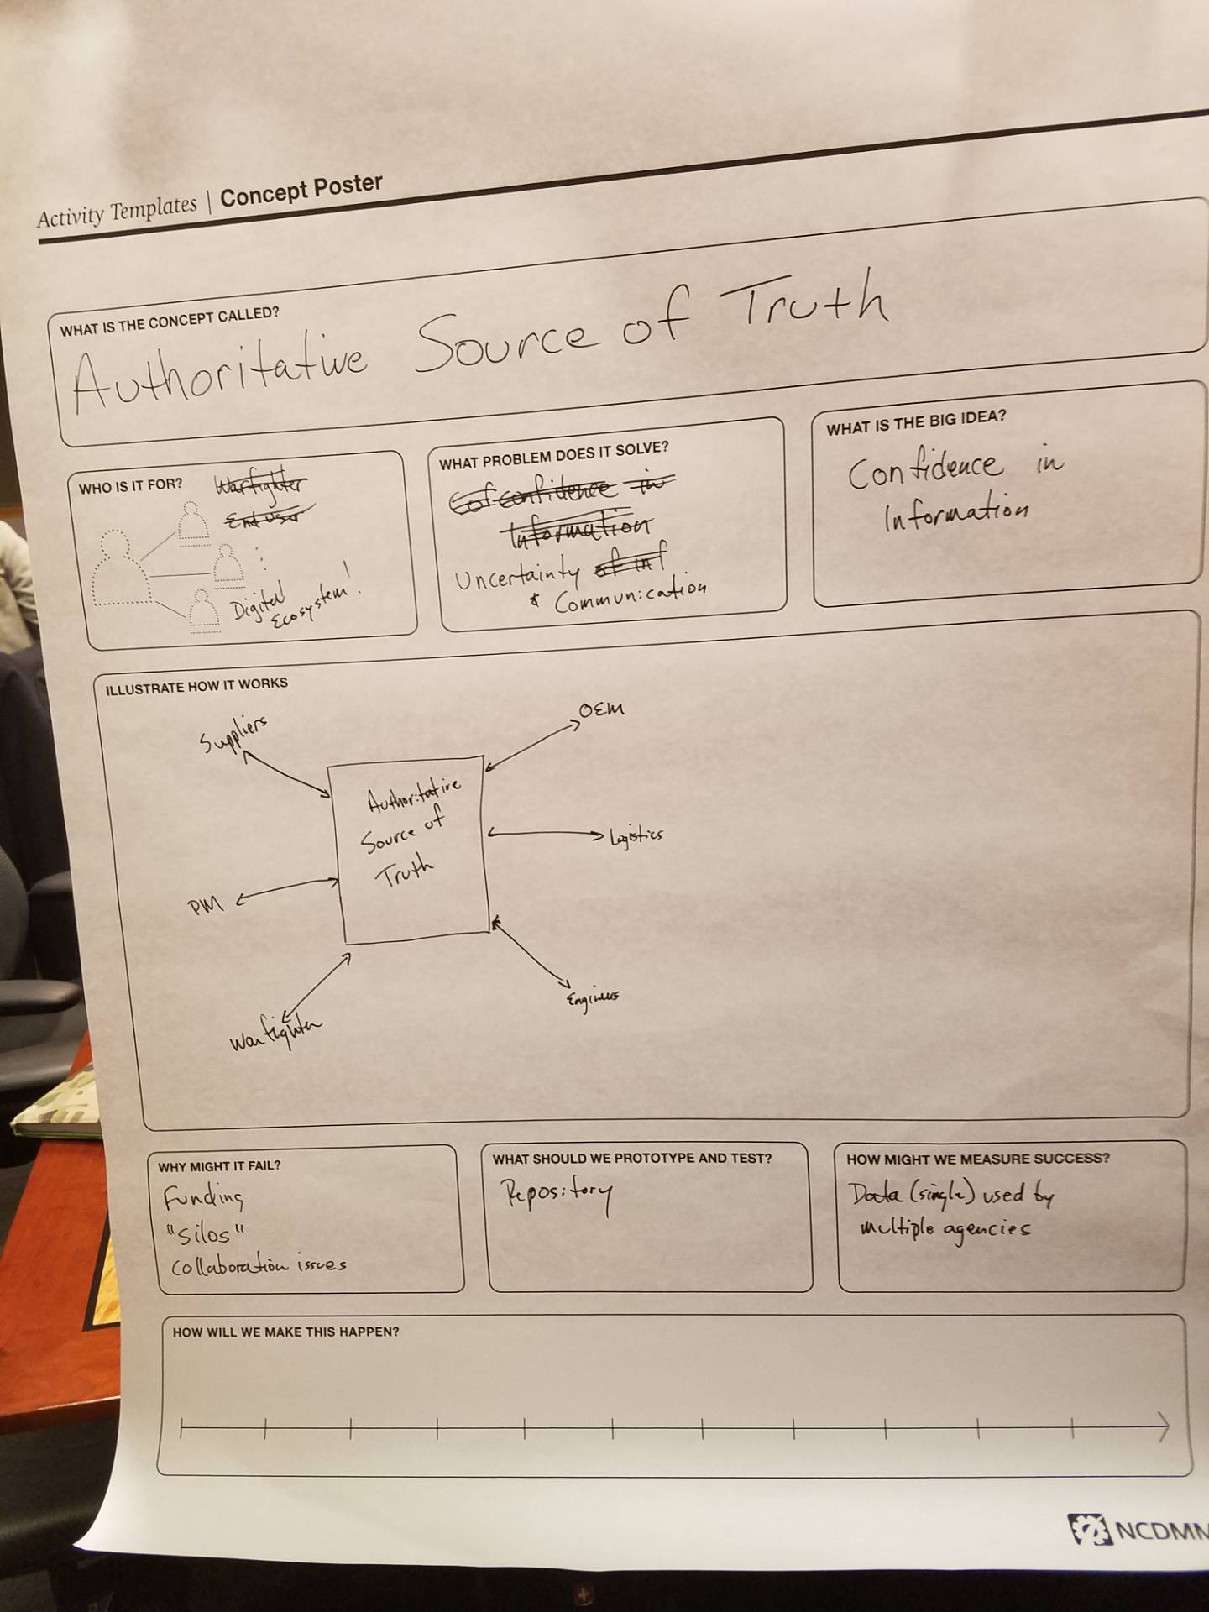
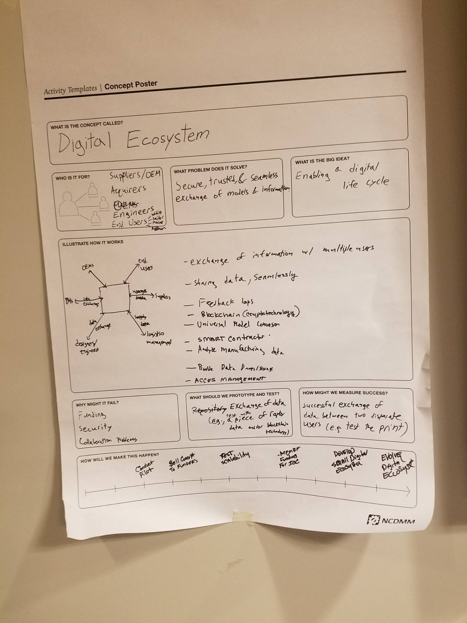
JAMMEX Sub-group
Authoritative Source of Truth
Digital Ecosystem

Slide 19
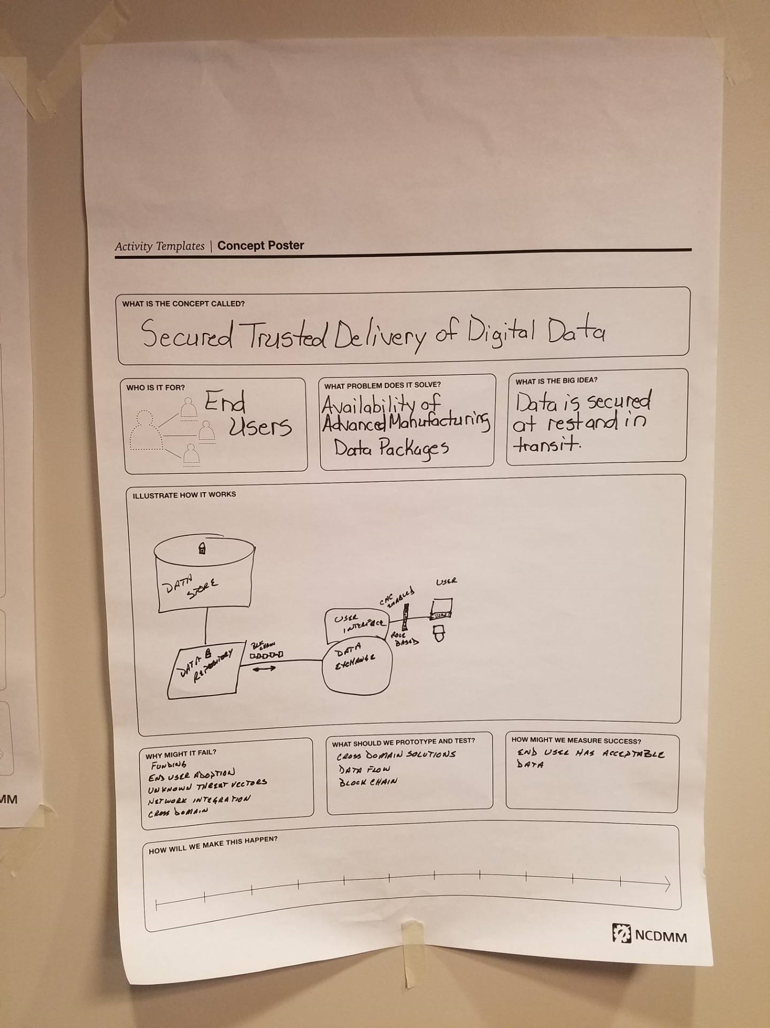
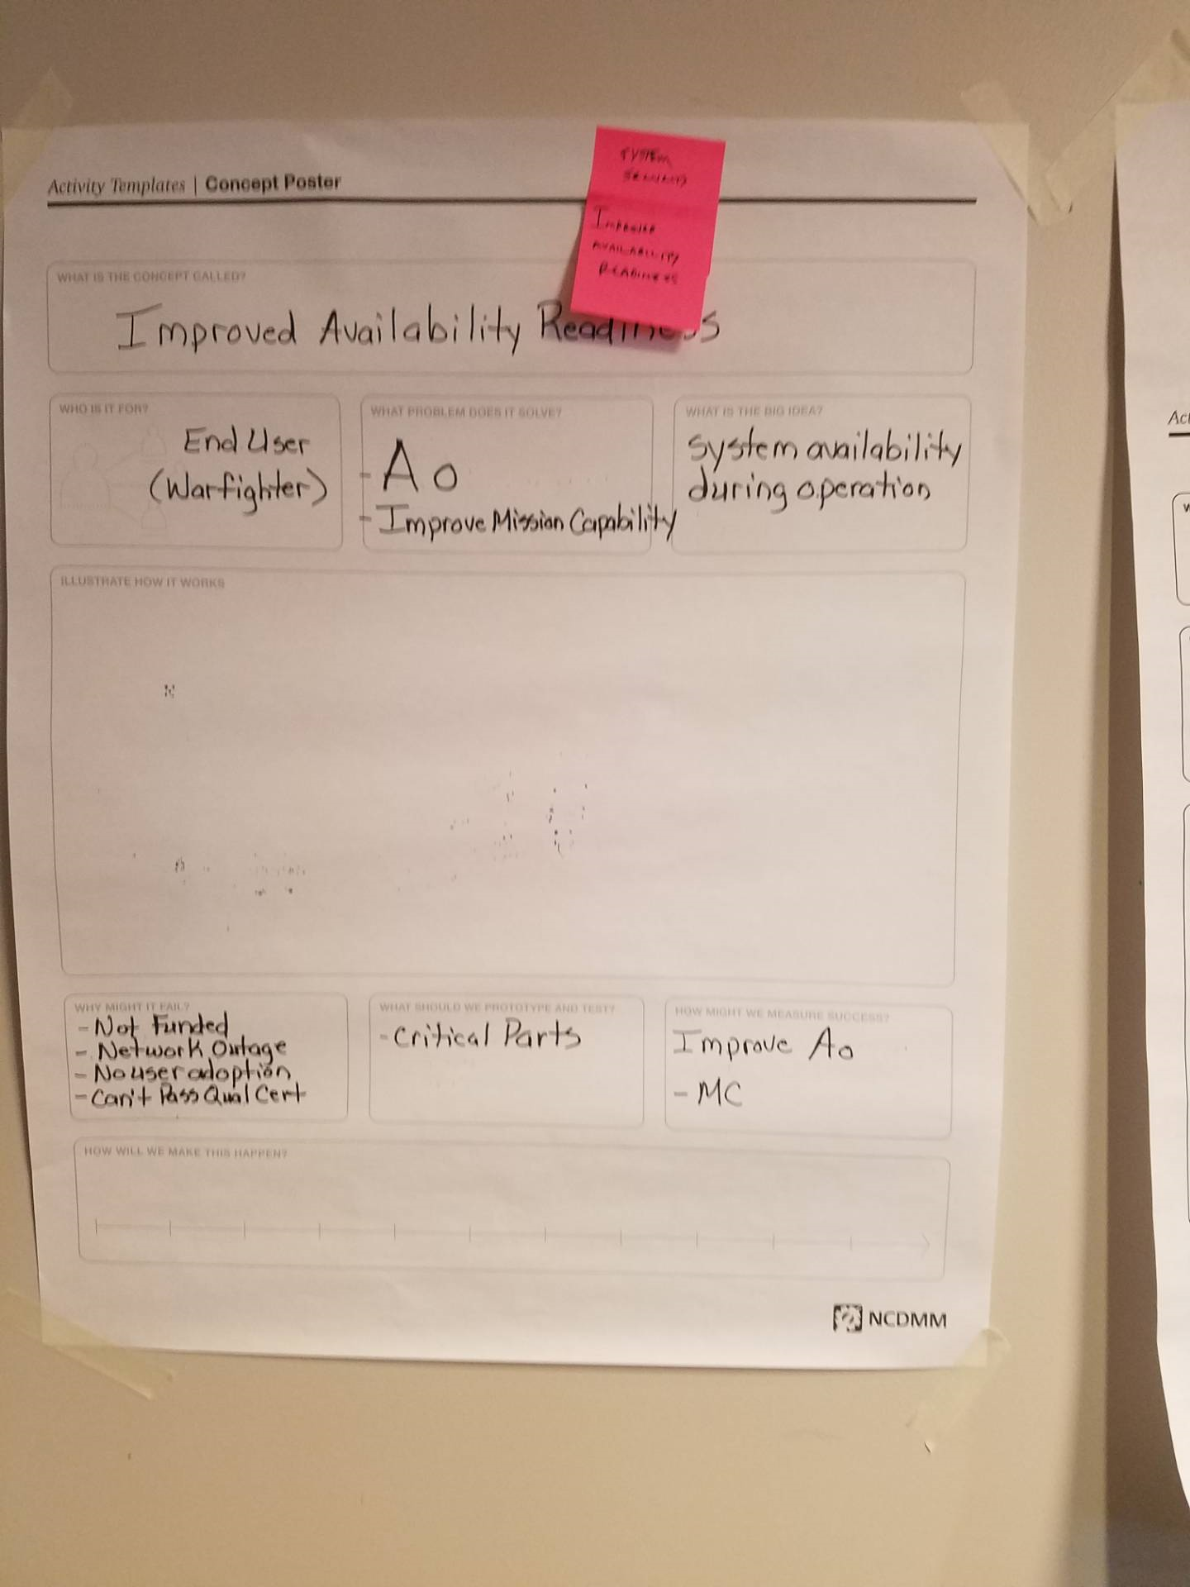
JAMMEX Sub-group
Secured Trusted Delivery of Digital Data
Improved Availability Readiness

Slide 20
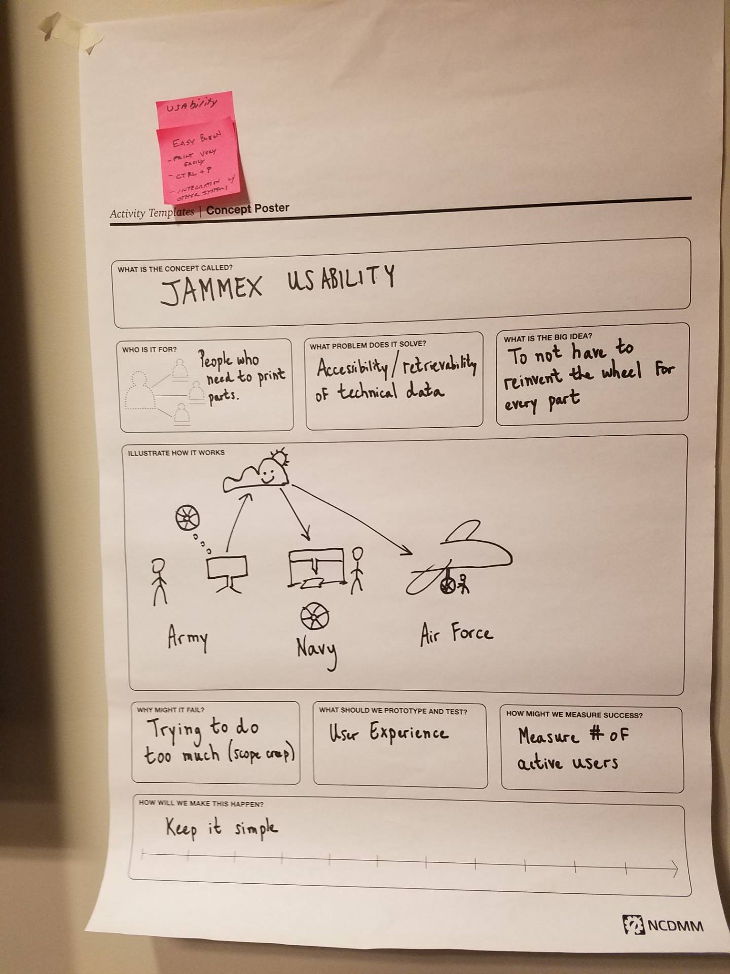
JAMMEX Sub-group
JAMMEX Usability

Slide 21
JAMMEX Sub-group
JAMMEX Next Steps
We need service level data! Interested in connecting with services
Build to begin within the DLA secure environment July 2019
User acceptance testing - Need users to review and test system, specifically forward operators.
Current gaps – risk assessment, feedback loop, completeness
Recap of input and user feedback – consolidated and shared with breakout group
Release 1.0 expected August 2019
DLA’s Technology Accelerator OTA Program – July 17
https://www.dla.mil/HQ/InformationOperations/Accelerate
1. NextGen 3D Scanners
2. Geometric Search
3. Printer Management and Security

Slide 22
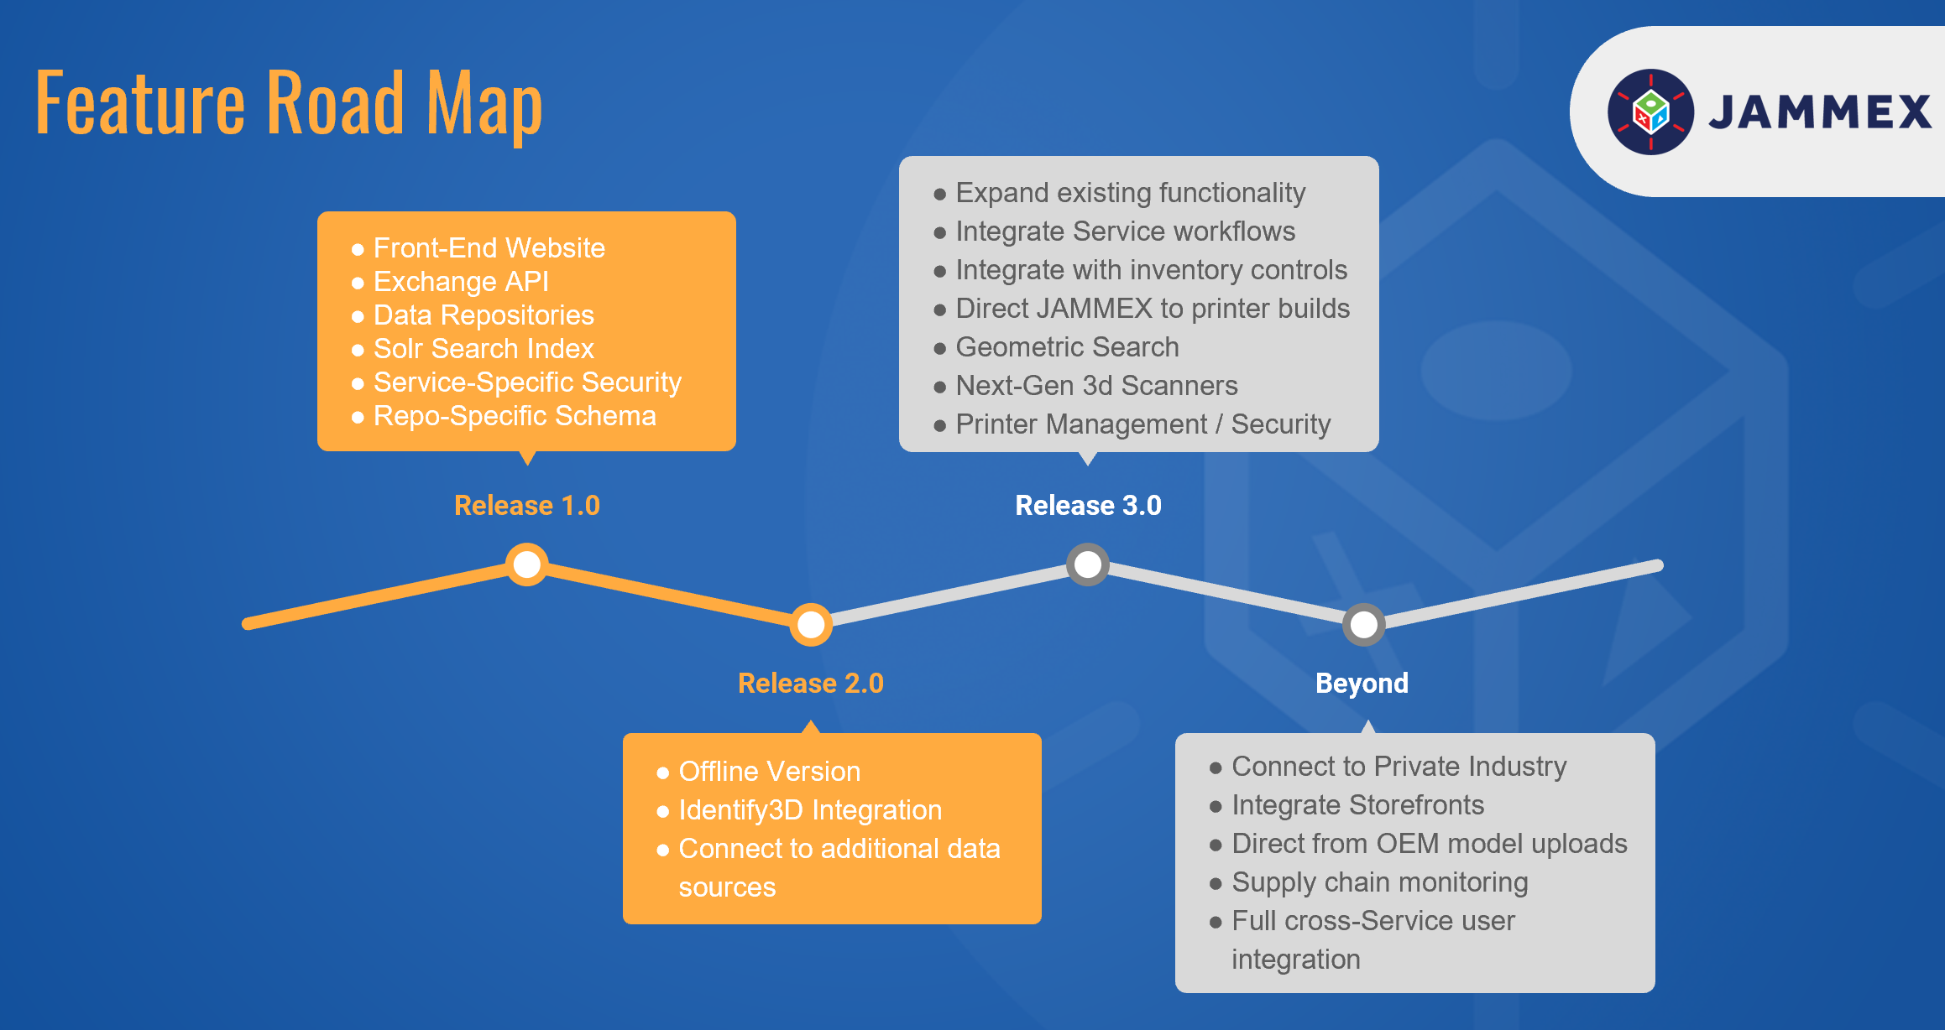
JAMMEX Sub-group
JAMMEX Key Takeaways
Need data
Need user feedback
Planning future phases

Slide 23
JAMMEX Sub-group
Members
Alex Viana NAVFAC
Bryce Weber NAVSEA
Chris Babcock Deloitte
Deborah E. Mies Granta
James Knotts Quotient
Jessica Swallow IDA
Joe Veranese NCDMM/AM
John Wilczynski AM
Marilyn Gaska Lockheed
Mark Benedict AFRL
Pam Rooney Troika
Patrick Veith OPNAV N4
Samuel Benavides USCG
Todd Moran CCDC
Wesley McDonald USAMC
William Mooney Lockheed
Joe Fagan DLA
Craig Gravitz DLA
Paul Witherell NIST
Michael Alston DLA
Grant Rotunda WARCOM
David Coyle NAVSUP
Lewis Shattuck NAVSEA
John Coleman Seta Support

Slide 24
2019 Additive Manufacturing
Workshop
TDP Standards
Sub-Group
Co Leads:
John Schmelzle
Tony Delgado

Slide 25
TDP Standards Sub-group
Objectives:
Share among Military Services and DLA lessons learned on AM TDP development
Develop recommendations to establish a more universal approach to TDP development for AM items in the DoD
Provide insights on policy changes required to enable AM 3D TDPs

Slide 26
TDP Standard Project Sub-group
Agenda / Steps to Achieve Objectives:
    Room: GVC C
TDP definition (Mil-Std-31000b) discussion
Review the TDP standards from each Service
Update on ASME Y14.46
JHU/Army example of how the NAVAIR SWP was applied to create a TDP

Slide 27
TDP Standards Sub-group
Day 1 Actions Completed
MIL-STD-31000 update
DoD agencies’ 3D TDP Status
Day 2 Actions Completed
Received Update on ASME Y14.46
Discussion on TDP vs. Tech Data
Reviewed sample TDPs

Slide 28
3D AM TDP Use Cases
TDP Standards Sub-group
Send parts to commercial industry
Send part to fleet for mfg
Address a gap to replace an OEM part
Critical part where we control AM process
Data leasing
JAMMEX

Slide 29
TDP Standards Sub-group
3D AM TDP Use Cases Fall into Three Categories
Criticality/Capability Matrix
Work
Force
Capability
Part Criticality
 | High | Low
High | Critical Manufacturing Process | Validated STEP File
Low | x | Build instructions
Based on the matrix, the level of detail/Attachment for the TDP and supplement will be defined

Slide 30
TDP Standards Sub-group
Attachments based on Criticality/Capability Matrix
High Capability/High Criticality
Build Files
Validated STEP
Critical Manufacturing Process
High Capability/Low Criticality
Validated STEP
Low Capability/Low Criticality
AM equipment requirements
Machine Tech Data
Material required for that machine and for that part
Inspection equipment
Part number
Post processing

Slide 31
TDP Standards Sub-group
Unique TDP Requirements
Data leasing
  Expiration Date
JAMMEX
  Metadata

Slide 32
Additive Manufacturing Technical Support Data Package (AMTSDP)
Due to the maturity level of AM, TDP’s should be accompanied by a data package containing risk assessments, historical data, recommended approaches, lessons learned, and other background data useful for improving manufacturing outcomes. Package contents should be tailored based on the technical skill required and criticality of parts
TDP Standards Sub-group
Need for Support Package
TDP
Feasibility study
Test Results
History of need for the part
BCA
Support Certification (Critical)
Fleet support (Non-Critical)
Risk
Lessons learned
Performance requirements
Approval
Costs

Slide 33
Paul Will Fix
TDP Standards Sub-group
YEA NIST !!
ASTM Standard on: Digital product definition and data management
He Needs Support. Contact information:
Paul Witherell (NIST) paul.witherell@nist.gov

Slide 34
Next STEPS
TDP Standards Sub-group
Open dialogue w/JAMMEX about TDP WG recommendations
JAMWG follow-on discussion
  MILSVC on existing TDP guidance
  Workforce training on TDP development
Leverage ASTM/ISO for Joint ISO/TC 261-ASTM F 42 Group: Digital product definition and data management

Slide 35
TDP Standards Sub-group
Members
Adam Hicks AFRL
Ben Kassel LMI
Daniel Krivitsky NAVAIR
Jesse Chambers DSPO
Jess Fuller WARCOM
John Schmelzle NAVAIR
Lisa Veitch IDA
Tony Delgado DLA
Megan McCarthy NIH/NIAID
Paul Witherell NIST
Larry Preston USAF
Victor Navazio DLA
Jacob Church CCDC AVMC
Ray Provost NAVWAR
Robert Anderson Quotient
Timothy Fouts Lockheed
Alex Blates AURA
Eric V. Kline NAVAIR
Jamie Schlosser WARCOM
Eric Upton JHU APL
Michael Presley JHU APL
Craig Hughes JHU APL
Christine Krikorian Army
Chris Babcock Deloitte
Tony Paris DLA
Dan Yang Global Res GE
Peter Koudal Global Res GE
Alex Mark Lockheed

Slide 36
2019 Additive Manufacturing
Workshop
Cybersecurity Sub-Group
Co Leads:
Dana Ellis
Tim Abbott
Jim Regenor
Al Lowas

Slide 37
Cybersecurity Sub-Group
Objectives:
Understand the current state of cybersecurity policy and guidelines as they relate to AM
Identify key functions within the AM environment
Perform gap analysis based on AM workflow and cybersecurity information system policies; identify path to solution

Slide 38
Cybersecurity Sub-Group
Agenda / Steps to Achieve Objectives:
    Room: Potomac Mtg CTR
Background on CTMA Project Adapting Blockchain Technology for TDP
How is the digital data represented and accessed during the following phases, design, distribute, manufacture, in-field) for a 3D printed part
What systems, tools, technologies, policies, procedures are already in place for a non-AM part?
Define AM Cybersecurity Risks (High, Medium, and Low)
White Board a High-level security framework
For each threat, list mitigation steps and build solutions
Define a specific use case to apply in developing Cybersecurity Framework

Slide 39
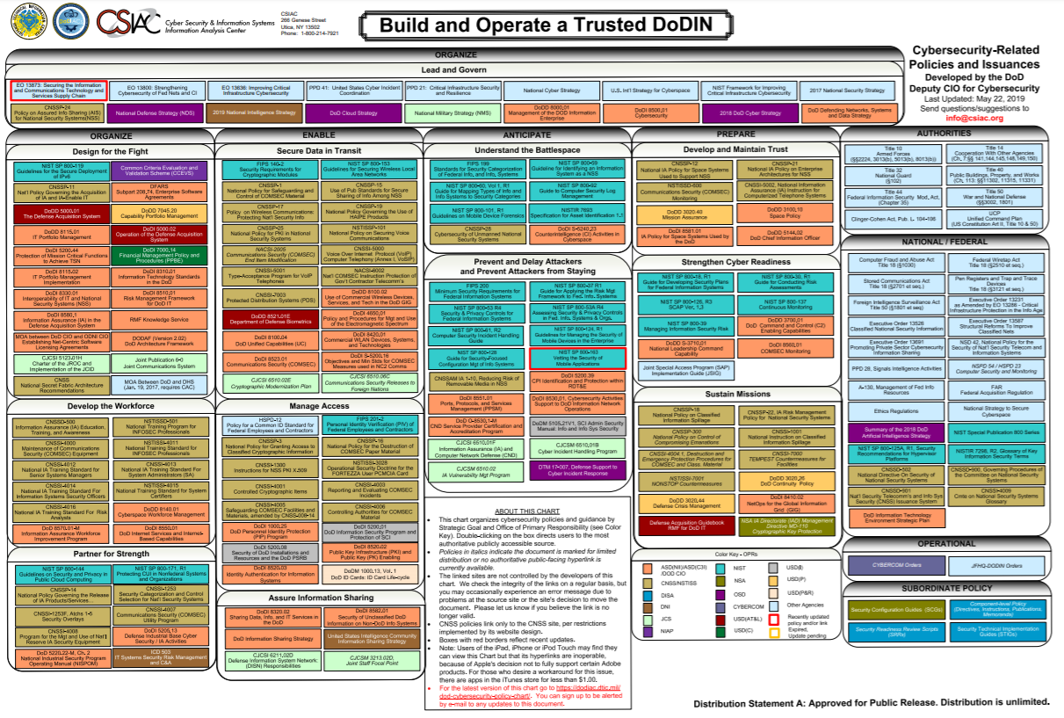
Cybersecurity Sub-Group

Slide 40
Cybersecurity Sub-Group
Provides a baseline for gap analysis
Observation: vast amount of policies exist
Orient: chart above represents the industry/government working group perspective
Decision: gap analysis that follows
Act: key takeaways

Slide 41
Cybersecurity Sub-Group
Challenges / Gaps Identified:
Cybersecurity knowledge combined with AM workflow application – need subject matter experts
Machine Identity
Trusted system/ecosystem approach
Lack of current secure-by-design systems
How to protect evolving cyber-physical systems from a dynamic threat environment
  Potential solution: Blockchain
Network disconnected operations

Slide 42
Cybersecurity Sub-Group
Key Takeaways:
Establish a cybersecurity AM strategic interest group with government and industry to collaborate on policy and address gaps
  Identify a DoD depot (e.g. Rock Island Arsenal or Tinker Air Force Base) for pilot implementation at the production level to identify and address gaps
  Partners to include: Air Force Sustainment Center, Army Rock Island Arsenal, Army CCDC, NAVWAR, other government agencies (e.g. NIST and DISA) and industry

Slide 43
Cybersecurity Sub-Group
Members
Alexander Mark Sikorsky
Brice Toth Penn St
Dana Ellis NCMS
Duncan Adams DLA
Emily Gisolfi Deloitte
Erisha Smith DoD
John Carbone GE
Mara Hitner Matter- Hackers
Mark Maxwell AURA
Michael Schall Quotient
Dan Yang Deloitte
Senthil Arul DLA
Taylor Brucki Quotient
Terrance McGowan Boeing
Mike Worden Raytheon
Timothy Abbott Moog
Jim Regenor BRG
Kevin Wallace CCDC
Steven Richard NAVWAR
Peter Koudal GE
Saadia Razvi NIST
Patrice Dillon Raytheon

Slide 44
2019 Additive Manufacturing
Workshop
Qualification and Certification Working Group
Co Leads:
Jennifer Wolk
Jeffrey Gaddes

Slide 45
Qualification and Certification
Sub-Working Groups:
Database & Common Language Sub-Group
  Co-Leads: Dr. Yan Lu; Jennifer Wolk; Peter Coutts
Quality Assurance Sub-Group
  Co-Leads: David Busby; Doug Fosnaught; Michael Gabertan
Standards Sub-Group
  Co-Leads: Jim McCabe; Matt Borsinger (remote)

Slide 46
2019 Additive Manufacturing
Workshop
Database & Common Language Sub-Group
Co Leads:
Dr. Jenn Wolk
Dr. Yan Lu
Peter Coutts

Slide 47
Database & Common Language Sub-group
Objectives:
Define common data exchange format
Define common data dictionary
Define gaps in current data dictionary

Slide 48
Database & Common Language Sub-group
Agenda / Steps to Achieve Objectives:
Room: Poseidon
Review existing draft data dictionaries
Define common language
Receive feedback from stakeholder breakout groups
Refine definitions
Finalize high level definitions and define sub-tier definitions

Slide 49
Database & Common Language Sub-group
Tenet:
The acquisition, generation, curation, and analysis of digital AM data across the AM product lifecycle will significantly reduce the cost and time associated with AM product deployment for the DoD
Recommendation:
Fund a program to demonstrate a Data Enabled, Agile, Rapid, and Low-Cost Additive Manufacturing

Slide 50
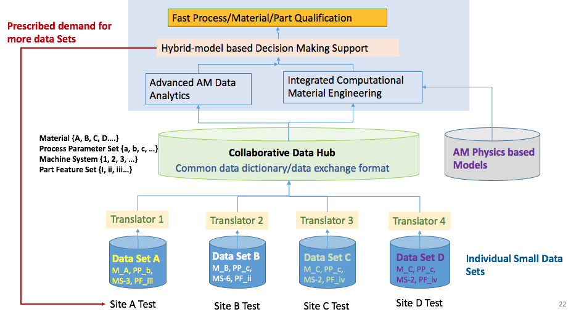
Database & Common Language Sub-group
Vision
Army Data
Navy Data
Air Force Data
Non-DoD Data

Slide 51
Database & Common Language Sub-group
Common Data Dictionary
Project
10
Vendors / Manufacturers / Suppliers / Contractor
1
2
Build
People / Personnel / Operators
11
3
Part / Specimen / Component
12
Non-AM System Equipment
4
AM System
In-Situ Monitoring System
Material / Feedstock
13
Software
5
Feedstock
Substrate
Gas
6
AM Fabrication Process
Pre-Process
AM Process
Post Process
14
Simulation
7
Process Data
AM System Data
In-Situ Monitoring Data
Other Process Data
8
Test / Inspection / Characterization
9
Synthesized Data

Slide 52
Database & Common Language Sub-group
Next Steps:
Establish a qualification challenge to develop and demonstrate value of data sharing. Outcomes include:
  Complete AM Data Dictionary
  Develop a Common Data Exchange Format
  Data Curation – federate data between existing databases
  Feasibility demonstration through qualification use case

Slide 53
Database & Common Language Sub-group
Members
Afina Lupulescu | ASM
Chuck Browne | NAVAIR
Clare Paul | AFRL RXMX
Hunter J. Smith | NIWC
Jacob Church | BAH
Jennifer Wolk | ONR
Josh Moser | NAVAIR
Matthew Sloane | Army
Peter Coutts | PSU ARL
Rich Martukanitz | CCAM
Ryan Myers | Hexagon
Shelby Mounts | ATI
Thomas Postma | FRSE
Victoria Navazio | DLA
William Frazier | NIST
Wyatt Hilkene | 3Diligent
Yan Lu | NIST

Slide 54
2019 Additive Manufacturing
Workshop
Quality Assurance Sub-Group
Co Leads:
Doug Fosnaught
David Busby
Michael Gabertan
Brian Ricks

Slide 55
Quality Assurance Sub-group
Objectives:
Baseline Quality Assurance, Qualification and Certification across the product life cycle
Identify Quality Assurance tools that impact AM in the supply chain
Share Qualification best practices/lessons learned

Slide 56
Quality Assurance Sub-group
Agenda / Steps to Achieve Objectives:
Room: Auditorium
Panel discussion with each key QA organizations
Evaluate and rank existing QA methods for DoD
Define which existing QA method is best for AM
Evaluate baseline technical use cases and methods

Slide 57
Quality Assurance Sub-group
Actions Completed
Overview from Different Perspectives, Panel with DLA, DCMA, Army, and Industry
Discussion on Quality Assurance, Qualification/Certification
Initial working common definitions for QA, Qual and Cert
Briefings from AFRL, GE, FAA and Army
Reviewed and assessed 16 Quality Assurance Tools and how impacts AM, cost/time/risk/need for these tools
Captured key takeaways
Drafted an outline for a concept of a “AM Lifecycle Qualification Guide”

Slide 58
Takeaways / Next Steps
Quality Assurance Sub-group
Information sharing of engineering data already produced is needed and have systems (Digital Storefront?), policies and resources to encourage or require this
A more cohesive standards development effort and engagement between DoD and SDOs
Maturation of in-situ monitoring and process control to impact Qualification and QA
Mature tools that can accelerate the MMPDS process including actual failure modes to process data – use Artificial Intelligence, Modeling and Simulation
Qualification/Certification process is the same for AM as any other item you want to fly with specific AM considerations
Key testing for airworthiness/safety critical items: Effect of defects, fatigue, feature based testing, zoning (e.g. casting), corrosion, damage tolerance and coupon level testing association with part performance.

Slide 59
Takeaways / Next Steps (Cont’d)
Quality Assurance Sub-group
We cannot speed up the qualification processes today, but we can speed up the R&D/data generation to support it. For Flight Critical - 1 in 1 million failure rate (0.999999)
In looking at the risk framework – a subcomponent may not be a critical part but is part of a critical assembly, that has to be considered as part of qualification and certification (FMECA covers this already review this for AM specific needs)
Needs further clarification – authority for approval vs. liability who is ultimately responsible for failures
Develop an “AM Lifecycle Qualification Map Guide” to pair with the Contracting Guide/Acquisition Guide (integrate into it?) to walk through the specific differences for AM relative to traditional manufacturing.

Slide 60
Qualification “Map” Outline
Quality Assurance Sub-group
Definitions and equivalencies (qualification in Army means what in Navy and Air Force and Industry/Definitions per the FAR)
Selection of AM Parts
  How to know when to use AM
  Design for AM
Using a Risk Based Framework (Criticality Levels and how the processes vary – equivalencies of these buckets as well)
  Fit check and ideas collected from the field goes to engineering
  Do triage at engineering (green/yellow/red box)
  For green box create non-critical TDP
Qualification Processes/Needs for:
  Machine qualification/robustness set up
  Materials + Processes – AM Machine Control/Post Processing
  Inspection techniques
  Design
  Workforce
Certified/Approved Technical Data Packages
  Specific needs for AM
  Connections to Bio industry/applications, automotive

Slide 61
Qualification “Map” Outline (Cont’d)
Quality Assurance Sub-group
Contracting Needs for Qual/Cert
  Standards
  QA requirements
Certification of Parts/Part Acceptance
  Regulations and requirements
  Lot sizes as an example
Certification Processes for DoD
  As an example, Airworthiness for AF is not different in process but the details in meeting the 5 tenets have to be considered (what level of data is needed to meet those
Qualification of the Supply Chain (vendors, manufacturers, suppliers) – QPL/QML
  Public private partnerships to leverage existing qualification done by industry
Tracking and maintaining AM parts
  Tracking through the system
  Failure data and feedback
  Traceability – anti-counterfeit parts (blockchain and RFID)
Quality Assurance techniques as they apply throughout
How organic manufacturing differs? Interaction for OIB and the QA requirements, engagement of DLA and ESA

Slide 62
Quality Assurance Sub-group
Key Takeaways:
Quality Assurance Tools Most Impacted by AM (5 of the 16 reviewed)
*Note: Need to build in Quality Assurance requirements into the Contract
Higher Level Quality Requirements
Statistical Process Controls,
Product Lot Testing (PLT)
First Article Testing (FAT)
Qualification
Customer complaint reviews

Slide 63
Future:
Quality Assurance Sub-group
Industry standards
Consistency around criticality taxonomy/mapping of parallel language
Material Database
Identify higher critical part and do a pathfinder “virtual project” or real pathfinder projects
Inspection methods - gaps (in-situ monitoring and NDE)
Update on every services AM policy
Supplier qualification
Variations for tooling – are there any difference?
An overview high level chart (like what James had – qualification map – Mark Shaw last year maybe released)
How is modeling/simulation being used or will be used in qualification?

Slide 64
Quality Assurance Sub-group
Members
Bill Macy | Macy Consulting
Brian Ricks | Raytheon
Bryan Bauer | DLA
Carrigan Braun | Harris Corp
Christopher Root | FRCSW
Cullen Hilkene | 3Diligent
David Busby | MDA
Doug Fosnaught | DLA
Jay Lambert | CCDC AvMC
Joseph Goings | NAVAIR
Joseph South | CCDC ARL
Larry Preston | USAF
Mark Shaw | GE Additive
Michael Gabertan | DCMA
N. Joseph Kott III | CCDC GVSC
Nathan Schuyler | NAVSEA
Peter Oschmann | Bundeswehr
Robert Allen Roach | Sandia
Sophia Lefantzi | Sandia
Tim Koczanski | DSP
William Fallon | Lockheed Martin

Slide 65
2019 Additive Manufacturing
Workshop
Standards Sub-Group
Co Leads:
Matt Borsinger (remote)
Jim McCabe
Jeffrey Gaddes

Slide 66
Standards Sub-group
Objectives:
Determine who is representing the DoD for each group and sub-committee of the pertinent NGSOs.
Determine what standards that are currently published or are in the works that are considered good enough to procure from for the DoD.
Identify where DoD should be focusing on in the standards development.

Slide 67
Standards Sub-group
Agenda / Steps to Achieve Objectives:
Room: Freedom
Introductions
Review group abstract/goals
Review background on AMSC
Review Defense focused gaps that are not in other working groups
Feedback on SDOs
Possible mind map on standards required to procure and make an AM part

Slide 68
    Selected “Defense Industry” Gaps Discussed
    Except Where Noted in Red
Standards Sub-group
Gap D17: Contents of a Technical Data Package – in Group 1
Gap D24: An Acquisition Specification – in Group 3
Gap PC4: Machine Qualification
Gap PC6: Adverse Machine Environmental Conditions: Effect on Component Quality
Gap QC1: Harmonization of AM Q&C Terminology
Gap QC2: AM Part Classification System for Consistent Qualification Standards
Gap QC3: Harmonizing Q&C Terminology for Process Parameters (w/QC1)
Gap QC4: Process Approval for DoD-procured Parts
Gap QC5: Machine Operator Training and Qualification – in Group 4
Gap NDE7: NDE of Counterfeit AM Parts
Gap M7: Cybersecurity for Maintenance – in Group 1

Slide 69
Standards Sub-group
Actions Completed:
Gap QC1: Harmonization of AM Q&C Terminology
  Current standards address this well enough with a good process for changing if needed.
Gap QC4: Process Approval for DoD-procured parts
  NAVSEA and Air Force have identified paths. SAE has a work item on part qualification guidelines that service branches may want to participate in.

Slide 70
Standards Sub-group
Challenges / Gaps Identified:
Material qualifications
May be some industry sectors interested (e.g., oil & gas) in environmental conditions for AM
Level of testing being identified
Part classification unification – Joint effort
NDE anti-counterfeit review of current specifications applicability to Additive Manufacturing

Slide 71
Standards Sub-group
Key Takeaways:
Need more data and specifications associated with performance of materials to move further.
Need to unify the classifications (beyond color) for the different AM parts to allow OEMs to better serve DOD.
Need more top level guidance that refers to family of specs underneath (start w/AMSC list)
Easier to identify relevant publicly available standards and specs than we expected, though there are still gaps

Slide 72
Standards Sub-group
Open Actions / Post-AM Workshop Actions:
Support coordinated DoD participation in the development of material specifications and pedigree data exchange (DSPO)
Assess overall level of DoD participation in NGSO standards setting (JAMWG QC)
Joint development of definitions for criticality levels tied to current specifications to assist with procurement (JAMWG QC)

Slide 73
Standards Sub-group
Open Actions / Post-AM Workshop Actions (Cont’d):
Follow SAE AIR7352 development of Part Qualification Guidelines. Ensure participation of pertinent DOD constituents.
Review of current and in development NDE standards and specifications applicable to AM.
A central repository of AM applicable standards and specifications and the process areas they are applicable to.

Slide 74
Standards Sub-group
Members
Alex Kitt | EWI
Andreas Heise | German Navy
Christopher Delima | U.S. Army
Dan Braley | Boeing
Edward Flinn | RIA
Elisa Peters | DLA
Federico Sciammarella | NIU
Jaleesa Nedham | NAVAIR
Jeffrey Gaddes | CCDC AvMC
Jessica L. Coughlin | NISA
Jim McCabe | ANSI
Jim Monroe | American Additive
Judith Ritchie | SAE
Katherine Olson | CCDC AvMC
Martin A. Negron | NAVAIR
Matthew Borsinger | DLA
Prabhjot Singh | GE Research
Ramin Chowdhury | MDA
Richard Boxwell | Parsons (MDA)
William Lunn | CCDC ARL

Slide 75
2019 Additive Manufacturing
Workshop
Business Practices Working Group
Co Leads:
Greg Kilchenstein
Marilyn Gaska

Slide 76
Business Practices Working Group
Sub-Working Groups:
DoD AM Acquisition Guide Sub-Group
  Co-Leads: John Ballou; Debbie Lilu
AM Supply Chain Integration Sub-Group
  Co-Leads: Ben Thompson; Col Brian Copes; Edilia Correa
IP Management Sub-Group
  Co-Leads: Mike Acosta; Howie Marotto

Slide 77
2019 Additive Manufacturing
Workshop
DoD Additive Manufacturing (AM) Acquisition Guide Sub-Group
Co Leads:
Debbie Lilu
John Ballou
Tim Koeppl
Bob Appleton

Slide 78
DoD AM Acquisition Guide Sub-group
Objectives:
Produce a First Draft DoD wide version (2.0) Acquisition & Contracting guide (in process)
Review the Draft Navy AM Acquisition & Contracting Guide v1.0 as starting point
Solicit input based upon the broad expertise of the working group members

Slide 79
DoD AM Acquisition Guide Sub-group
Agenda / Steps to Achieve Objectives (Day1):
Room – Fort Worth
Morning
  Review overall Navy draft document for format and subject selection
  Detailed content review sections 1-10 (AM background information)
Afternoon
  Continue detailed review of document incorporating necessary correction and needed changes for DoD version
    Section 11 (Intellectual Property)
    Section 12 (Scenarios)

Slide 80
DoD AM Acquisition Guide Sub-group
Agenda / Steps to Achieve Objectives (Day2):
Room – Fort Worth
Morning
  Continue detailed review of document
    Section 13 (Acquisition & Contracting Considerations)
    Section 14 (Risk Considerations)
Afternoon
  Continue detailed review of document
    Appendix (Sample Contract Schedules)
    Overall review and prepare out brief

Slide 81
DoD AM Acquisition Guide Sub-group
Completed Actions:
Changed title to develop broader approach to encompass all stakeholders
Reviewed / commented Sections 1 – 12 (Day 1)
Reviewed / commented Sections 13 - 14 and appendices (Day 2)
Laser focused on AM specific requirements

Slide 82
DoD AM Acquisition Guide Sub-group
Ongoing Actions:
Drive collaboration between Services and Agencies on AM acquisitions and procedures
Focus on AM acquisition processes that can be utilized across a spectrum of AM technologies and uses
Review and incorporate output from the other working groups
Team will continue to communicate as necessary

Slide 83
DoD AM Acquisition Guide Sub-group
Key Takeaways:
Multiple policy changes are necessary to foster the potential of AM
Guide will supplement policy
OSD should consider assigning an acquisition program to pilot the guide
Increase communication throughout the AM community
THIS IS A GUIDE AND NOT REGULATION

Slide 84
DoD AM Acquisition Guide Sub-group
Members
Armen Kurdian | Penn State University | Program Management
Bob Appleton | RWAppleton & Co | Logistics (maintenance and supply)
Debbie Lilu | NCMS | Program Management
Dee Wilcox | Sikorsky | Contracts
John Ballou | NAVSUP HQ N415 | Logistics (maintenance and supply)
Tim Koeppl | NCMS | Contracts, Legal, Logistics (maint & supply)
Milissa Dart | DLA | Contracts
Mike Nash | IDA | Contracts
Edward Flinn | RIA-JMTC | Program Management

Slide 85
2019 Additive Manufacturing
Workshop
AM Supply Chain Integration Sub-Group
Co Leads:
Col Brian Copes
Edilia Correa
Ben Thompson

Slide 86
AM Supply Chain Integration Sub-Group
Objectives:
Identify if AM integrates w/ current process
Define changes to integrate AM
Investigate / Examine Abstract
Explore AM Technology System
  Equipment
  Feedstock
  Service
  Maintenance

Slide 87
AM Supply Chain Integration Sub-Group
Agenda / Steps to Achieve Objectives:
Team Introduction-AM/Supply experience
DLA power point presentation
Define Supply Chain requirements
Brainstorm AM Integration topics / abstract
Define requirements for integration
List unknowns, request from sub-groups
Identify absolute supply chain policies
Review with Group leader

Slide 88
AM Supply Chain Integration Sub-group
Cataloging and Provisioning (Current policy applies)
Reinforce the following:
Tenets
  Flexibility for Engineering Design Control Authority to assess item inherent characteristics and application
  Maintain ability to track items of supply
  Ensure AM parts are identifiable within Federal Catalog System
Policy
  Makes determination whether item should be same NSN or different one

Slide 89
AM Supply Chain Integration Sub-group
Supply Chain Integration (Current policy applies)
Reinforce the following
Tenets
  Same items across Services will be identified to enable joint id and use
  Synchronize efforts across DoD to identify common processes
  Integrate AM solutions across the supply chain
Policy
  Develop a guiding document that integrates AM processes across the DoD
  Implement systemic solutions that facilitate sharing of information across the DoD regarding common use

Slide 90
AM Supply Chain Integration Sub-group
Supply Chain Policy
Utilize government, industry and academia expertise to establish a responsive resilient supply base for AM
Mil Services retain engineering authority and configuration management for AM items for integrated materiel and procurement management
Mil Services and DLA support supply chain planning and execution to ensure effective incorporation of AM
Explore policy hierarchy for clearer guidance on need to identify and implement common processes across the Department
Monitor usage; performance and effectiveness of implementation of AM into the supply chain

Slide 91
Observations
AM Supply Chain Integration Sub-group
Provide CLARITY / DEFINITION on Internal Services’ supply support options (local, industry, or depot) and integration with DLA managed supply chain

Slide 92
AM Supply Chain Integration Sub-group
Takeaways:
The issues apply beyond additive manufacturing to all advanced technologies
Create an agile framework that maximizes Advanced Manufacturing implementation (Joint Reg)
DoD leverage industry / academia capabilities and expertise to accelerate implementation of Advanced Manufacturing
SCI will include all efforts addressed across the sub-groups

Slide 93
AM Supply Chain Integration Sub-group
Inputs
Data Standards
  TDP- Common elements that define the item
Qualification & Certification
  Agreed upon test methods and qualification criteria
Business Practices / Standards
  Non-government standards critical to scale up capability
Workforce Development
  Acquisition and sustainment personnel
Outputs
Qualified AM parts

Slide 94
AM Supply Chain Integration Sub-Group
Members
Col Brian Copes ODASD Logistics Dir
Edilia Correa Defense Logistics Agency
Ben Thompson OSD / FRC East
LCDR Noel Koenig NAVSUP WSS
Elizabeth Henry ProMan Strategies
Scott Storms NAVSEA 05T
Maggie Gutierrez Lockheed Martin
Richard Lonardo Defense & Energy Systems
Bill Peterson NAVSUP WSS
Edwayne Robinson DLA Logistics
Jamie Treat DLA Logistics
Matthew Harman Boeing (facilitator)
Ryan McClain Chem Bio Center
CAPT Jason Bridges OPNAV

Slide 95
2019 Additive Manufacturing
Workshop
Intellectual Property Management
Sub-Group
(Licensing Negotiation Simulation)
Co Leads:
Luis Miguel (Mike) Acosta
Col (Ret) Howie Marotto

Slide 96
Intellectual Property Management Sub-group
Objectives:
Simulate OEM-Gov Licensing of Technical Data for AM of Part by Government
Staged Approach
For Each Stage
  Planning
  Prepare Outline
  Negotiation
  Prepare Summary

Slide 97
Agenda / Steps to Achieve Objectives:
Intellectual Property Management Sub-group
Entire Group Orientation
  Factual Background & Procedures
Teams: Alpha Industries, Beta Corp., Gov.
Stages:
  Introduction: Table Setting, Objectives
  Define Tech Data, Rights, Services & Distribution/Access
  Liability and Warranty
  Consideration
  Finalize & Sign the Deal
  Entire Group Outro

Slide 98
Stage Outline:
Intellectual Property Management Sub-group
Objectives: Target & Threshold
Strategy Outline
Anticipated “Partner Positions” and Responses
Potential Consideration
Debrief
  Successes/Failures
  Could Have/Should Have

Slide 99
Outline of Simulation Exercise:
Intellectual Property Management Sub-group
Scenario was reviewed, questions addressed
Gov, Alpha and Beta OEM Teams made, assigning real Gov & Industry personnel to each
Staged approach for preparation and negotiation, with target subject assigned per stage: Introduction; Defining Data, Rights Services; Warranty & Liability; Consideration: and Finalize & Sign the Deal
Group Debrief and prep Outbrief

Slide 100
Intellectual Property Management Sub-group
Objectives:
Simulate negotiation of licensing to the government of data and rights for AM
Explore flexibility of OTAs, 3Ps, Special Negotiated Licenses, and other contracting mechanisms in support of same
Identify gaps and opportunities in current IP procedures for licensing data and rights for AM by the government

Slide 101
Intellectual Property Management Sub-group
Actions Completed:
Explored two contract vehicles for licensing of IP for AM purposes (3P and OTA)
Identified a number of lessons learned that can be applied to future IP publications
Identified gaps, e.g., yield standards/AM manufacturing criteria (price per part installed) and DIDs
Explored solutions for warranty challenges

Slide 102
Intellectual Property Management Sub-group
Actions Ongoing:
Prepare executive summary
Request consideration of a negotiation of with widely different evaluation factors (i.e., strict vs loose), potentially unmanned aviation system for a flight critical component
Consider publishing AMIP Guide for industry and government
Consider role of DCMA in licensing AM

Slide 103
Intellectual Property Management Sub-group
Challenges / Gaps Identified:
Have more acquisition and program professionals in next Simulation
Need to develop common lexicon for AM
Government application of OTAs are too similar to DFARS; not taking advantage of flexibility, defaulting to DFARS
Need template for Specially Negotiated License Rights limited to program use

Slide 104
Intellectual Property Management Sub-group
Key Takeaways:
Gov’t recognition of need to incentivize industry (GPR and Unlimited Data Rights is a disincentive to industry) and limit options/drives up cost
Gov’t cannot ask for “everything, just in case;” Gov’t must better identify its data needs and target rights more narrowly to meet needs
Risk profile for AM approach is different, requires changes to contracting approach, e.g., OEM profit mechanism might no longer be sustainment, but licensing (not AM unique)

Slide 105
Key Takeaways (cont.):
Intellectual Property Management Sub-group
Gained insights into partner’s viewpoint
  OEM: Non Recurring Engineering cost recoupment and profit
  Gov: State Objectives, not Requirements
Explored +/- of “Pay for Performance,” e.g., tracking
Need for Flexibility and Novel Approaches

Slide 106
Intellectual Property Management Sub-group
Members
Mike Acosta Marine Corps Systems Command
Howard Marotto Phillips Corporation
Alan Liu Defense Logistics Agency
Amy Hoage 3rd Dimension Industrial 3D Printing Company
Gregory Yukish Aleph Objects, Inc.
Will Cottrell Raytheon
Mike Anslinger Raytheon
Eleanor Mitch 14bis Supply Tracking
Joe Randall Lockheed Martin
Kelly Kyes Boeing
Matthew Harman Boeing
Michael Minter Lockheed Martin
Cynthia K. Waters NSWC Carderock Division
Timothy Slabouz USMC
Bob Held Held Intellectual Property, LLC
Michael Yukish Penn State University
Barry Edelberg Office of Naval Research

Slide 107
2019 Additive Manufacturing
Workshop
Workforce Development Working Group
Co Leads:
Michael Britt-Crane
Jim Davis

Slide 108
Workforce Development Working Group
Engineering and Design
Full Workforce Working Group
Full Workforce Working Group
Acquisition
Professionals
Technician Workforce
Tactical Applications &
Operationalization
- Define workforce
Segmentation
- Identify Topics
- Identify commonalities,
gaps, and priorities
- Identify actions
- Identify roles, tasks, & KSAs
Notes:
Abstract:
Discuss and develop short and long term strategies for the development of the DoD workforce in the application of additive manufacturing technology as it applies to their respective field. The objective is to identify gaps and prioritize needs within different stakeholder groups within the DoD workforce.
There will be three distinct sub-groups focused on the particular needs and challenges within these communities and the groups they engage (e.g. what information do leadership, peers, and others need to know?). Sub-working group outputs from the workshop will include a list of stakeholders and opportunities/roadblocks identified for their sub-working group as they apply to short and long-term strategies.
Sub-groups:
AM technician training and certification for the conventional supply chain as well as
forward deployed and tactical applications.
DoD engineering education and training requirements (conventional supply chain focus)
DoD acquisition of professional education and training requirements

Slide 109
Workforce Development Working Group
Objectives:
Identify AM workforce segmentation
Identify job roles (current and near future)
Identify tasks (work to be done)
Identify knowledge, skills, and abilities (KSA) of critical roles
Map KSAs to training (knowledge/skills developmental mapping)
Identify training gaps and priorities (inputs to joint workforce development roadmap)
Identify follow-on actions
Notes:
Primary construct: Supply chain > Secondary construct Product lifecycle.

Slide 110
Workforce Development Working Group
Agenda (Day One):
Identify DoD AM workforce segmentation across the DoD supply chain and product lifecycle.
Within each segment, capture AM work tasks.
Identify tasks that are common within the workforce segment and those specific to roles or occupations.
Identify missing tasks, roles, or workforce populations.
Identify critical job roles or occupations.
Day 1 out brief.

Slide 111
Workforce Development Working Group
Agenda (Day Two):
Based on tasks identified on day one, identify KSAs for critical job roles or occupations (three/four).
Categorize KSAs into general, tool specific, and organization or mission specific KSAs.
Identify current training that covers each KSA.
Identify training gaps, priorities, and a joint roadmap to close gaps including CY2019 actions.
Day 2 out brief.

Slide 112
Taxonomy
Workforce Development Working Group
Tasks e.g. print part, qualify part
Job roles e.g. maintenance tech., design engr.,
operation tech., production engr.
KSA Knowledge, skills, & abilities required
for a given job role. (Competencies)
Occupation Comprising one or more job roles
Segment Broad categorization of AM WF

Slide 113
Outputs
Workforce Development Working Group
Refined list of 38 AM and AM relevant tasks and knowledge areas
4 Task categories aligned to technical roadmap:
  Design, Process, Supply, Material
3 defined AM workforce Segments:
Engineering, AM Users, Acquisition Professionals
  8 Engineering and AM user job roles
  Up to 12 Acquisition career fields
Discussion of ongoing DoD AM training & education
Discussion of Outreach: executive and general population approach
First cut at characterizing training needs for each job role
Notes:
Slide 4 - Where did the list of 38 AM and AM relevant tasks come from (was this from an earlier Army meeting? Would Adrian know this?)

Slide 114
Engineering Workforce
Workforce Development Working Group
Engineering, Design, and S&T
  Engineers in the acquisition world that are not business ops professionals
  Civilian and Uniform
Job Roles
  Design Engineer
  Production Support Engineer: Shop floor, machine operation oversite
  Process: Production process design and prove out, producibility (machine specific)
  Test & Evaluation: DT, NDT, Qual./Cert., etc. (does QA belong?)

Slide 115
Engineering Courses
Workforce Development Working Group
Basic DFA & Printer Use
DFA, Reverse engineering, Machine capabilities, Troubleshooting parts
Level 1 (2-3 days)
Level 2 (1 week )
Troubleshooting, Advanced Use, & Basic Maintenance
Deep on troubleshooting and use (machine specific)
Advanced DFA
Topology optimization
Simulation, FEA
Advanced DFA software
AM Materials
Material and process specific (starting with machine specific
Tied directly to material characterization
Detect defects
NDE
Part Screening and Selection (triage)

Slide 116
Engineering Course Mapping
Workforce Development Working Group
Design Engineers
Basic DFA & Printer Use (Level 2)
Part Screening and Selection (triage)
Advanced DFA
Production Process Engineers (Future)
Basic DFA & Printer Use (Level 2)
Troubleshooting, Advanced Use, and Basic Maintenance
Production Support Engineers
Basic DFA & Printer Use (Level 2)
Troubleshooting, Advanced Use, and Basic Maintenance
Test & Evaluation
Basic DFA & Printer Use (Level 1)
AM Materials

Slide 117
AM Users and Tactical Applications
Workforce Development Working Group
Industrial Technician – trained technical users
Military Technician – depot, allied trade (machinists, welders, etc.)
General Users – anyone with no prior technical experience/AM experience
Technicians within the acquisition supply chain and users outside the conventional supply chain

Slide 118
Acquisition Workforce
Workforce Development Working Group
The Defense Acquisition workforce is responsible for the development of DoD systems. There are 15 functional areas to include military and civilian, program managers, systems engineers, logisticians, cost estimates, contract officers, finance, and many more.
Cost, schedule, performance
  It could be cheaper
  It could have higher or lower reliability
  Impact of non-availability
Job Roles
  Driven by Title 10 Chapter 87

Slide 119
Workforce Development Working Group
Acquisition Professionals
AM 101 - Work with DoD SMEs in assessing commercially available courseware (multiple delivery modes) to identify single vender that covers the foundational knowledge of AM. Learning will be provided to all acquisition professionals.
CAREER FIELDS – Work with the functional leads to identify knowledge requirements unique to their career field, determine best mode of delivery, build content
COMMUNICATION STRATEGY – To build awareness of learning availability as well as other supporting materials
Learning specific to needs of impacted career fields
AM 101
Communication Strategy
Auditing Business-CE Business-FM Program Management | Science and Technology Manager Engineering Test & Evaluation | Contracting Life Cycle Logistics Production, Quality & Manufacturing

Slide 120
Workforce Development Working Group
Members
Rob Arthur | Defense Acquisition University
Ryan Ash | U.S. Army – CCDC
Adrian Bailey | U. S. Army – CASCOM
David Barrett | U.S. Navy – OPNAV
Michael Britt-Crane | ManTech, OUSD (R&E)
Consondra Davis | Defense Logistics Agency
Jim Davis | Defense Acquisition University
Maj Melissa DePriest | USMC – Aviation
Ron Edmunds | Defense Contract Management Agency
Emily Escalante | U.S. Navy – NAVAIR
Ryan Fisher | U.S. Navy – NAVSEA
Viktor Gegic | U.S. Army – CCDC
David Heckman | ManTech, OUSD (R&E)
Tony Higgins | Markforged

Slide 121
Workforce Development Working Group
Members (cont’d)
Leah Hull | Raytheon
Jared Lenahan | U.S. Navy – OPNAV
Travis Mayberry | Raytheon
Michael Nikodinovski | U.S. Army – CCDC
Karla O'Connor | Defense Acquisition University
Capt Timothy Otto | USMC – 1MLG
Brad Ruprecht | U.S. Army – CCDC
Gug Sresty | Applied Systems & Tech. Transition
Christopher Theisen | U.S. Army – CCDC
Ashley Totin | NCDMM/America Makes
GySgt Daniel Valdes | USMC – 1MLG
CW3 William Wencil | U.S. Army – CASCOM
James Zunino | U.S. Army – CCDC

Slide 122
2019 Additive Manufacturing
Workshop
DoD AM Policy Development
Working Group
Co Leads:
Greg Kilchenstein
Steve Linder

Slide 123
DoD AM Policy Development Working Group
Objectives:
Develop a new, long term AM policy to holistically integrate AM across DoD acquisition, technology development and application, engineering, and logistics.
Expand DoD AM Policy beyond Sustainment Direct-Tasking Memorandum (DTM)
Identify AM Policy Tenets & Statements

Slide 124

Agenda / Steps to Achieve Objectives:
Day 1
Welcome / Walk Through
Divide into Teams (Acq, R&E, Logistics)
Brainstorm AM Wants/Needs (Teams)
Identify Policy Tenets by Discipline (Teams)
Create Policy Statements (Teams)
Day 2
Align Policy Statements to Responsible Parties
Review Policy Statements from other WGs
Write Policy (Acq, R&E, Logistics Teams)

Slide 125
DoD AM Policy Development WG
Takeaways: Developed 24 Policy Statements in the following disciplines:
  Overarching Policy (8) (Next 2 slides)
  Engineering and Digital Engineering (5)
  Qualification & Certification and Specs & Standards (5)
  Acquisition and Supply Chain (2)
  Workforce (2)
  Collaborate and Authorities (2)

Slide 126
Overarching Policy Statements
DoD AM Policy Development WG
AM will be advanced and sustained by organizational constructs that promote accountability through governance, data-driven through metrics and feedback
AM supports Joint Force commanders and COCOM theater requirements, through new manufacture, repair, and innovation
AM plans, programs, and requirements are adequately resourced
We will collaborate across our DoD AM community of interest
AM capabilities are sustainable

Slide 127
DoD AM Policy Development WG
Overarching Policy Statements (Cont’d)
Create innovative, flexible and agile AM processes and procedures for the field activities and the defense industrial base
Ensure OEMs have methodologies that identify AM components at all stages of the Product Life Cycle (including development of the BOM, and configuration management).
AM infrastructure is integrated into the current Supply Chain, including maintenance operations

Slide 128
DoD AM Policy Development Working Group
Responsibilities Identified: Policy statements distributed by organization:
  All (Overarching Policy) (8)
  USD (Research & Engineering) (15)
  USD (Acquisition & Sustainment) (9)
  DLA (4)
  Military Departments (17)

Slide 129
DoD AM Policy Development Working Group
Next Steps:
Complete Draft Instruction and Internally Coordinate (July 2019)
Start formal DD106 Coordination (Sept 2019)
Complete Coordination and Provide for Signature (Jan 2020 )
Publication and Issuance (Feb 2020)

Slide 130
Members
Greg Kilchenstein (Ldr) OSD(MR)
Steve Linder (Ldr) OSD(R&E)
Kelly Visconti ProMan Strategies
Lou Kratz Lockheed Martin
Kathy McLernon (Fac) LMI
Anthony Reinhart OSD(MR)
Dave Oaks LMI
Ray Langlais LMI
Ben Bouffard Navy
Chandira McNeill NAVAIR
MSGT Douglas McCue USMC
Eric Kirchner DLA
Major Melissa DePriest USMC
Alan Pentz Dept of Navy
Josh Beard Markforged
Mark LaViolette Deloitte
Michael Nash IDA
Milissa Dart DLA
Rebecca Taylor NCMS
Rick Barto Lockheed Martin
Robert Bruce Cochran AFMC
Ross Wilhelm NUWC Keyport
Andrew Yang FRC-SE
James Giquinto DLA
Tony Paris DLA
Bill Walch America Makes
Nelson Williams Army G-4
Sandra Nelson DCMA
Susan Gavin Raytheon
Heather Shirey ASA/ALT

Slide 131
Summary of Key Next Steps
Establish a cybersecurity AM strategic interest group
Create a DoD capability to inter-operably share AM data
Develop and institute a standard DoD AM tech data package
Complete AM data dictionary and develop common data exchange format
Develop a DoD AM qualification guide
Draft and coordinate DoD AM acquisition guide with intellectual property guidance
Create a Joint Regulation on AM in the supply chain
Integrate DoD AM training and education into policy and guidance
Develop, coordinate, and publish a DoD AM policy

Slide 132
2019 AM Workshop Final Thoughts
Alignment of AM workshop working groups with Joint Additive Manufacturing Working Group (JAMWG) is important to continue work
AM-focused policy must include the entire product life cycle
There is a need for a central database for AM tech data, 3D model exchange, and IP rights
AM data must be in a “shareable” format across the military services and industry

Slide 133
AM Workshop 2020
23-24 June 2020
Lockheed Martin Global Vision Center
Crystal City, VA
Align work groups with JAMWG Councils
  Call for abstracts (Aug – Sep 2019)
  Workshop topics selected from submissions

