Slide 1
Welcome
America Makes Overview
January 28, 2015
Rob Gorham
Director of Operations
National Center for Defense Manufacturing and Machining
rob.gorham@ncdmm.org

Slide 2
America Makes Introduction
The Foundation is Laid – In March 2012, President Obama proposed the formation of the National Network for Manufacturing Innovation (NNMI) and America Makes, the National Additive Manufacturing Innovation Institute was launched in August as the initial Institute for Manufacturing Innovation (IMI)
The Vision is Simple – Leverage our nation’s brilliant technical minds in all corners of government, industry and academia to accelerate the adoption of additive manufacturing and 3D printing technologies in the U.S. manufacturing sector and increase domestic manufacturing competitiveness
The Goal is Bold – Create truly collaborative environments to bring tech advancements from the lab to the factory floor, create jobs, produce more competitive products, and ultimately reaffirm our place in the global market.

Slide 3






America Makes Introduction
America Makes is a public/private partnership with substantial federal, private industry, and academia investment
The partnership is a multi-agency collaboration between industry, government and universities, led by the Defense-wide Manufacturing S&T team
We have an innovation facility in Youngstown, Ohio
We have 120 members and continue to grow
We are operated by the National Center for Defense Manufacturing and Machining (NCDMM)

Slide 4
Our Purpose
At our core, our main mission is to “Bridge the Gap” and address technology readiness levels 4-7 to enable technology transition and commercialization through funding innovation projects

Slide 5
Benefits of Membership
For All America Makes Members:
Proven environment to coordinate, cooperate, innovate
Opportunities to leverage federal funding and cost-sharing
Access to our comprehensive Additive Manufacturing knowledge-base
Of Interest to Small & Medium Enterprise Members:
Network with high-level decision makers from large industry
Help navigating the complex government customer market
IP adoption and market readiness mentoring
Of Interest to Large Industry Members:
Insight into cutting edge innovation & development
Access to vetted supply chain & potential acquisitions

Slide 6
Benefits of Membership (Cont’d)
Of Interest to Members in Academia:
Deeper understanding of industry and government R&D needs
Leverage our network for collaboration
Distribution channels for research and IP exposure
Of Interest to Government Organization Members:
Insight into cutting edge innovation & development
Infrastructure for program management and contracts
Special project facilitation
Of Interest to Members in Economic Development:
Cutting edge opportunities for your clients
Facilitated match-making for collaboration
Access “shovel-ready” economic development opportunities

Slide 7
122 Member Organizations (as of 1/16/15)
3D Systems Corporation*
3M
Advance Methods in Innovation
Alcoa
Allegheny Technologies Incorporated*
American Foundry Society
Applied Optimization Inc.
Applied Systems and Technology Transfer (AST2)*
Arkema, Inc.
ASM International
Association of Manufacturing Technology*
Bayer Material Science*
Binghamton University
The Boeing Company
Carnegie Mellon University*
Case Western Reserve University*
Catalyst Connection*
Concurrent Technologies Corporation*
Connecticut Center for Advanced Technology, Inc.
DANTE Solutions, Inc.
Deloitte Consulting, LLC
DSM Functional Materials
DVIRC
Eaton Corporation
EWI
The ExOne Company*
General Electric Company (GE)*
General Dynamics, Global Imaging Technologies
Greenleaf Corporation
Grid Logic Incorporated
Hoeganaes Corporation
Honeywell, Inc.
Illinois Tool Works, Inc.
Inside 3D Printing
Jabil Circuit, Inc.
Johnson & Johnson Global Supply Chain
Johnson Controls, Inc.*
Kennametal*
Lawrence Livermore National Laboratory
Lehigh University*
The Lincoln Electric Company
Lockheed Martin*
Lorain County Community College
Los Alamos National Laboratory
Louisiana State University
M-7 Technologies*
MAGNET*
Materials Sciences Corporation
Materion Corporation
MAYA Design Inc.
Meggitt Control Systems
Met-L-Flo
Michigan Technological University
Milwaukee School of Engineering
Missouri University of S&T
MIT Lincoln Laboratory
Moog, Inc.
NNSA's National Security Campus
NorTech*
North Carolina State University
Northern Illinois Research Foundation
Northrop Grumman*
Oak Ridge National Laboratory
Ohio Aerospace Institute*
OpenArc
Optomec*
Oxford Performance Materials*
Pennsylvania State University*
PTC Alliance Holdings Corp.
Raytheon Company*
Rhinestahl Corporation
Robert C. Byrd Institute (RCBI)*
Robert Morris University*
Rolls-Royce Corporation
RP+M
RTI International Metals, Inc. *
SABIC Innovative Plastics Business
Sandia National Laboratories
Sciaky, Inc.
Senvol LLC
Siemens Industry, Inc.
SME*
Solid Concepts
South Dakota School of Mines & Technology
Southern Company Services, Inc.
Stony Creek Labs
Stratasys, Inc.
Strategic Marketing Innovations, Inc.
Stratonics*
TechSolve*
Texas A&M University
The Johns Hopkins University Applied Physics Laboratory
The Timken Company*
Tobyhanna Army Depot
Triad Production Group
Tyco Electronics Corporation
UL, LLC
United Technologies Corporation
University of Akron*
University of California, Irvine
University of Connecticut
University of Dayton Research Institute
University of Louisville
University of Maryland – College Park
University of Michigan Library
University of Notre Dame
University of Pittsburgh*
University of Tennessee, Knoxville
University of Texas – Austin
University of Texas at El Paso
USA Science and Engineering Festival
Venture Plastics, Inc.
Western Illinois University-Quad City Manufacturing Lab
Westmoreland County Community College*
Wohlers Associates, Inc.*
Wolf Robotics
Wright State University
Youngstown Business Incubator*
Youngstown State University*
Zimmer, Inc.
Platinum Members ($200K) = RED; Gold Members ($50K) = BLUE; Silver Members ($15K) = BLACK ($15K); * Original Members (38)

Slide 8
Our Approach to Intellectual Property (IP): Conserve, Integrate, Transition
You Own Your Own IP – You will own both pre-existing IP and any you develop through consortium effort
We Provide Protection – We have a membership agreement and operating plan in place that is designed to protect your interests by ensuring that all participants play by the same set of rules
Increase Chances of IP Adoption – We facilitate IP
transition through our project-based approach and
expansive network that represents multiple industries, markets and stakeholders
All Consortium Developed IP is owned by the inventing organizations – We help to conserve, integrate and transition

Slide 9
How We Approach Innovation
Project Funding – We competitively award projects to our members using public and private funds, addressing prioritized topics on our member-driven technology roadmap. Currently 44 projects totaling $48M.
Our Vast Network – We act as a connector and facilitator between all of our members. Everyone has a seat at the table to contribute and collaborate with us and one another.
Workforce Readiness – Training and educational outreach is a priority for the institute. Every public/private-funded project requires an educational outreach component.
Technology Transition – We make it real. Every public/private-funded project also requires a pilot technology transition demonstration.

Slide 10
Roadmap Development and Integration
We must develop and deploy, a National American Additive Manufacturing Technology Roadmap and Investment Strategy that listens to your specific needs / opportunities and integrates them into DoD Roadmap enabling prioritization of DoD investments
  America Makes has coordinated the develop of a robust AM / 3DP roadmap and based on successful experience, will develop an integrated DoD roadmap using the established process methodology
  The DoD roadmap will identify common issues / needs and eliminate duplicate efforts and funding
The need exists for the maturation of a Additive Manufacturing (AM) and 3D Printing (3DP) supply chain ecosystem that leverages the accelerated desire to use AM and 3DP
This need demands a method that at it’s core, communicates our roles in relationship to each other and the effectiveness of such a network

Slide 11
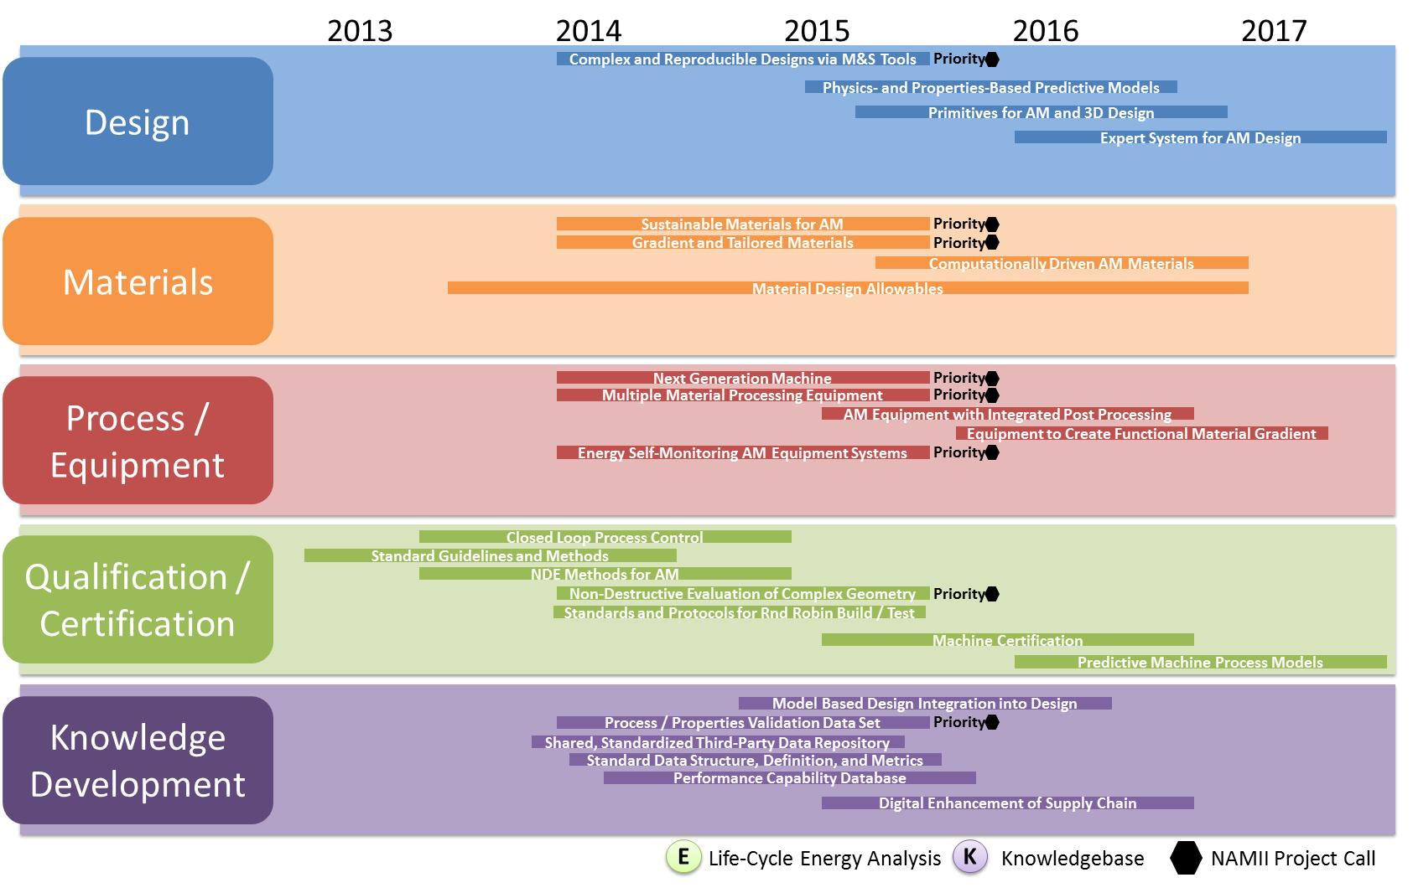
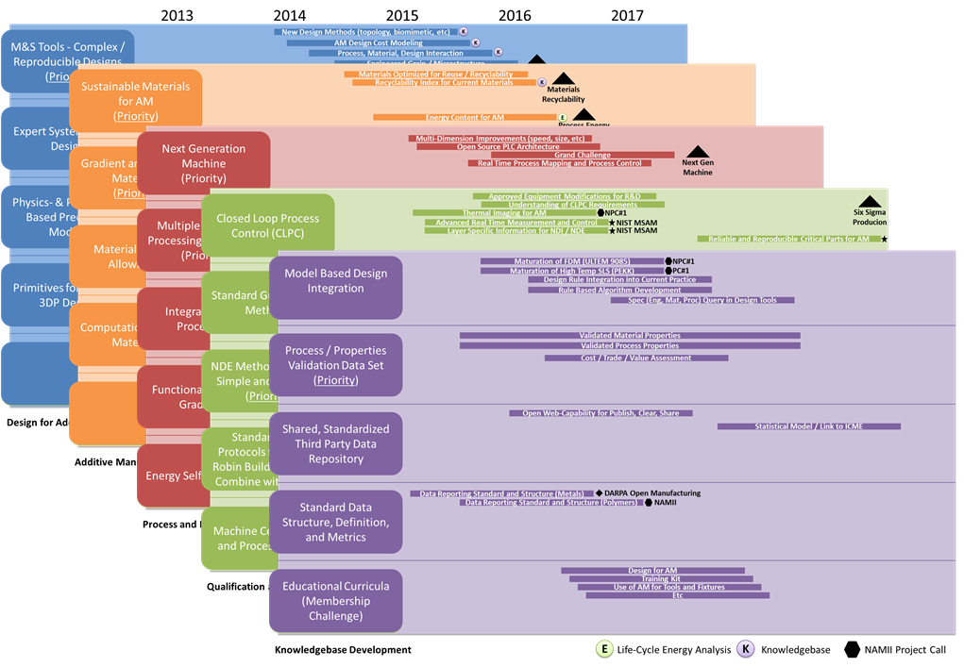
Roadmap v1.0 Background
America Makes Roadmap v1.0 delivered Summer 2013 identifying over 75 gaps and needs for public / private investment

Slide 12
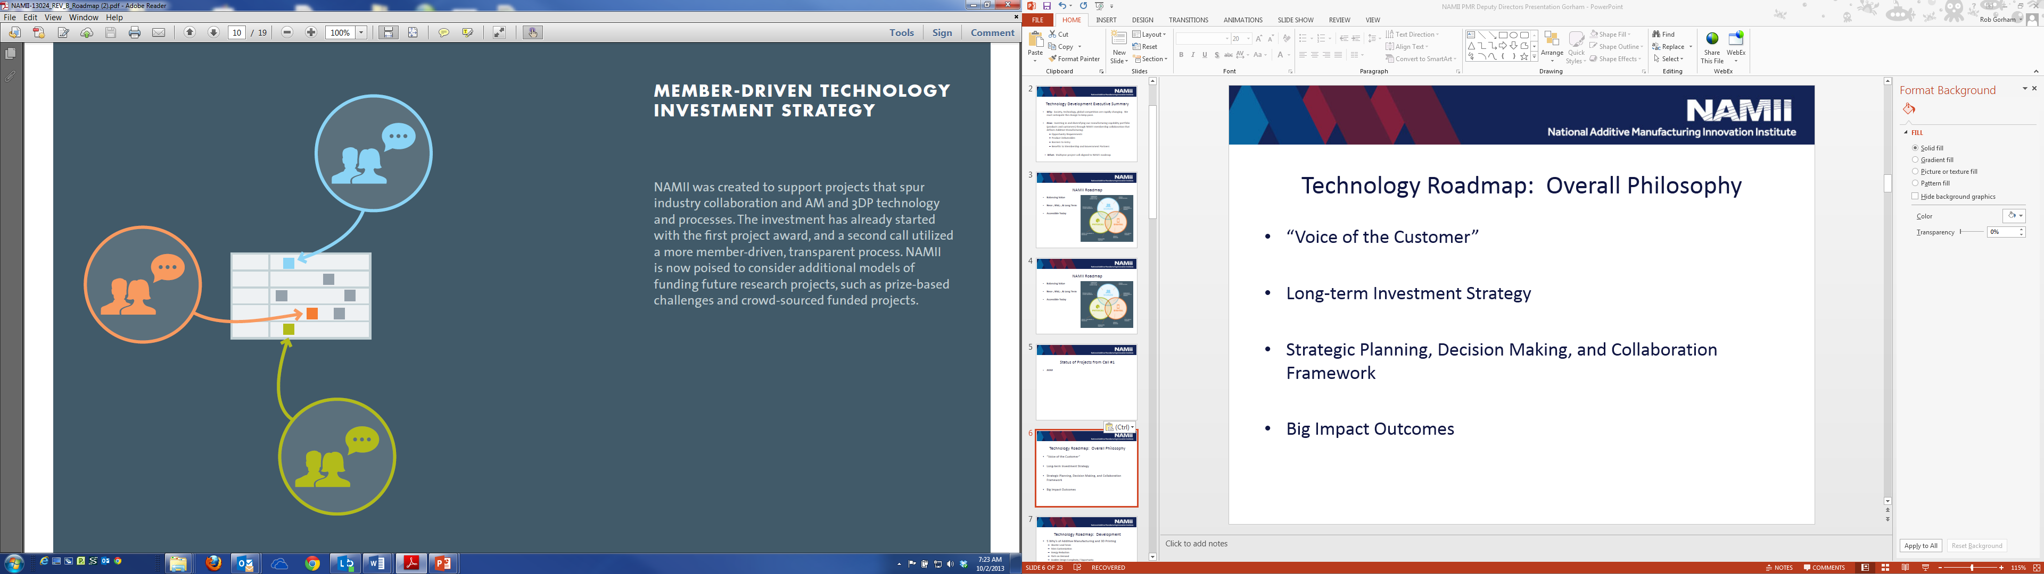
Roadmap v1.0 Background
“Voice of Customer”
Roadmap v1.0 used to shape current portfolio
  Investment to date totaling $48M
  Consortium-Driven: 22 Projects
  Agency-Driven: 9 Projects
  RAMP: 13 Projects
  Crowd-Funded: In Development

Slide 13
Capability Gaps / Issues
Need/Issue | Impact if not Addressed
Dimensional accuracy & surface finish | Additional processing cost, unusable parts
Uniform mechanical properties – different in build direction | Increased design complexity & added weight, suboptimal designs
Improved process control & repeatability | Acceptable part quality, process yield & cost
NDE methods for complex defects and part geometry-understanding of potential defects – effects of defects | Undetected defects leading to component failure.
AM Standards (Materials, process, machine, quality) | Slow implementation of AM in industrial base
Qualification and Certification protocols | Slow adoption, conflicting approaches, waste in research and sustainment dollars
Design tools for AM components | Suboptimal design, increased time to market, material waste, poor performance

Slide 14
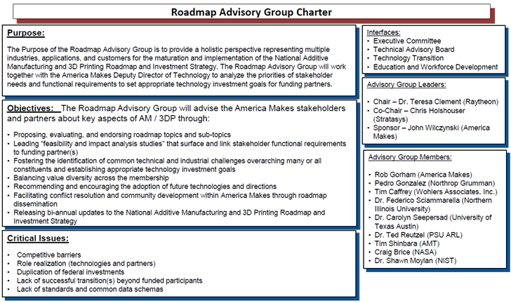
Roadmap Advisory Group
Roadmap Advisory Group (RMAG) chartered and stood up Spring 2014
Established a systems engineering roadmap decomposition process for FUTURE project investment prioritization
Roadmap v1.0 update to Roadmap v1.1 (Winter 2015) and Roadmap v2.0 (Fall 2015)

Slide 15
Technology Roadmap v1.0: Observations
Unclear what Future State Capabilities Result from Roadmaps
  Need to Identify & Prioritize Critical Technology Elements (CTE’s)
Hard to Gauge Individual Project Impact on Roadmap Mission
  SE-Based Flow Down Metrics Needed to Relate Projects to CTE’s
  Hard to Tell which AM Materials/Processes are being Advanced
  Baseline Material & Process Gaps should Drive CTE Advancements
Unclear what Current State Tech Gaps the Roadmaps Address
  Known Tech Gaps vs. Perceived Needs should Define R&D Focus
Current Five Roadmap Swim Lanes a Good Start but too Broad
  Swim Lanes should Sequence Projects based on CTE Maturation
Out-Year Project Ideas a Mix of CTE’s, Solutions, Gaps, & Goals
  Standard Project Template needed to Capture Key Workshop Info

Slide 16
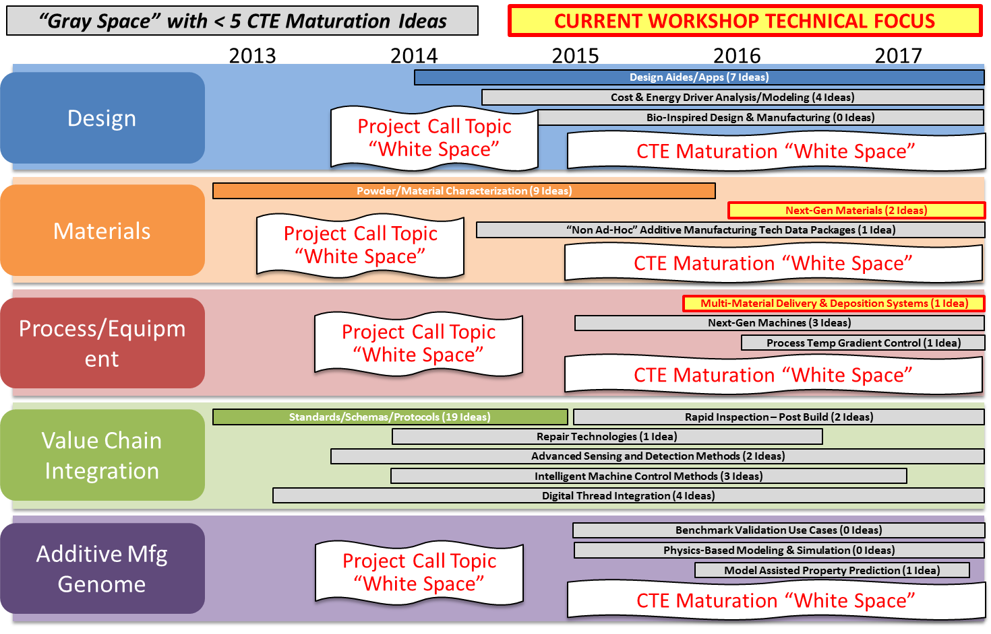
Systems Engineering Based Roadmap Update Process

Slide 17
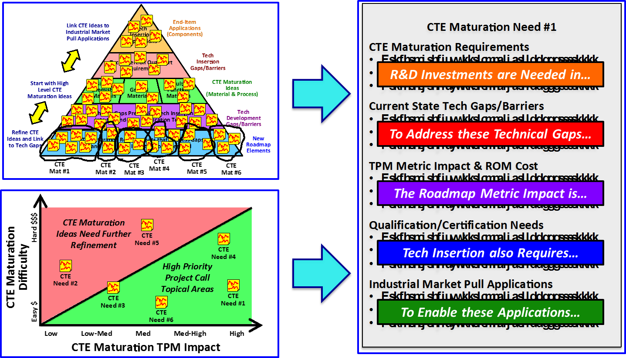
Systems Engineering Based Roadmap Update Process

Slide 18
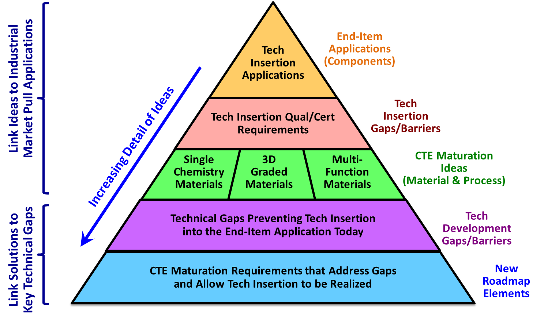
SE Based Roadmap – Brainstorming Pyramid

Slide 19
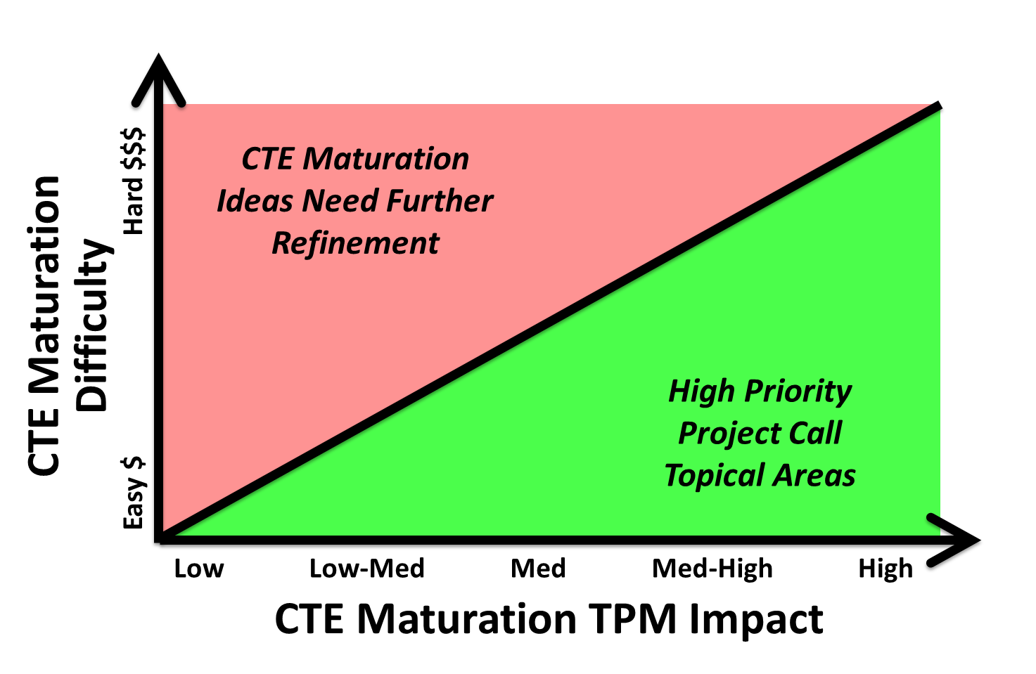
SE Based Roadmap – Impact Difficulty Matrix

Slide 20
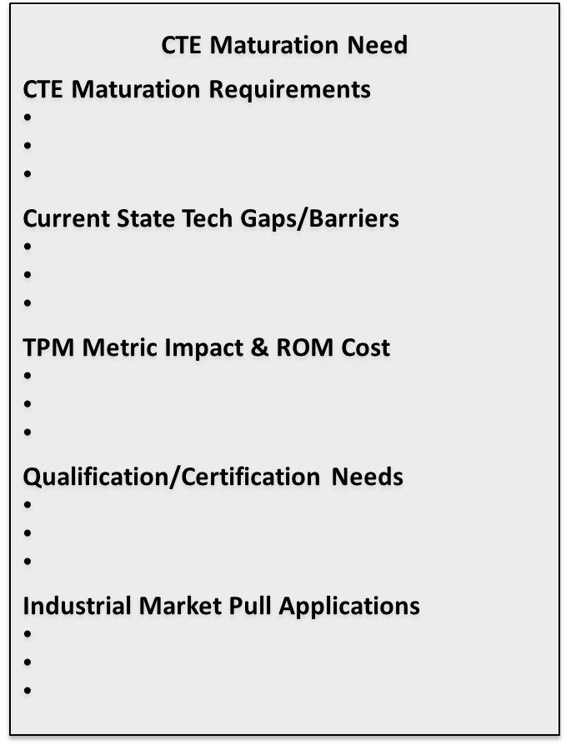
SE Based Roadmap – Concept Poster Template

Slide 21
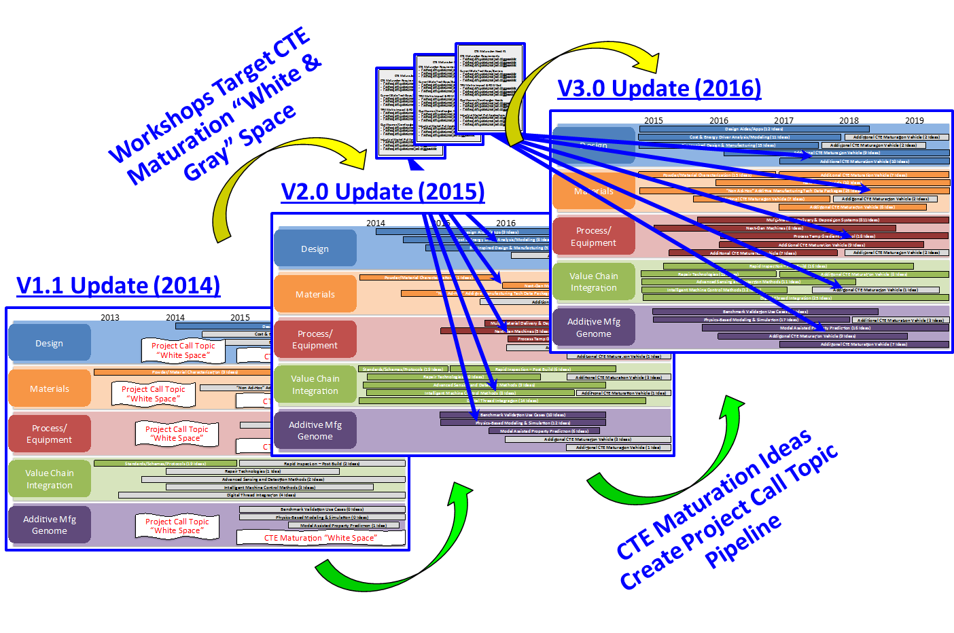
Systems Engineering Based Roadmap Update Process

Slide 22
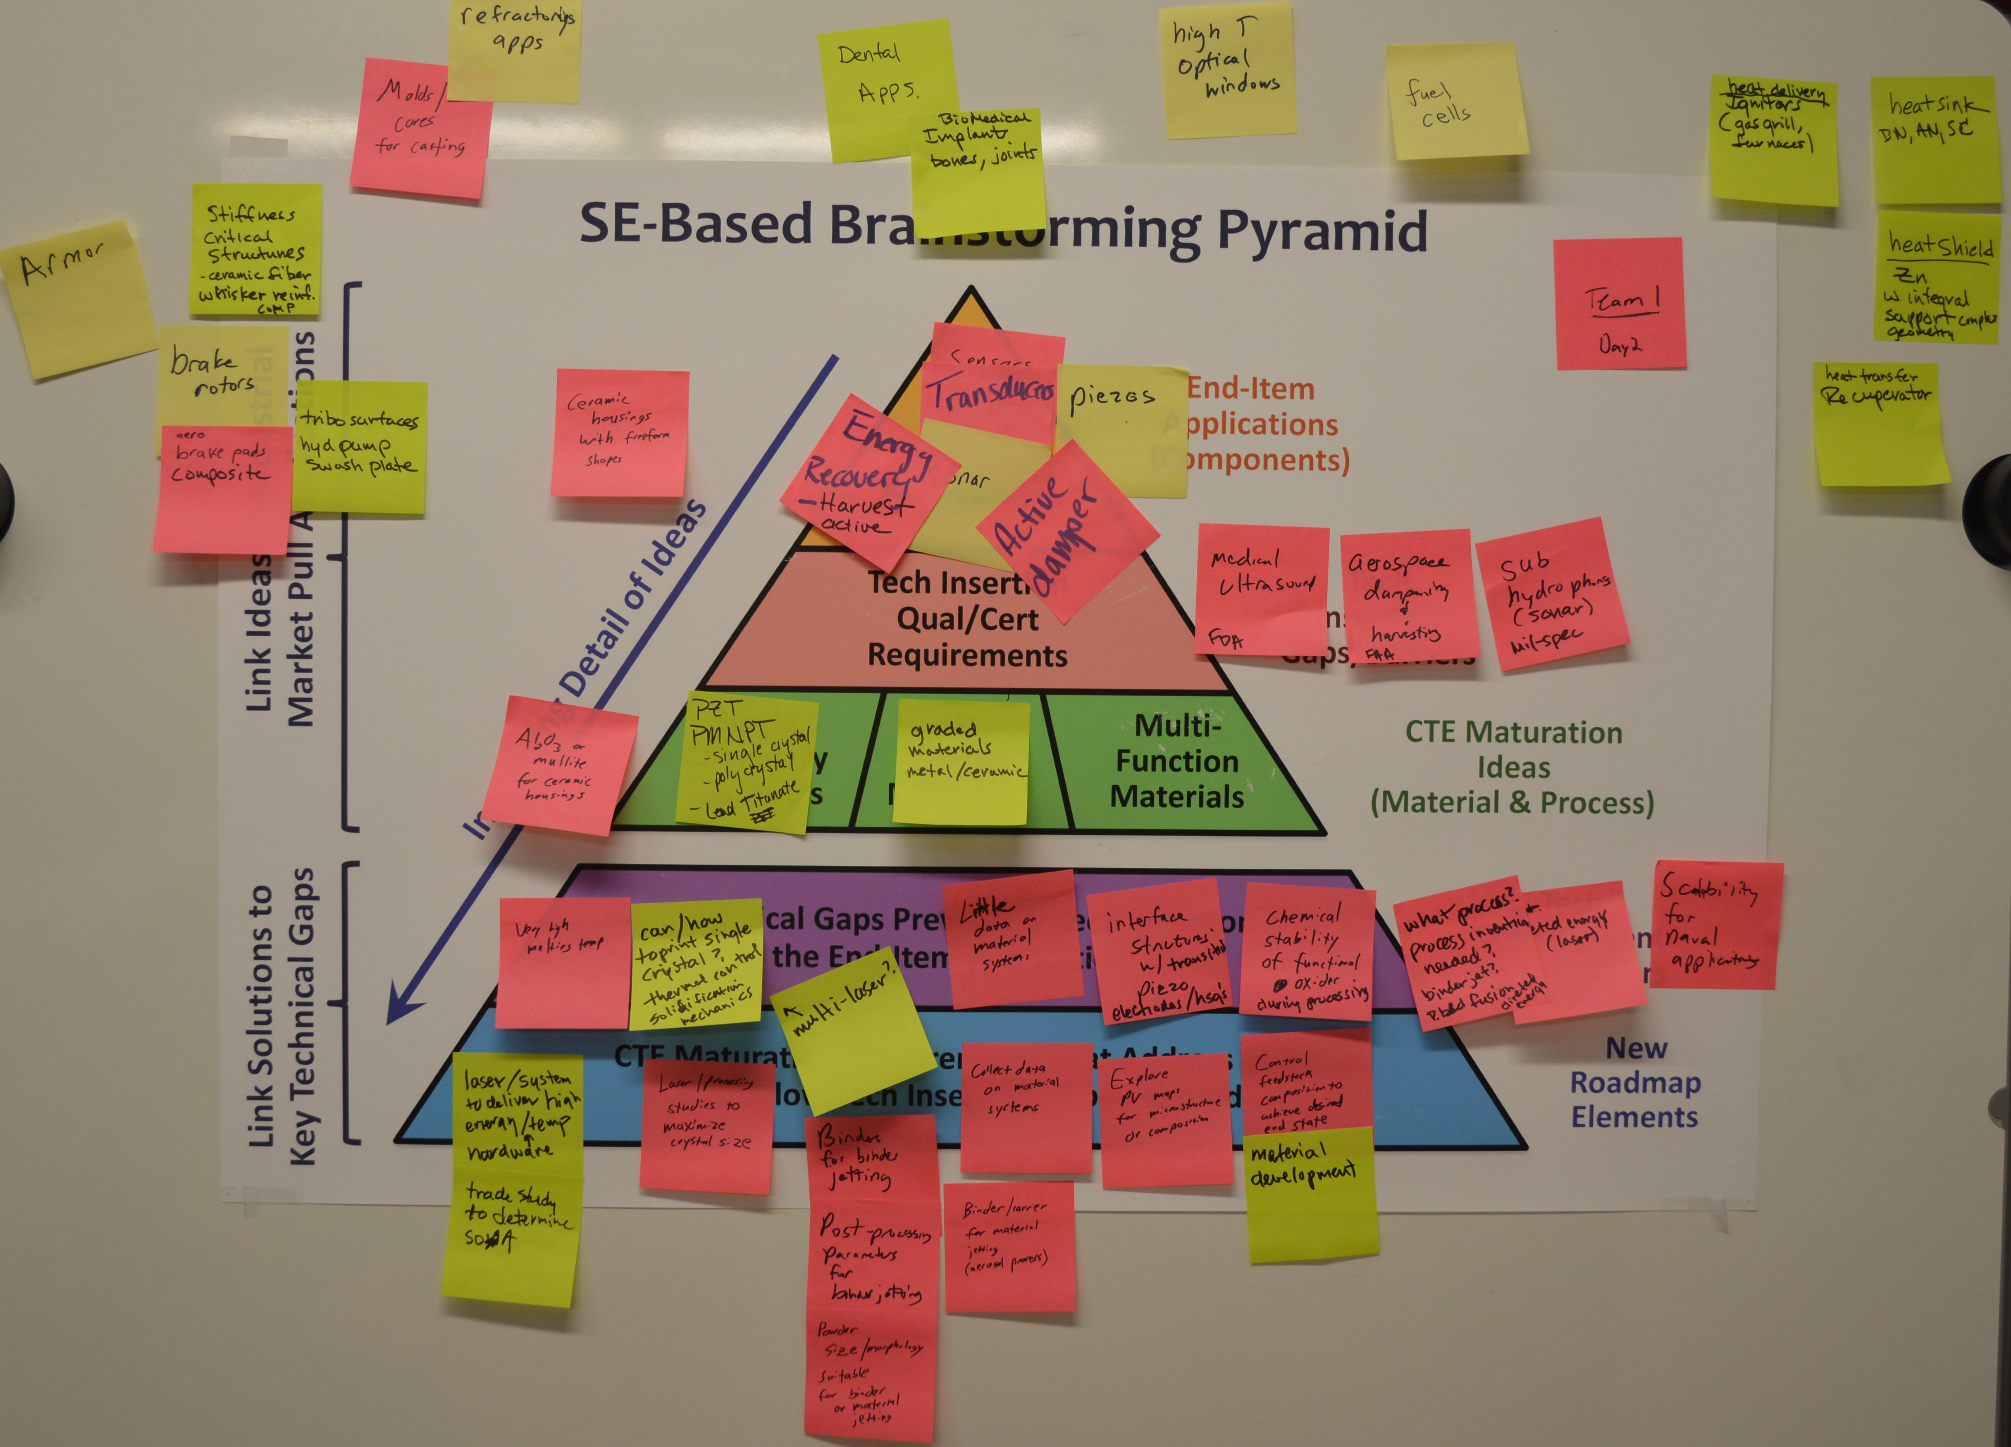
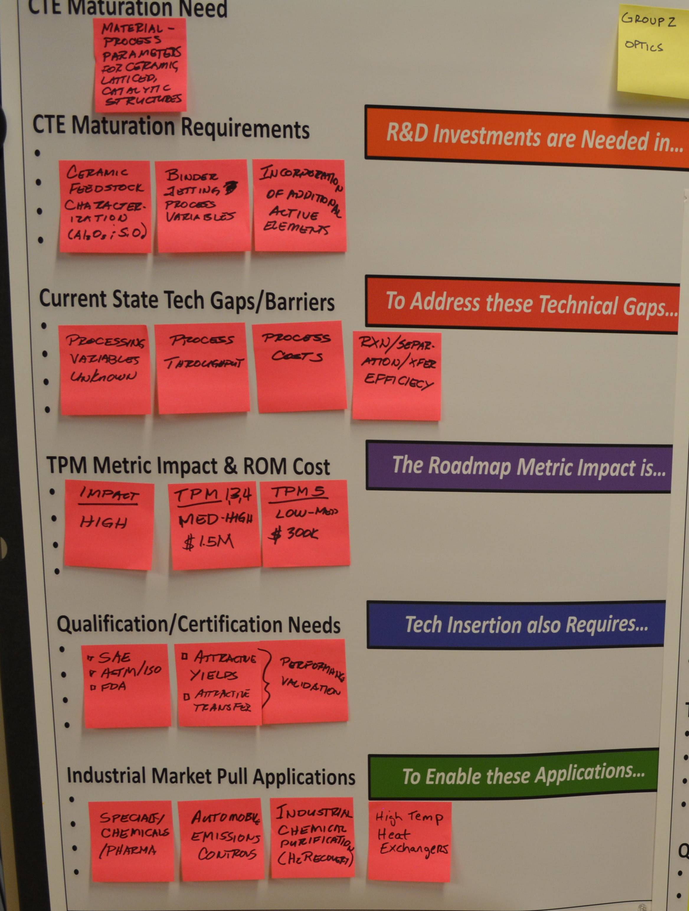
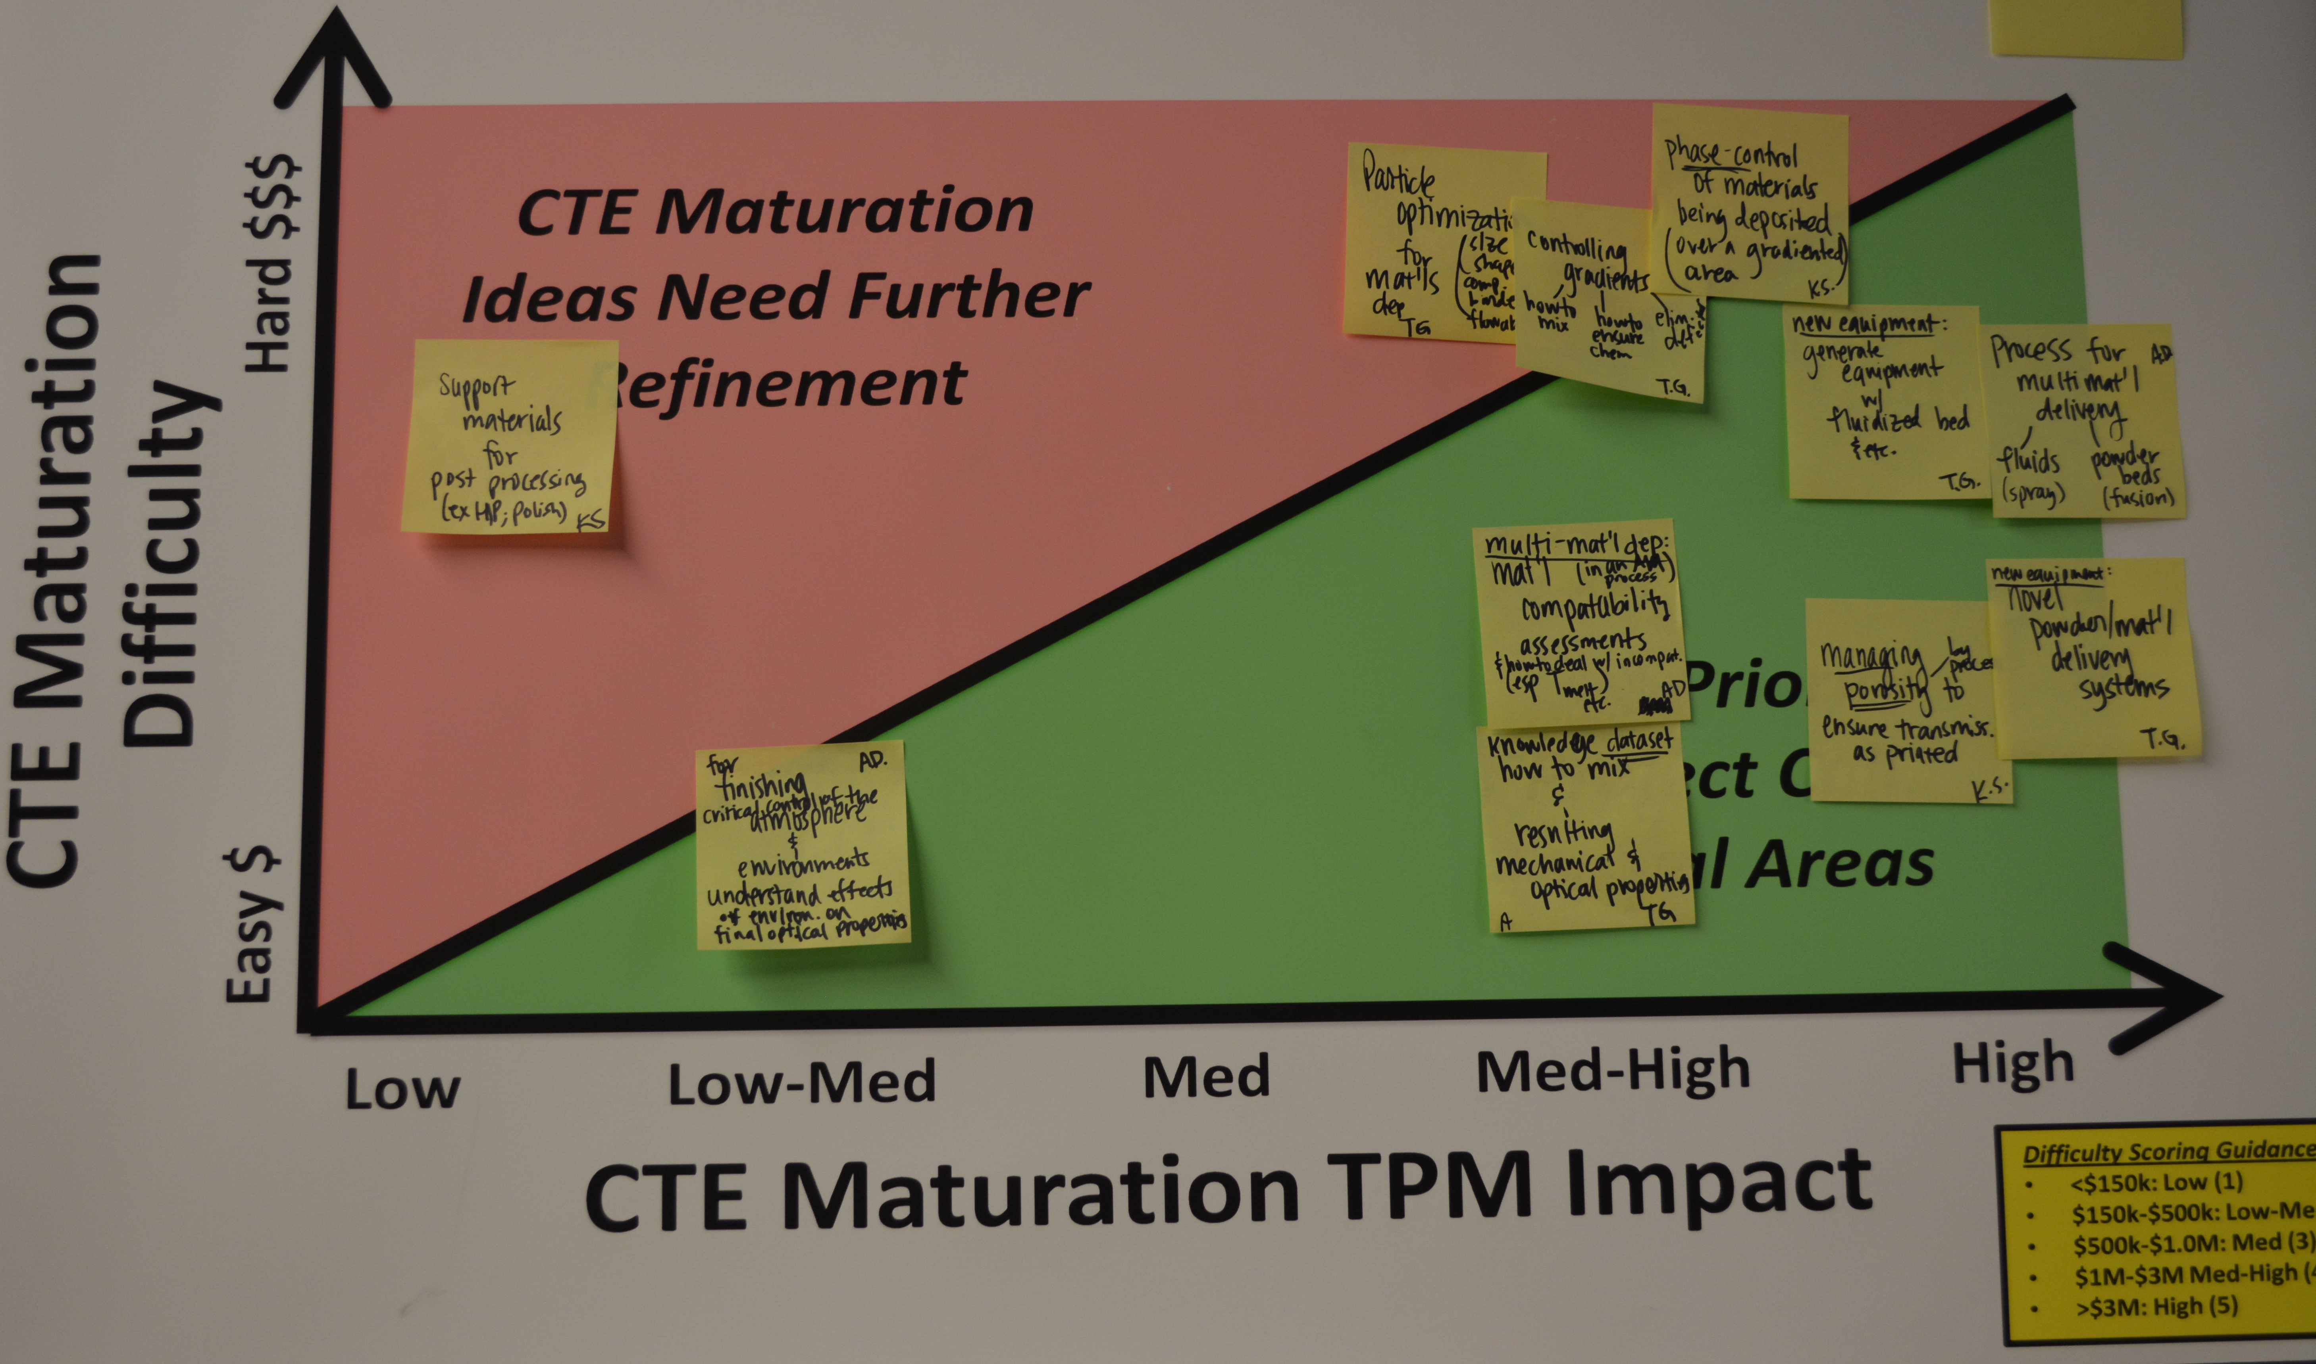
Technology Roadmap: Prioritization
SE Brainstorming Pyramid
Impact Difficulty Matrix
Concept Posters

Slide 23
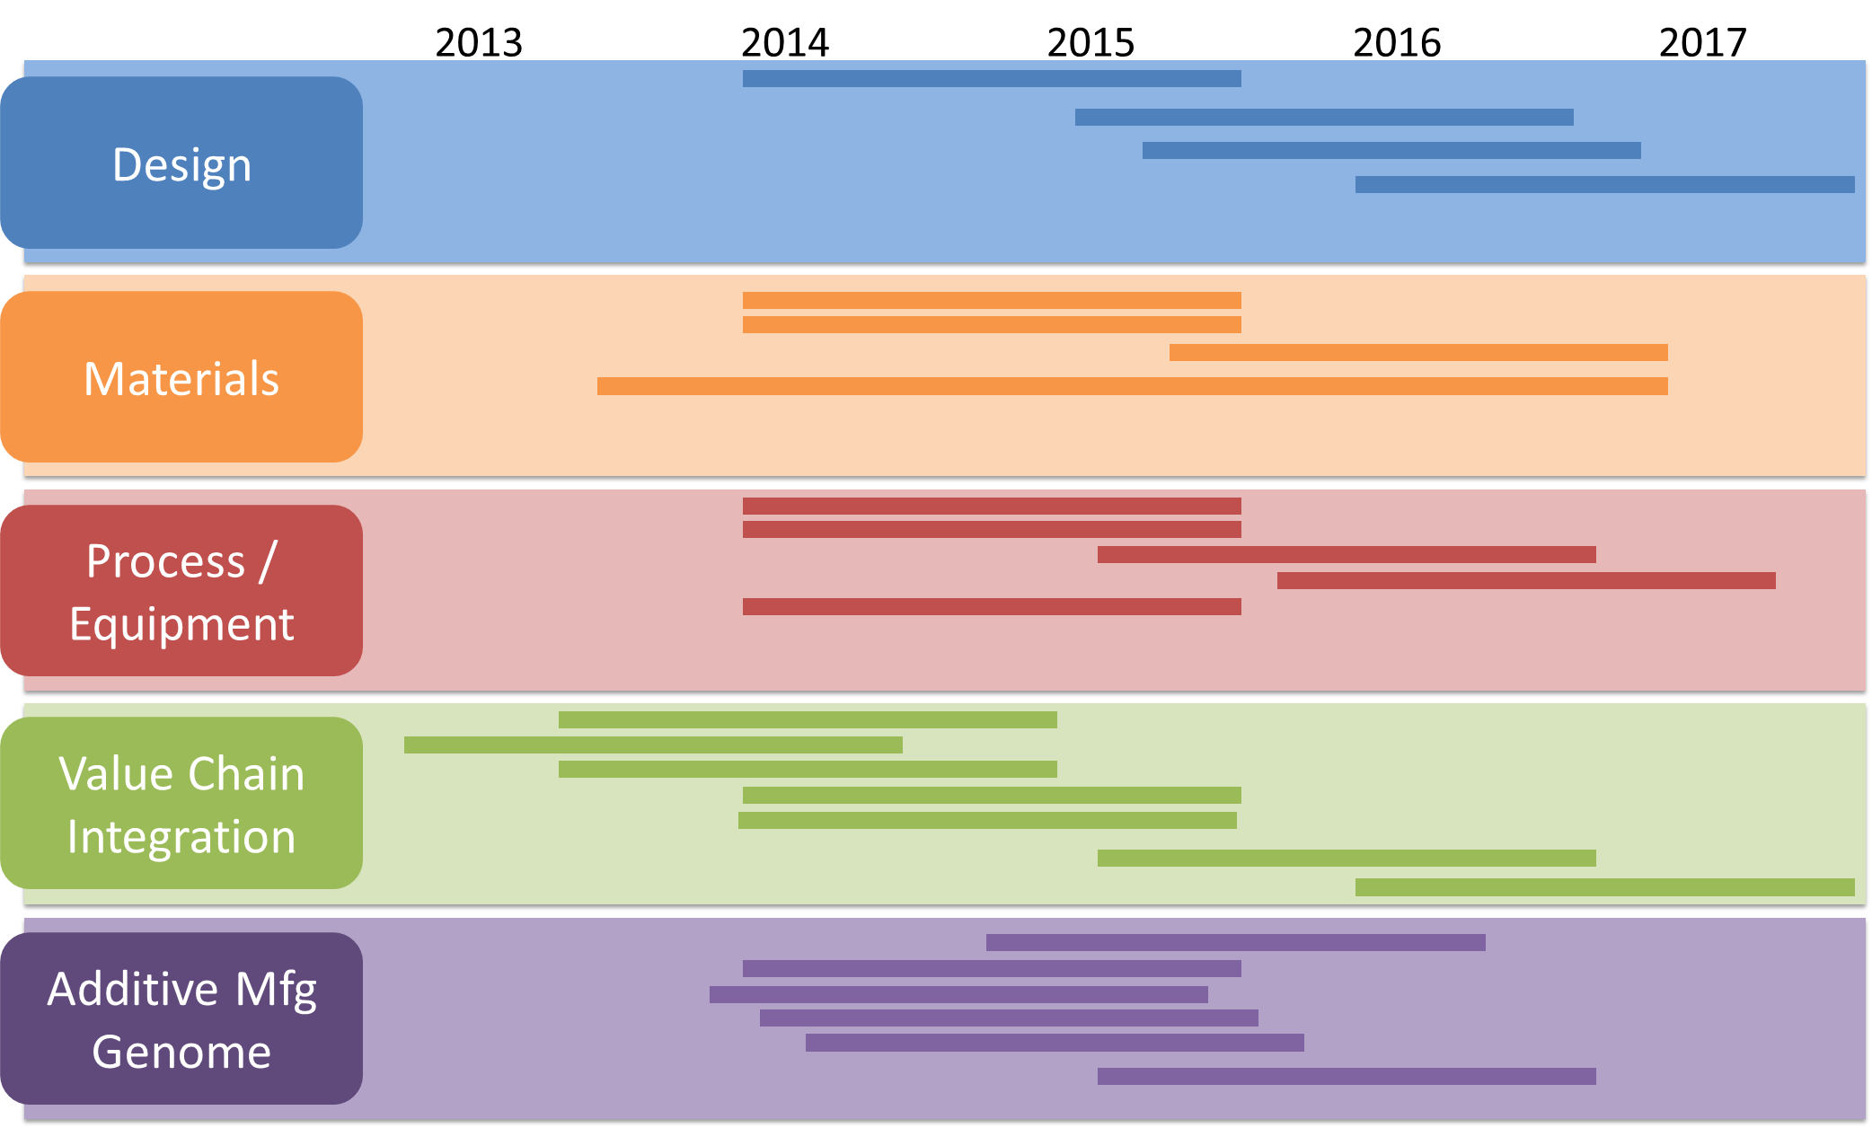
Technology Roadmap

Slide 24
Technology Roadmap: Continuous Improvement
Roadmap V1.0
Aerospace
Automotive
Medical
Energy
Electronics
Consumer
Technology Roadmap Advisory Group (RMAG) formed

Slide 25

Project Call #1
7 Projects Awarded; April 2013 Kick-off
Projects Address Metals & Polymers
  Materials Characterization
  Process Capability & Characterization
  Quality Control
$9.5 M Technical Investment ($4.5M Government Funds + $5M Cost Share)
Each Project includes Technology Transition, Advanced Manufacturing Enterprise, and Workforce Education
35 Participants (8 of the 35 Are Universities)

Slide 26
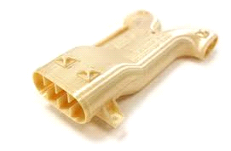
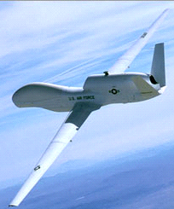
Maturation of FDM Component Manufacturing
PROBLEM
APPROACH
Original Equipment Manufacturers (OEMs) lack the necessary information to design for production using Additive Manufacturing (AM) technologies. Fused Deposition Modeling™ (FDM™) presents one potential method for production.
Generate B-basis allowables for ULTEM™ 9085
FEA analysis and manufacturing of select industry relevant sub-element component parts – common part geometry, thick/thin wall
Create a design guide parts using ULTEM™ 9085, design out structural defects due to build path
Develop certification procedures and validate
OBJECTIVE
Improve the U.S. manufacturing competitive landscape using FDMTM by enabling defense and aerospace OEMs to productionize ULTEM 9085 FDMTM manufactured parts.
Performing Organization(s): rp+m
Start Date: May 2013
End Date: February 2015
BENEFITS
AM community gains deeper understanding of properties and market opportunities of high temp FDM polymer parts through access to materials knowledgebase
Certification procedures widespread
Market expands for ULTEM ™ 9085 parts including aerospace, automotive, medical and customized consumer products
IMPLEMENTATION
Transition site in discussion

Slide 27
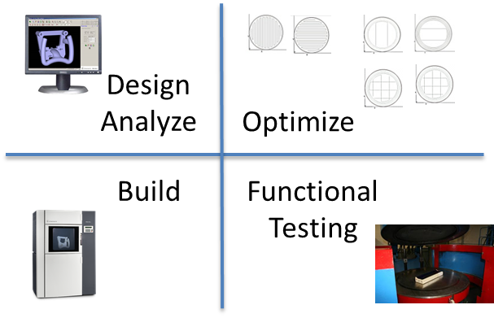
Sparse-Build Rapid Tooling by Fused Deposition Modeling for Composite Manufacturing and Hydroforming
PROBLEM
APPROACH
Optimization methods for VARTM Vacuum Assisted Resin Transfer Molding and Hydroforming Tools
Utilize ULTEM 9085 for strength and heat deflection temperature
Test representative coupons to establish design properties database
Establish design strategies
Build tools
Functionally test tools to validate analysis correctly predicted performance
OBJECTIVE
Develop FDM based tooling strategies utilizing ULTEM 9085 and FDM internal build structure options balanced between cost savings and mechanical strength.
BENEFITS
Performing Organization(s): MS&T
Start Date: May 2013
End Date: July 2014
Larger tools can be affordably and predictably implemented
Reduced tool cost and faster cycle times can be realized
IMPLEMENTATION
Stratasys markets applications to increase use of machines and materials
Boeing desires to implement results into their factory
GNK Aerospace & Steelville manufacturing are both following results

Slide 28
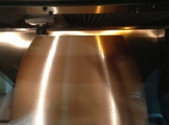
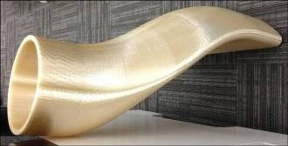
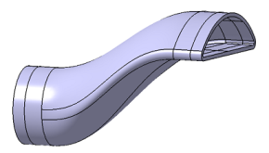
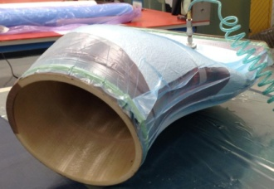
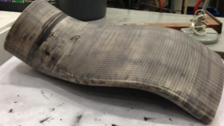
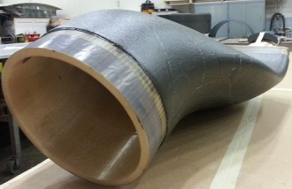
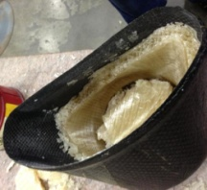

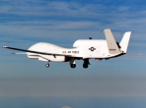
Fused Deposition Modeling (FDM) of Complex Composites Tooling
PROBLEM
APPROACH
FDM has the potential to provide solutions for complex composite tooling. But, it needs additional validation before it can be readily implemented.
Utilize ULTEM S1 Support materials to build complex tools
Test representative coupons to establish design properties database
Establish design strategies
Build tools and prove joining methods
Functionally test tools to validate analysis correctly predicted performance
OBJECTIVE
Utilize FDM materials and processes to demonstrate a viable, low-cost, short-lead time alternative to existing composite tooling options
Performing Organization(s): Northrop Grumman
Start Date: May 2013
End Date: Sept 2014
BENEFITS
TRL\MRL Maturation
Targeted Manufacturing Flow
Complex composite tools can be affordably and predictably implemented
Reduced tool cost and faster cycle times can be realized
FDM Material / Process Characterization
Direct 3D CAD Model to Composite FDM Tool
Design and Analysis
Composite Layup and Out of Autoclave Cure
IMPLEMENTATION
Stratasys markets applications to increase use of machines and materials
NGC desires to implement results into their factory
RP+M & RCBI will offer training and services to implement this solution to a variety of companies
Prep Tool and Build Part
Breakout and Finishing
Breakout, Validate and Recycle
Assembly and Platform Integration

Slide 29
Maturation of High Temperature Selective Laser Sintering (SLS) Technologies and Infrastructure for Air and Space Vehicles
PROBLEM
APPROACH
Increasing foreign based PEKK material cost and non-recyclability are largest cost drivers in High Temp SLS F-35 component price
Generate B-basis allowables for PEKK
Process parameter determination such as lowest processing temperature for PEKK for faster cool down
Determine recyclability
Demonstrate on “Industry Application”
Topology optimization of relevant designs for requirements
OBJECTIVE
Establish domestic sources of recyclable, high temperature, ESD compatible PEKK polymers to reduce costs.
Performing Organization(s): Northrop Grumman, OPM, Arkema, AST2
Start Date: May 2013
End Date: March 2015
BENEFITS
Elimination of sole-source supply chain risk
Savings of $6.2-million per aircraft in lifetime fuel consumption
Reduced production energy costs
Reduced production raw materials cost and transportation cost
IMPLEMENTATION
Transition / dissemination through America Makes network

Slide 30
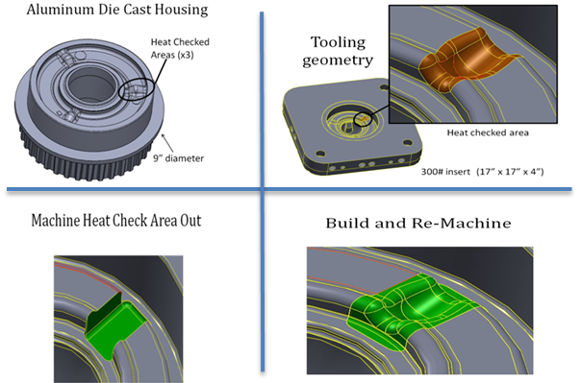
Qualification of AM Processes and Procedures for Repurposing and Rejuvenation of Tooling
PROBLEM
APPROACH
Fabrication of new dies can cost up to $1.5M and have long lead times of 22-26 weeks.
Compare mechanical properties and microstructure of various AM repair type methods (LENS, POM, etc.) on H13 and maraging steel dies, to baseline welding repair
Evaluate bond strength and die life of each
Comp model residual stress/distortion for heat treatment
NADCA and American Weld Society to provide guidelines and training
OBJECTIVE
Develop, evaluate, and qualify methods of rejuvenation and repurposing (RR) using Additive Manufacturing
Performing Organization(s): CWRU
Start Date: May 2013
End Date: February 2015
BENEFITS
NADCA published guide, workshops, and webinars on RR of tooling using AM
Industry-wide adoption of RR of tooling results in $500M/year cost savings for die casting manufacturers
Use of AM within DoD facilities for RR of tooling
Life cycle energy cost reductions through many manufacturing sectors including automotive from extending die cast tool life
IMPLEMENTATION
Transition site in discussion

Slide 31
Thermal Imaging for Process Monitoring and Control of Additive Manufacturing
PROBLEM
APPROACH
Industry must have confidence in AM processes where they can produce predictable microstructure and distortion, both governed by thermal history
Integrate thermal sensors to adjust process real time for increased quality/consistency of microstructure and mechanical properties
Harden sensors for EBDM process
3D visualization and correlation of data
Expand process maps to real-time microstructure control
OBJECTIVE
Implement multi-sensor thermal imaging for process monitoring and control on electron beam, wire-fed (Sciaky’s electron beam direct manufacturing – EBDM), and laser, powder-fed based (Optomec’s Laser Engineered Net Shaping – LENS®) AM processes.
Performing Organization(s): PSU
Start Date: May 2013
End Date: February 2015
BENEFITS
Quality confidence in EBDM and LENS® processes
Multi-sensor thermal imaging and control installed within Optomec LENS and Sciaky EBDM machines
Increased adoption due to greater confidence in part properties and quality
Rapid qualification due to consistency in microstructure and mechanical properties
IMPLEMENTATION
Transition site in discussion

Slide 32
Rapid Qualification Methods for Powder Bed Direct Metal Additive Manufacturing Processes
PROBLEM
APPROACH
Qualification of a process takes an exorbitant amount of time, holding back adoption of promising AM processes
Industry struggles to control microstructure and mechanical properties across direct metal laser sintering (DMLS) and electron beam melting (EBM)
Thermal property modeling, Power/Velocity (P/V) process mapping to melt pool geometry
Determine effect of powder size distribution on P/V process map and resulting microstructure
Construct process maps for DMLS and EBM
Develop process-based cost models
Demonstrate on “Industry Application”
Performing Organization(s): CWRU, CMU, Pratt & Whitney, GE Aviation, Lockheed Martin, Kennametal, Bayer, U. Louisville, Wright State U, NC State
Start Date: May 2013
End Date: February 2015
BENEFITS
Verified methods for tight control of microstructure and mechanical properties
Reduction in amount of testing/time to qualify
Ability to switch between high P/V (high rate, low res) and low P/V (low rate, high res) will provide overall faster build times and ability to serve new markets
Industry uses cost models to make decisions on adopting AM into their factory or supply chain
IMPLEMENTATION
Transition site in discussion

Slide 33
Project Call #2
Eight Priority Topics Selected Based on Crowd-Sourced Roadmapping Process
  Complex and Reproducible Designs via Modeling and Simulation Tools
  Sustainable Materials for AM / 3DP
  Gradient and Tailored Materials
  Next Generation Machine
  Multiple Materials Processing Equipment
  Energy Self-Monitoring Additive Manufacturing Equipment Systems
  Non-Destructive Evaluation of Complex Geometries
  Process / Properties Validation Data Set
Solicitation Issued 8/29/13; Proposals Received 10/31/13
Announced 15 Project Awards 1/21/14
Awarding $9M of America Makes Funding with $10.3 million matching cost share from awarded project teams = $19.3M total funding

Slide 34
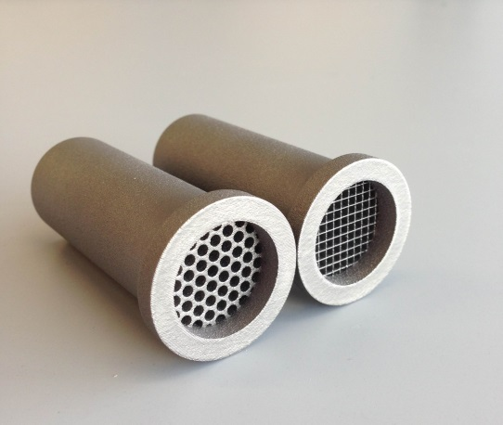
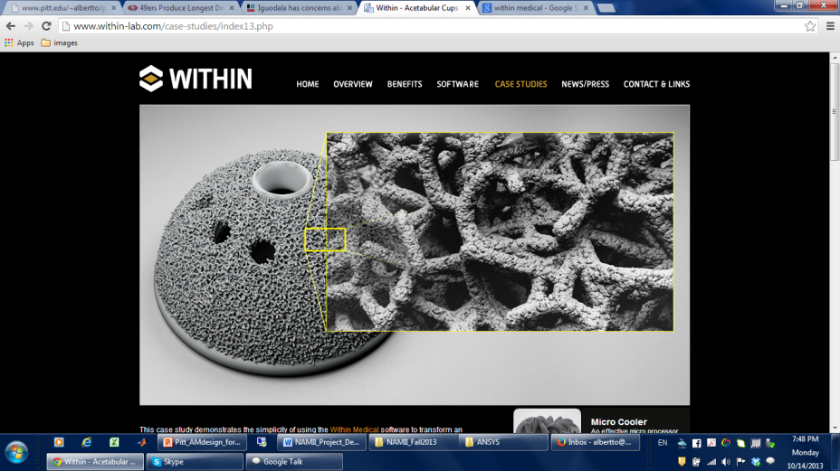
Developing Topology Optimization Tools that Enable Efficient Design of Additive MFD Cellular Structures
PROBLEM
APPROACH
Current structural optimization method is inefficient for the design of additive manufactured cellular structures with variable density.
  Calibrate cellular structure micromechanics models from simulation and experiment.
  Topology optimization for mechanical parts based on micromechanics models
  Reconstruct detailed cellular structure.
OBJECTIVE
    Develop experimentally-validated micromechanics models, topology optimization, and reconstruction algorithms for different cellular structures.
    Demonstrate and validate capability of design and optimization tools on design of a realistic structural component
Performing Organization(s): Univ of Pittsburgh, ANSYS
Start Date: April 2014
End Date: August 2015
BENEFITS
Enable efficient design of cellular structures in load-bearing parts for Defense Wide applications
IMPLEMENTATION
Commercial FEA package ANSYS

Slide 35
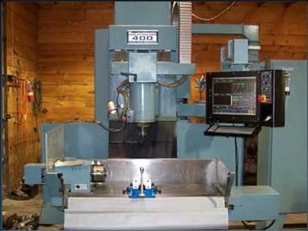
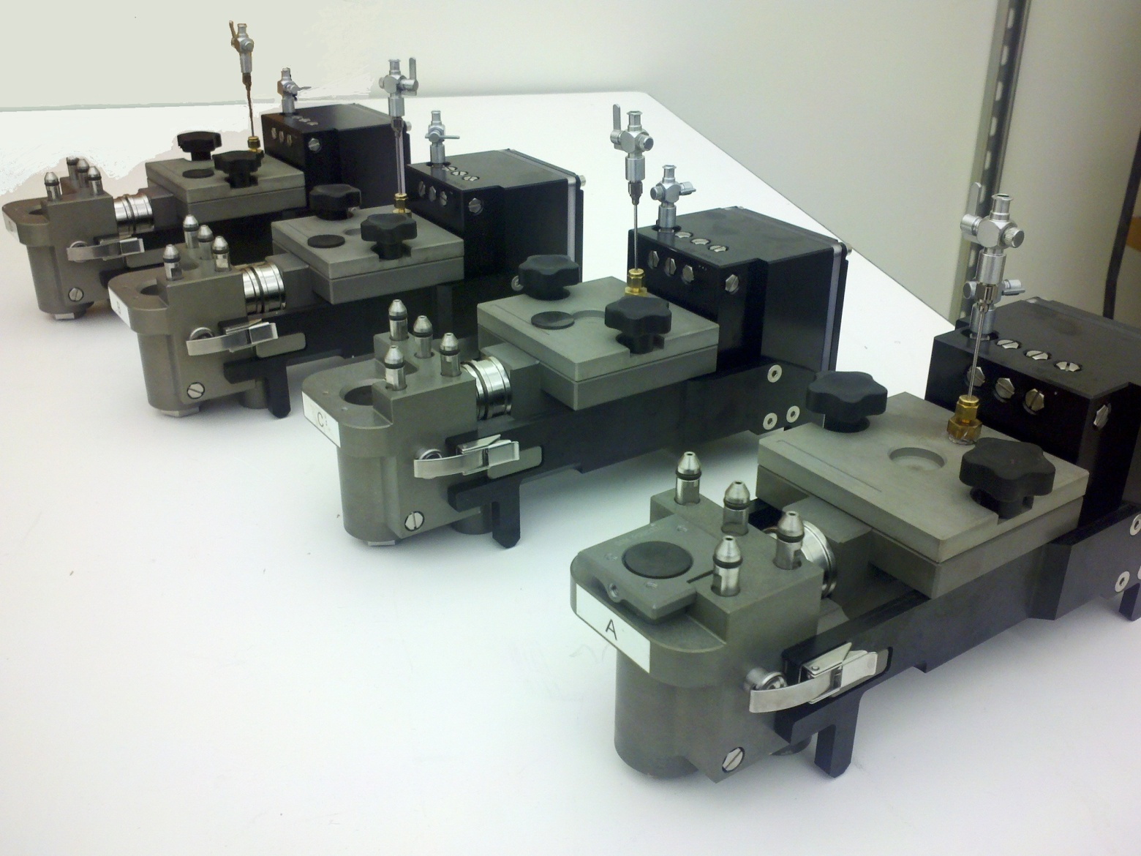
Development of a Low Cost LENS Engine
PROBLEM
APPROACH
Adoption of Metal Laser Deposition technology has been hindered by the difficulty of integrating this new technology into existing production methods.
Uses experience from Optomec’s Aerosol Jet Print Engine
Manufacture pieces
Assemble at MachMotion
Initial testing
Ship equipment to TechSolve for testing
Develop software tools, install as ready
Validate machine output
OBJECTIVE
Develop a LENS Print Engine that will enable metal laser deposition equipment to be installed as an accessory on the installed machine tool base.
Performing Organization(s): Optomec / MachMotion/TechSolve, Benét Labs, Lockheed Martin
Start Date: March 2014
End Date: August 2015
BENEFITS
Potential for use at repair facilities and depots for maintenance and sustainment efforts.
IMPLEMENTATION
Initial implementation at an TBD university.

Slide 36
Development of Knowledgebase of Deposition Parameters for Ti-6Al-4V and IN718
PROBLEM
APPROACH
There is currently no widescale process parameter database or “knowledgebase” for process parameters for the LENS blown powder directed energy deposition process.
  Define standard process parameters
  Simulate deposition with varied parameters
  Experimental validation via designed experiments
  Rinse and repeat if necessary
  Populate knowledgebase
OBJECTIVE
Development of a knowledgebase that offers a matrix of vetted process parameter combinations for LENS.
Performing Organization(s): Optomec / Applied Optimization
Start Date: March 2014
End Date: August 2015
BENEFITS
  Improved efficiency (lead time, cycle time, cost) and quality of AM component production and repair
  Increased acceptance of AM methodology by reducing the AM process development barrier (development time and skill level / experience of process developer)
  Improved competitiveness of AM practitioners
IMPLEMENTATION
Commercially available software from Applied Optimization.

Slide 37
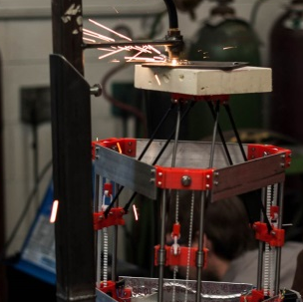
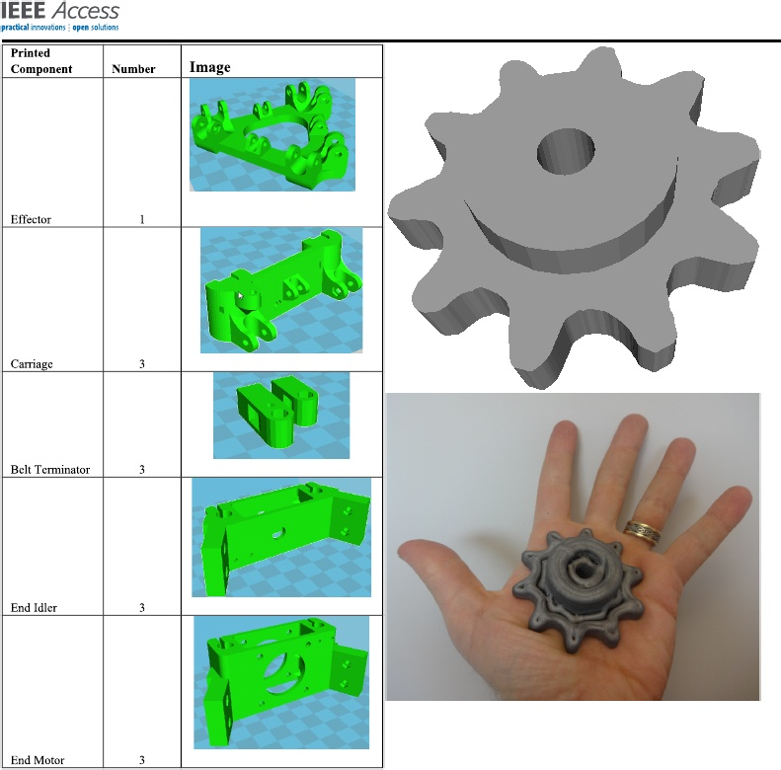
Metal Alloys and Novel Ultra-Low-Cost 3-D Weld Printing Platform for SME Rapid Prototyping and Production
PROBLEM
APPROACH
The US does not have a low cost metal 3D printer offering. While access to polymer printing is affordable and accessible, nothing exists for metal.
Mature MOST stage 3D printer
Develop and mature alloys specific to the MOST printer
Characterize quality ( surface finish, microstructure, mechanical)
OBJECTIVE
Reduce the cost of metal 3D printing by a factor of 100 by maturing current proven concept to commercialization
Performing Organization(s): Michigan Tech University
Start Date: April 2014
End Date: August 2015
BENEFITS
Radical reduction in cost of metal 3DP, expansion of 3DP user base, FOSH designs for rapid technological development and widespread commercialization
IMPLEMENTATION
Transition partners Aleph Objects Inc. and Re:3D
Re:3D is Austin, Texas startup that successfully ran a kickstarter and exceeded goal by 600%
Office of Innovation and Industry Engagement at Michigan Tech actively involved

Slide 38
Accelerated Adoption of Additive Manufacturing Technology in the American Foundry Industry
PROBLEM
APPROACH
US metalcasting industry facing severe challenges resulting in over 1000 facilities closing.
Technology Acceleration Definition
Deployment Process
Analyze data / cause and effect relationships impacting rate of deployment
Improve, accelerate, optimize adoption
Implement system controls
OBJECTIVE
Recapitalize the metalcasting industry by developing a framework (education, management, marketing, business) for the establishment of a AM regional network for U.S. foundry industry grounded in AM
Performing Organization(s): Youngstown Business Incubator, ExOne, Youngstown State University, AFS, Univ Northwestern Iowa, Humtown Products, Janney Capital
Start Date: April 2014
End Date: August 2015
BENEFITS
Accelerate US metalcasting industry with the adoption of AM technologies into their operations that: (1) reduces production time for new molds from months to less that a week and (2) part consolidation and reduction of welds, fasteners, assembly pieces, total weigh, and inventory
IMPLEMENTATION
Neighborhood, regional, national approach to enable network sustainability

Slide 39
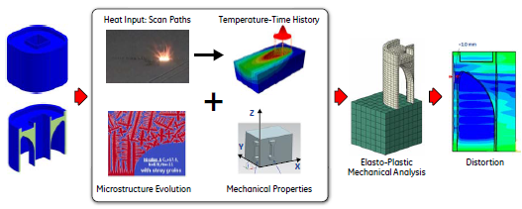
Development of Distortion Prediction and Computational Methods for Powder Bed AM
PROBLEM
APPROACH
An absence exists with suitable distortion prediction tools resulting in ad-hoc rules of thumb to compensate and mitigate the problem.
Define canonical features
Validation of distortion prediction
Distortion compensation
Curriculum development
OBJECTIVE
Benchmark and validate physics-based thermal distortion prediction and mitigation tools for commercialization.
Results will lead to a 3X to 4X reduction in development time.
TRL - Currently 4 targeting 6
Performing Organization(s): GE Research / United Technologies / Honeywell
Start Date: September 2014
End Date: February 2015
BENEFITS
Create the ability to virtually evaluate and optimize processes & product alternatives for reduced cost (iterations reduced from 5+ to less than 2)
Rapid deployment of virtual AM process evaluation through wiki and AM transfer functions
IMPLEMENTATION
GE Leap Engine
Various other aerospace components

Slide 40
In-Process Quality Assurance
PROBLEM
APPROACH
No commercially available reliable IPQA system. Post process inspection becoming a field unto itself.
Establish CTQs
Determine what sensors are most sensitive to CTQs
Test on Multiple platforms and materials
Compare with post process analysis
OBJECTIVE
Develop an in situ IPQA process that is not material or platform dependent.
Performing Organization(s): GE Aviation, Honeywell, Aerojet Rocketdyne
Start Date: August 2014
End Date: March 2016
BENEFITS
Material and platform independent In-Situ IPQA process
Reduced post process inspection time required
IMPLEMENTATION
Commercialize the IPQA process with the help of Burke E. Porter Machinery Co.

Slide 41
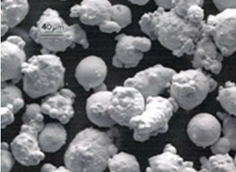
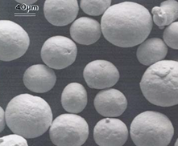
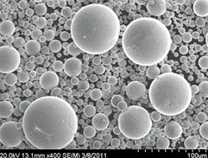
Database Relating Powder Properties to Process Outcomes for Direct Metal AM
PROBLEM
APPROACH
The most severe supply chain restriction is requirements to procure quality powders from machine manufacturers. Therefore, a large variety of powder systems must be usable in direct metal machine for broad adoption
Include experimental results from studies of powder spreadability, the ability of the powder to be sintered, powder melting outcomes (including meld pool geometry and microstructure)
OBJECTIVE
Develop a first-of-its-kind database relating powder properties to process outcomes and identify process variable changes need to make a current incompatible powder, comparable to standard powders
BENEFITS
Performing Organization(s): CMU, NC State
Start Date: June 2014
End Date: December 2015
Regional cluster of AM powder production, catalyzed by America Makes and bringing powder suppliers and AM machine user together.
IMPLEMENTATION
10 industry partners across powder production, medical device, aerospace, and electronic connector industries
As part of the TTP, plan to develop (through separate funding) software to methodically take users through testing methods needed to create and expand powder property vs part quality databases

Slide 42
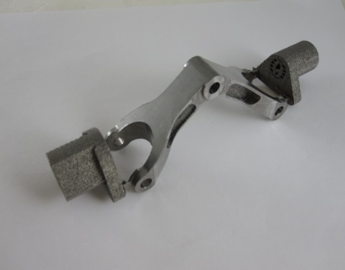
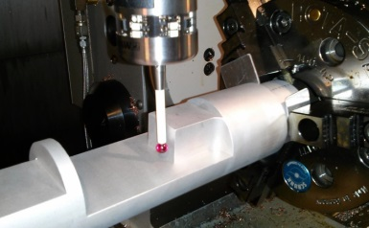
Automatic Finishing of Metal AM Parts to Achieve Required Tolerances and Surface Finishes
PROBLEM
APPROACH
Most metal AM processes produce parts that need finishing to achieve required tolerances and surface finish.
  Improve existing visibility algorithm to determine number of finishing orientations and feasible placement of sacrificial machining fixtures
  Improve algorithm for addition of machining allowance based on full or partial finishing
  Improve algorithm to determine maximum cutting forces and size optimization of sacrificial machining fixtures
OBJECTIVE
Integrated software solution that will create an automatic hybrid system that can deliver direct metal parts with required tolerances and surface finish.
Performing Organization(s): NC State/ Iowa State/Kennametal/CalRAM/Advanced Machining/Fineline Prototyping/John Deere, TechSolve
Start Date: March 2014
End Date: August 2015
BENEFITS
Reduction of cost for use of additively manufactured parts for maintenance and sustainment efforts.
IMPLEMENTATION
Potential implementation at John Deere.

Slide 43
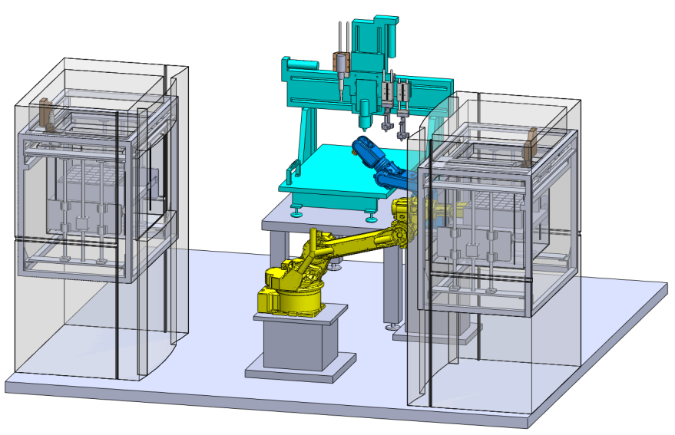
3D Printing Multi-Functionality: Additive Manufacturing for Aerospace Applications
PROBLEM
APPROACH
Current AM technology is limited in terms of final product functionality and multi-material usage.
Maturing/demonstrating the Multi^{3D} Manufacturing System
Evaluate thermoplastic materials for Aerospace Applications
Application demonstrations – technology pull
OBJECTIVE
Development and optimization of Multi^{3D} Manufacturing System​
Evaluation of materials and material interfaces for use in AM in aerospace applications​
Fabrication of 4 innovative aerospace demonstrations with applications in the fabrication of UAVs and satellites.​
Performing Organization(s): UTEP/YSU/University of New Mexico/Lockheed Martin/Northrop Grumman/Stratasys/RP+M/
Start Date: March 2014
End Date: August 2015
BENEFITS
Integrated structures that are multi-functional
IMPLEMENTATION
Northrop Grumman, United Technologies, NASA

Slide 44
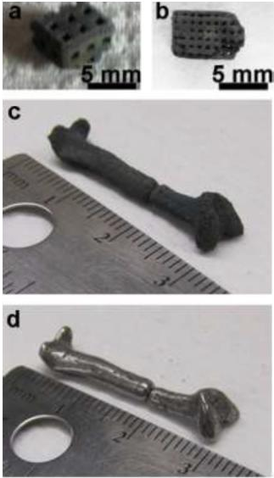
Additive Manufacturing of Biomedical Devices from Bioresorbable Alloys for Medical Applications
PROBLEM
APPROACH
Biocompatible, bioresorbable magnesium allows with controlled degradation rates and strength characteristics suitable for biomedical devices exist, but lack manufacturing methods of converting materials into required shapes, such as bone plates, tracheal stents, and scaffolds
Demonstrate 3D printing of iron based alloys and magnesium
Fabricate 3D constructs in shapes of plates, screws, and stents
Fabricate simple 3D printed constructs and extended to generation of plates, screws, and stents
Characterize 3D printed magnesium constructs for structure, corrosion, and biocompatibility
Demonstrate controlled corrosion of magnesium based alloys
OBJECTIVE
A powder bed AM technology (ExOne) will be used to demonstrate the feasibility of manufacturing required shapes
Performing Organization(s): Univ. of Pitt. / ExOne / Magnesium Elektron Powder
Start Date: May 2014
End Date: November 2015
BENEFITS
AM will alloy the reduction of energy and cost savings over traditional implant manufacturing methods by tailoring the process / application to the individual
IMPLEMENTATION
Must go through further testing and clinical trials

Slide 45
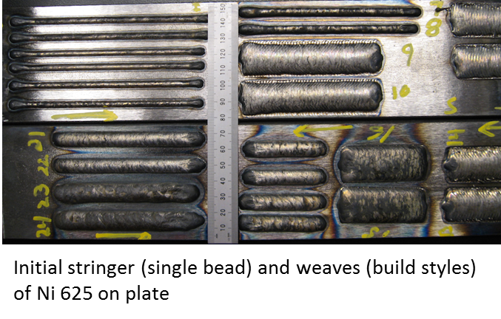
High Throughput Functional Material Deposition using a Laser Hot Wire Process
PROBLEM
APPROACH
Direct additive manufacturing of metal parts is limited by cost and availability of consumables, build times, and steep temporal and spatial thermal gradients compromising metallurgical/microstructural control.
Assess, demonstrate, and benchmark laser-assisted, wire-based additive process developed by Lincoln Electric Company
Model the effect of variation in process parameters on the structural and compositional heterogeneity and impact on efficiency of material usage
Integrated supply chain of materials / consumable suppliers, machine manufactures, process optimizers, workforce trainers, and product validators
OBJECTIVE
Establish the robustness and reliability of the Laser Hot Wire (LHW) process as a viable additive manufacturing (AM) technology that can be used in Heavy Fabrication, Aerospace and Energy sectors
BENEFITS
Performing Organization(s): CWRU
Start Date: May 2014
End Date: November 2015
Enable deposition rates of 20 lbs/hour with less than 10kW of laser power
IMPLEMENTATION
Team composed to address the whole supply chain (solution creation, product assessment, product acceptability)
Oil and Gas Sector: Nickel alloys as a cladding for caster rolls, chocks and housings that are subject to harsh environments and corrosion
Aerospace Sector: Titanium forgings for structural airframe components are driven by mechanical properties such as durability

Slide 46
Electron Beam Melted Ti64 AM
Demo and Allowables Development
PROBLEM
APPROACH
Widespread consideration of EBM additive manufacturing mandates a statistically significant set of materials design allowables
Leverage methodologies, building block approach and transition to production processes previously used in development and implementation of AM technologies at NGAS
OBJECTIVE
Develop B-Basis allowables for electron beam melted Ti-6Al-4V additive manufactured material.
Performing Organization(s): Northrop Grumman/GE Aviation/Concurrent Technologies/ Robert C. Byrd Institute
Start Date: September 2014
End Date: March 2016
BENEFITS
Utilization of structures produced from Ti64 made by additive manufacturing
IMPLEMENTATION
Northrop Grumman aerospace and spacecraft platforms

Slide 47
Refining AM Materials to Improve NDI
PROBLEM
APPROACH
Ultrasonic Inspection is difficult on EB-DED produced AM materials due to high attenuation. Radiography must be used which is more cost and time.
Produce samples using various processing parameters to study the microstructural effects.
Utilize simulation and modeling tools to investigate UT probe designs
OBJECTIVE
Improve the microstructure of EB-DED parts or the inspection techniques to make ultrasonic inspection possible.
Performing Organization(s): EWI / Lockheed / Sciaky
Start Date: March 2014
End Date: March 2015
BENEFITS
Reduced buy-to-fly ratio of F-35 components which leads to overall cost of the F-35 system
IMPLEMENTATION
Lockheed Martin Aerospace – F-35 Program

Slide 48
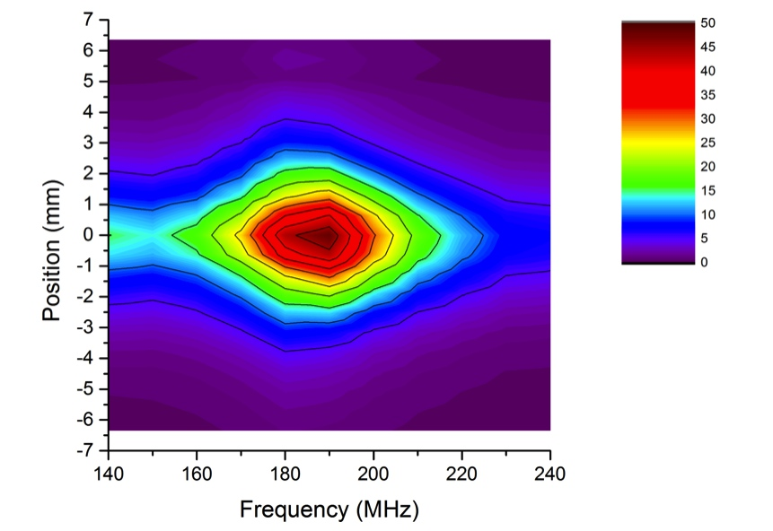
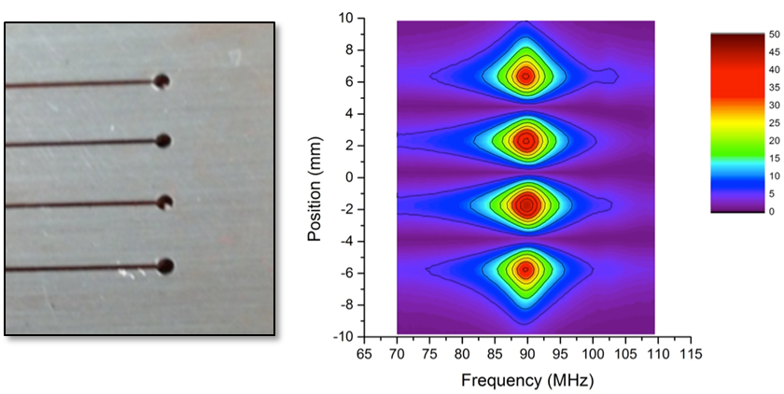
Optimization of Parallel Consolidation Method for Industrial AM
PROBLEM
APPROACH
Limitations in industrial advanced manufacturing printing (build speed and volume)
Micro-Induction Sintering (MIS): New 3D additive manufacturing
method and Powder consolidation using very high frequency, spatially compact magnetic fields
Parallel Consolidation: Many parallel consolidation points simultaneously acting on the powder bed
OBJECTIVE
Development of a next generation 3D printing method by consolidating powder at many points on a part simultaneously
Develop method for 10x or greater increase in typical AM build speeds to set the foundation for 100x – 1000x build speed increase
Performing Organization(s): Stony Creek Labs, Grid Logic
Start Date: May 2014
End Date: November 2015
BENEFITS
US (Stony Creek Labs) equipment and part provider
Advance Technology Set the foundation for significant build speed increase in AM technology
IMPLEMENTATION
Complex aluminum or aluminum alloy parts (6061 as pilot) with Raytheon Missile Systems
3D printer and part production
Strong transition funding approach (state, fed, and private)

Slide 49

Product Lifecycle Management
Partnered with Siemens
Includes TeamCenter and NX
Centralized Data Management
Strong Controls (ITAR, IP, etc.)
Traceability to Multiple Work Items to Ensure Pedigree

Slide 50



