Slide 1
2021 Additive Manufacturing Workshop Final Outbrief Education and Workforce Development Co Leads: Josh Cramer (josh.cramer@ncdmm.org) Michael Britt-Crane (michael.d.britt-crane.civ@mail.mil) Karla O’Conner (Karla.OConnor@dau.mil)

Slide 2
Education and Workforce Development
Objectives:
Instructor led training on the utilization of Additive MFG technologies in various manufacturing settings.
Participants will engage in an interactive training session exploring streamline the manufacturing process, improve product life cycles, and allow for mass customization, which can lead to improved profitability
Participants will work collaboratively and with a virtual coach to build business case scenarios specific to their roles, technologies, and facilities
Planned Deliverables:
Participants will build detailed action plans leading to business case scenarios to deploy within their roles/companies in successful integration of additive manufacturing

Slide 3
Education and Workforce Development
Accomplishments and Deliverables
Deployed a pilot of the “Optimizing for Additive MFG” Instructor Led Training
Mix of DoD (6), Industry (4), Academia (3) and Workforce Organizations (4)
Gathered feedback of the participants for full modification and amended full scale version deployment
Broad engagement of engineering/engineering techs/fabrication techs in the adoption and understanding of AM integration into traditional settings
Logistics – Supply Chain considerations “Just because you have a printer doesn’t mean you can start printing parts” – consideration for additional content
Safety considerations was more of a gap that initially thought
Disposal Chains was suggested as additional content as well
This opportunity highlighted that in AM we are still a very diverse group and that many of the folks engaged are part of the “club”

Slide 4
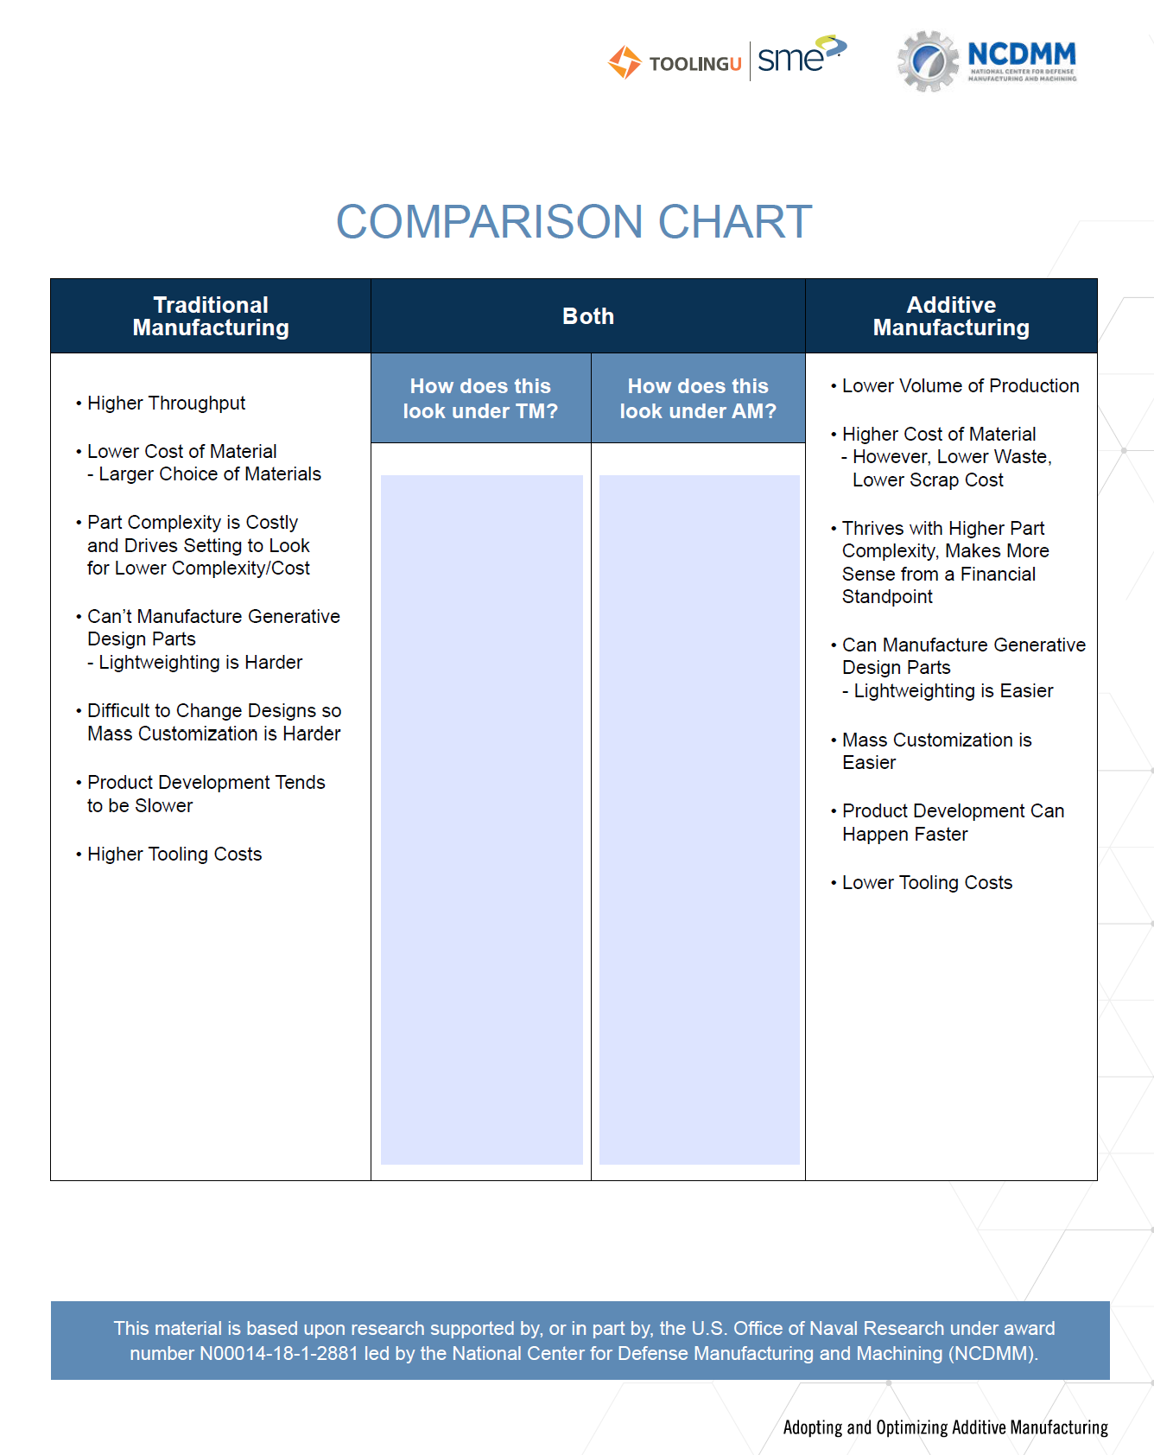
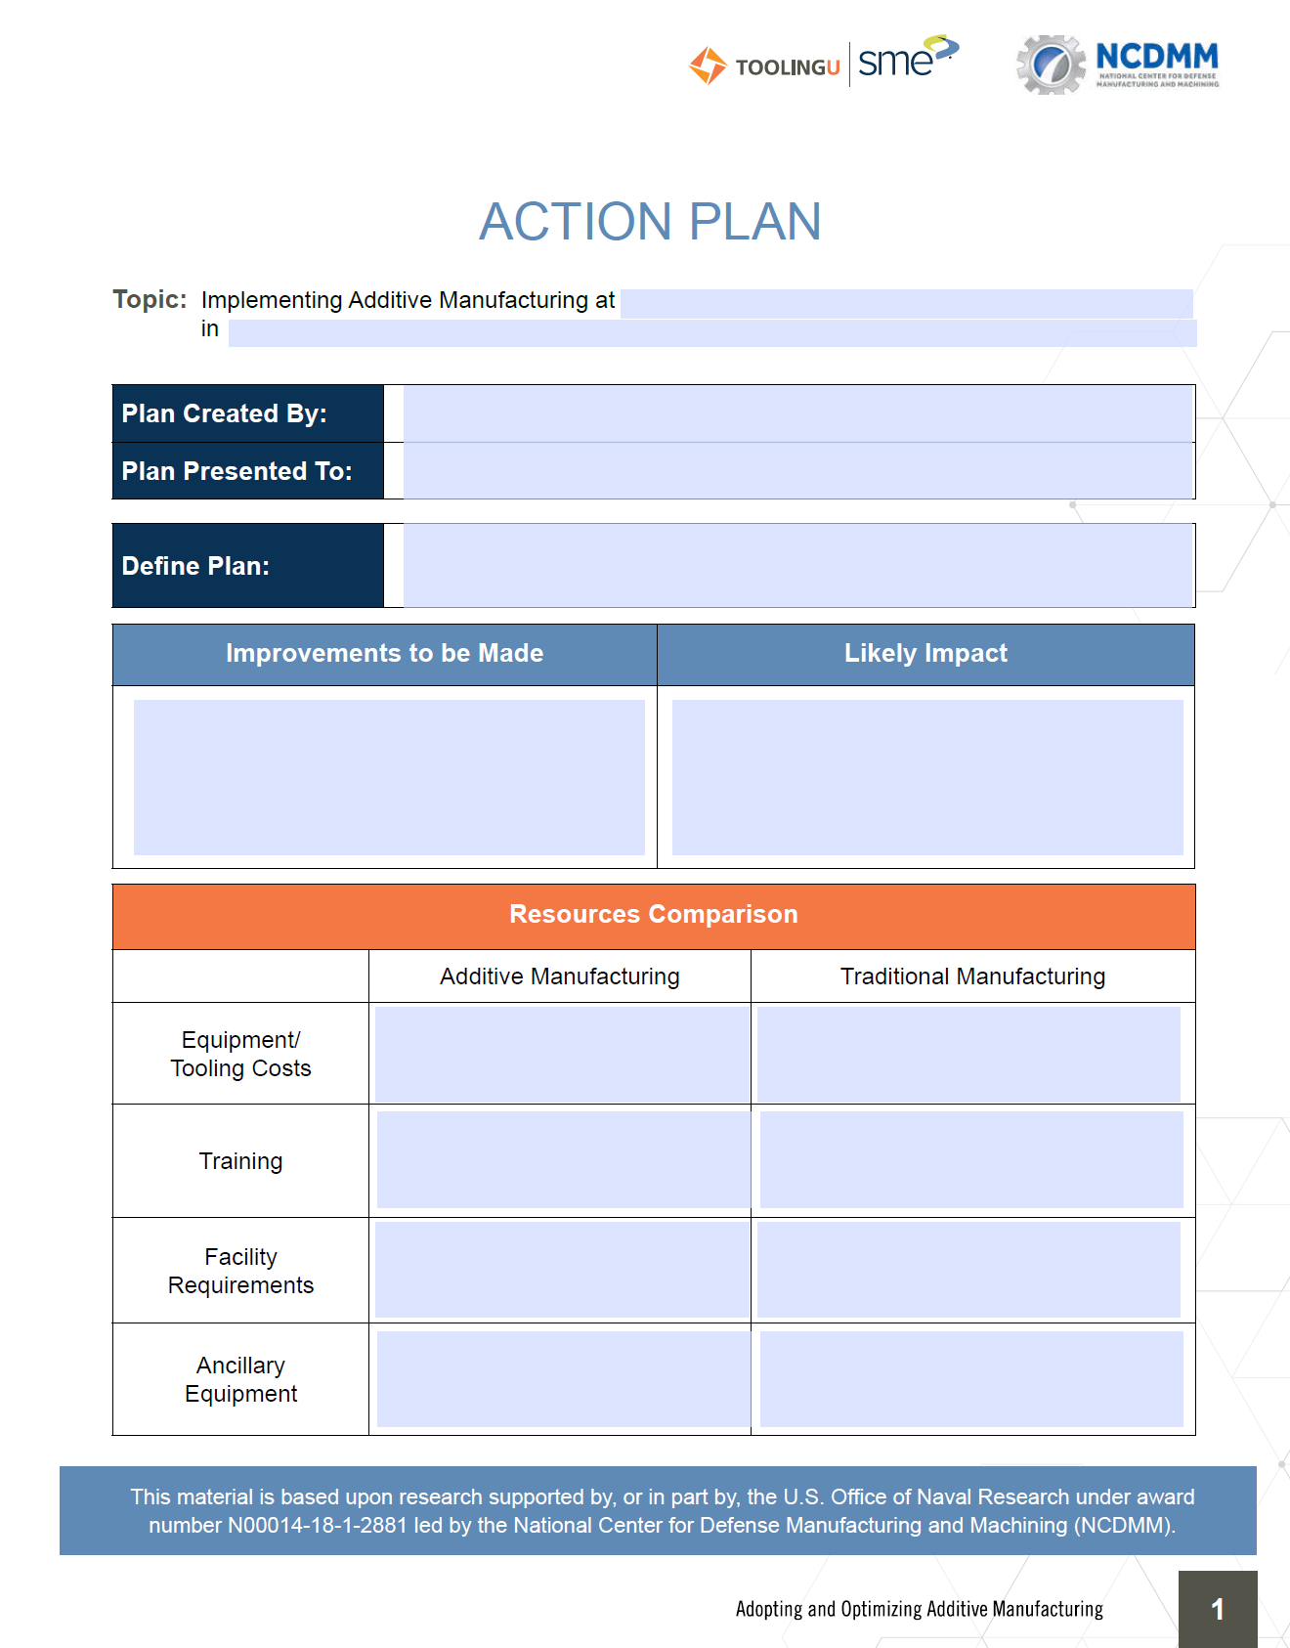
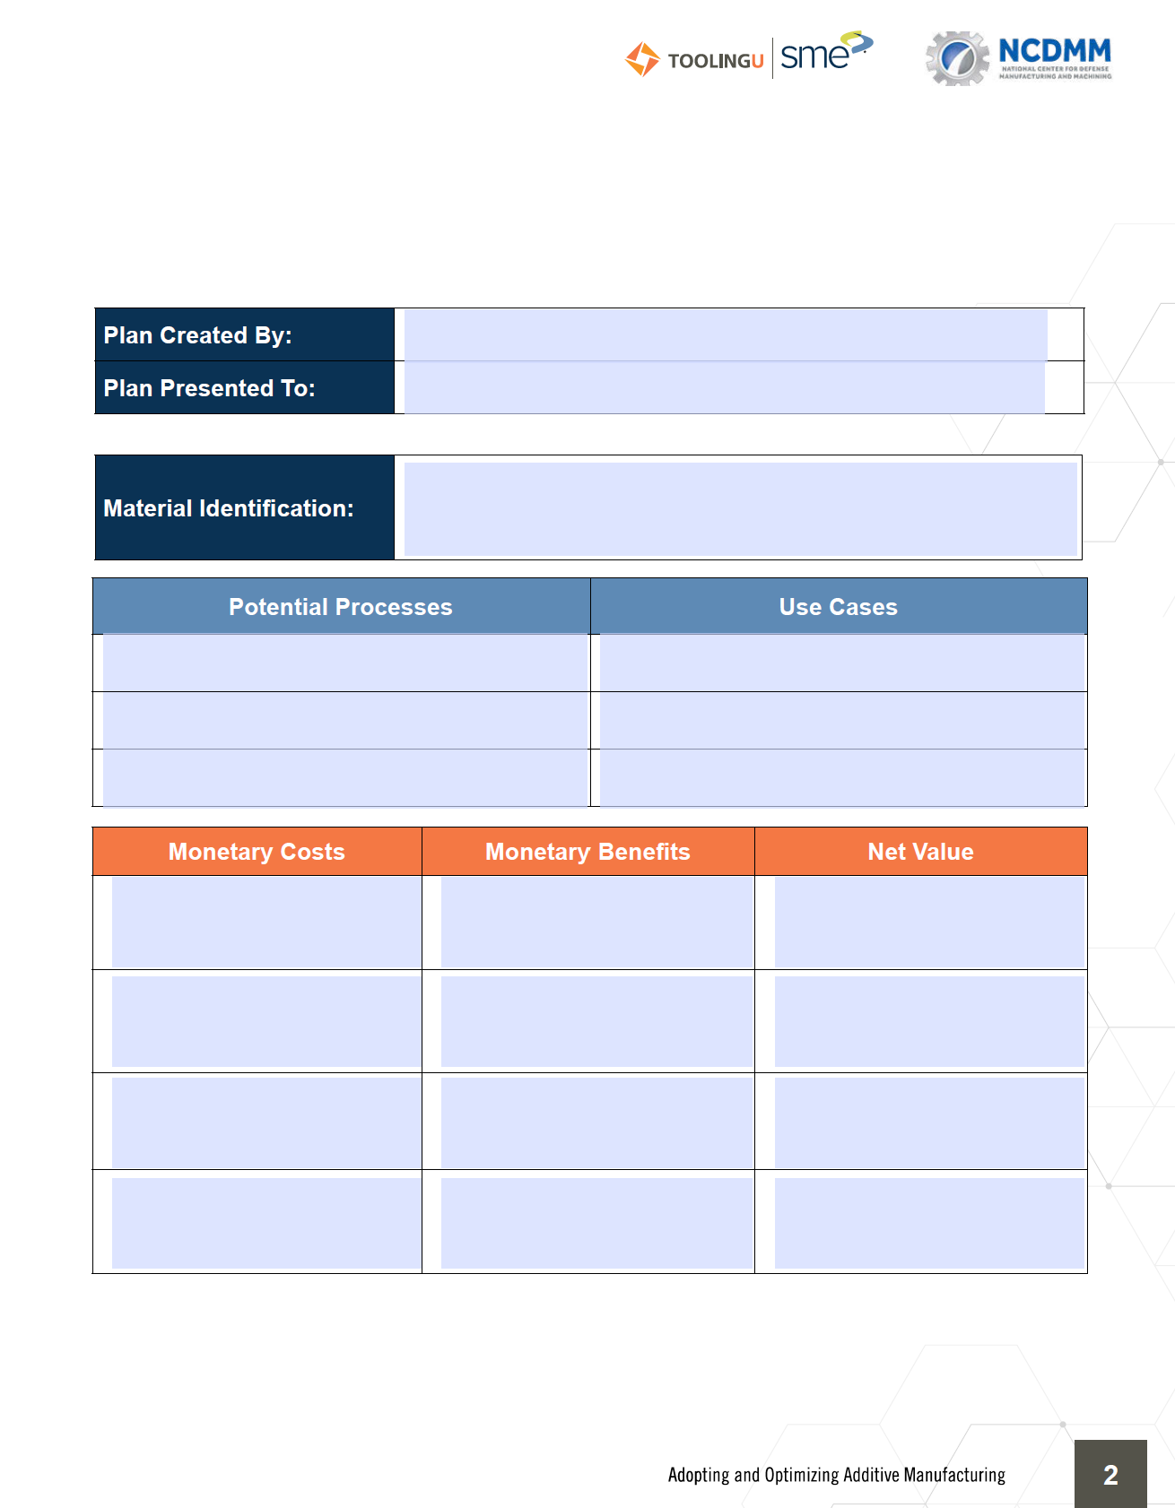
Working Group Name
Key Takeaways – Some snapshots…

Slide 5
Working Group Name
Recommendations and Next Steps:
Further engagement with core team subject matter experts to review and assess feedback
Deploy suggested amendments through continuous improvement for full scale deployment
The team would be open to working with interested groups in future deployments
Our next Instructor Led Training will be on “Managing a Digital MFG Facility” – reach out to engage

Slide 6
Working Group Name
Questions?

