Slide 1
2021 Additive Manufacturing Workshop Final Outbrief AM Decision Making: AM Business Case Co Leads: Stephen Kuhn-Hendricks, PhD (stephen.kuhn-hendric@navy.mil) William Peterson (william.t.peterson2@navy.mil) Ernesto Ureta (ernesto.ureta@navy.mil) Timothy Vorakoumane (timothy.vorakoumane@navy.mil)

Slide 2
AM Decision Making: AM Business Case
Objectives:
Define equations of the AM business case
Identify business data opportunities and challenges
Address the influence of AM use cases on the business case
Planned Deliverables:
Draft business case equations
Mathematical frameworks for objective evaluation of business case

Slide 3
AM Decision Making: AM Business Case
Governing Equation
$$A_{CC}=C_{TR}−C_{AM} ≥0$$
Traditional Manufacturing
$$C_{TR}=C_{Start−Up}^{\left(TR\right)}+C_{Purchase}^{\left(TR\right)}+C_{Shipping}^{\left(TR\right)}+C_{Storage}^{\left(TR\right)}+C_{Contracting}^{\left(TR\right)}+C_{Readiness}^{\left(TR\right)}$$
Additive Manufacturing
$$C_{AM}=C_{NRE}^{(AM)}+C_{Production}^{\left(AM\right)}+C_{Shipping}^{\left(AM\right)}+C_{Storage}^{\left(AM\right)}+C_{Contracting}^{\left(AM\right)}+C_{Readiness}^{\left(AM\right)}$$

Slide 4
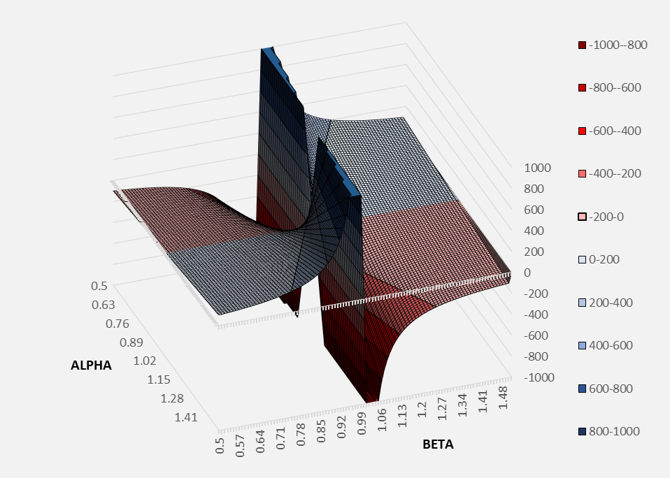
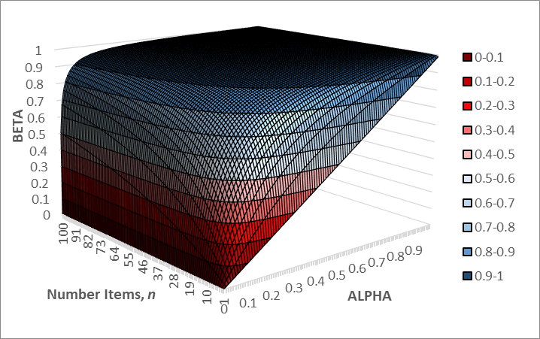
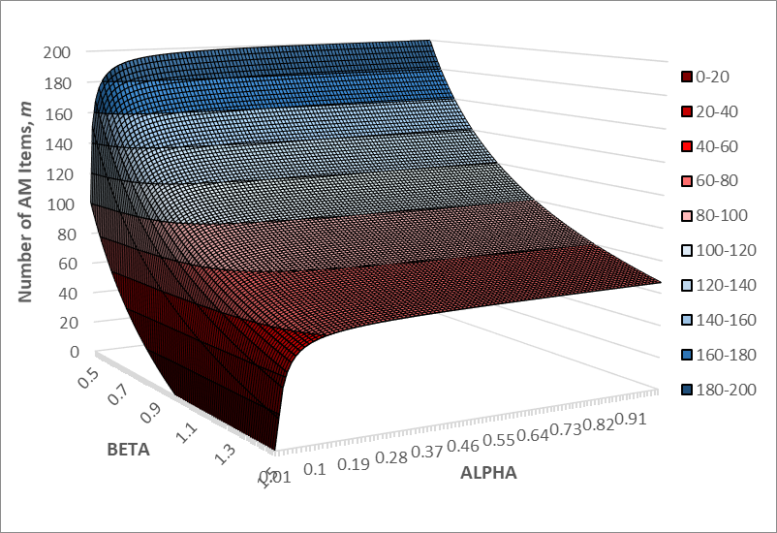
AM Decision Making: AM Business Case
Part Costs Only
Non-Zero Start-Up, AM NRE, Equal Quantity
$$n=\frac{c_{start}−αc_{start}}{βc_{p}−c_{p}}$$
$n$: number of parts
$α$: ratio of start-up to AM NRE
$β$: ratio of per part cost trad. and AM
Zero Start-Up, AM NRE, Equal Quantity
$$\frac{β}{α(1−β)}−\frac{β}{1−β}=n$$
$n$: number of parts
$$β<\frac{nα}{1+nα−α}$$
$α$: 1-%AM NRE
$β$: ratio of per part cost trad. and AM
Zero Start-Up, AM NRE, Unequal Quantity
$$1−\frac{1}{α}+\frac{1}{β}n=m$$
$n$: number of trad. parts
$m$: number of AM parts
$α$: 1-%AM NRE
$β$: ratio of per part cost trad. and AM

Slide 5
AM Decision Making: AM Business Case
Cost Time Trade-Off
Derivation from Governing Equation
$$C_{TR}−C_{AM} ≥0$$
$$C_{Start−Up}^{\left(TR\right)}+C_{Purchase}^{\left(TR\right)}+C_{Readiness}^{\left(TR\right)}−C_{NRE}^{\left(AM\right)}−C_{Production}^{\left(AM\right)}−C_{Readiness}^{\left(AM\right)}≥0$$
$C_{Start−Up}^{\left(TR\right)}+C_{Purchase}^{\left(TR\right)}+τ\left(T^{(TR)}−T^{(AM)}\right)≥C_{NRE}^{\left(AM\right)}$+$C_{Production}^{\left(AM\right)}$
Implementation Equation
$$\frac{1}{dσ}\left[βc_{t}\left(\frac{1+nα−α}{α}\right)−c_{t}n\right]≤τ$$
$n$: number of parts
$α$: 1-%AM NRE
$β$: ratio of per part cost trad. and AM
$d$: number of days saved per order
$σ$: number of orders
$τ$ is the cost in dollars per day that the DoD is willing to pay save time with an AM solution

Slide 6
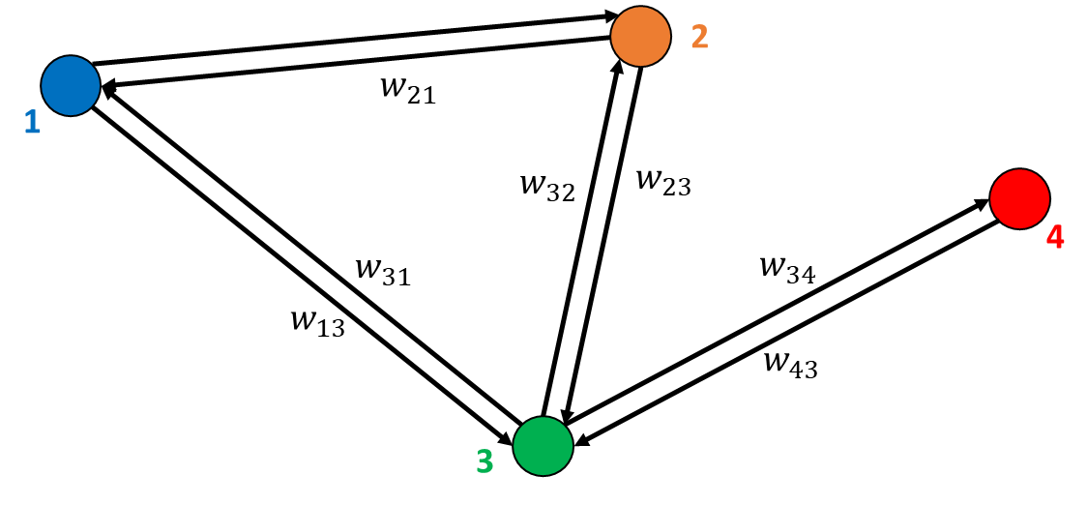
AM Decision Making: AM Business Case
Shipping
$$W_{ij}=D_{ij}⨀Ψ_{ij}+Q_{ij}$$
$D_{ij}$: distance matrix
$Ψ_{ij}$: travel rate matrix
$$C_{ij}={mR_{ij}⨀D}_{ij}⨀Ψ_{ij}$$
$Q_{ij}$: Queue time matrix
$R_{ij}$: Cost rate matrix
Storage
$r$: Cost rate
$$A_{Storage}=rt\left\lceil \frac{np_{v}}{C_{V}}\right\rceil −rt\left\lceil \frac{mp_{v}}{C_{V}}\right\rceil$$
$t$: Storage time
$p_{v}$: Part volume
$C_{v}$: Cube volume
$n,m$: Number of trad., AM parts
Contracting
$$C_{Contracting}=\sum_{i=1}^{n}{r_{i}t_{i}}$$
$r$: Labor rate
$t$: Contracting time

Slide 7
AM Decision Making: AM Business Case
Potential Use Cases for AM
New AM Designs
Rapid Prototyping
Obsolescence
Part performance
Entirely replace the traditional part supply with AM supply
Lifecycle economics/value
Supplement supply chain for traditional part with AM supply
Hybrid (integration with supply chain logic)
AM lead time replacements
Operational/expeditionary

Slide 8
AM Decision Making: AM Business Case
Recommendations and Next Steps:
White paper of overarching AM business case equations and analysis
DoD to decide on overarching business goals for AM
Standardize lower level equations (e.g. how to calculate AM cost, how to estimate costs) across DoD
Standardize and require in policy the collection of data necessary to evaluate the AM business case across the DoD

Slide 9
AM Decision Making: AM Business Case
Questions?

