Slide 1
3Degrees
Implementing winning 3D Printing Solutions through practical insights and materials expertise
Mike Vasquez, PhD
mike@3degreescompany.com

Slide 2
Helping the world’s top manufacturers develop solutions, materials and strategies
TraceAM
A Company
AMx
A Non-Profit

Slide 3
Founded in 2012 in Chicago, IL
Independent, technology-agnostic 3D Printing and Materials Science consulting company.
Partner to 3D Printing end users, original equipment manufactures (OEMS), and material suppliers helping them implement winning 3D Printing Solutions through practical insights and materials expertise.
Host of 3Degrees Discussions Podcast a weekly podcast where we speak with the innovators, entrepreneurs, and leaders in the 3D Printing industry. Currently the show has 75 episodes including interviews from leaders at NASA, Ford and Boeing
Economics and Strategy
Materials and Systems
Expertise
Production Qualification
Workforce Development & Training

Slide 4
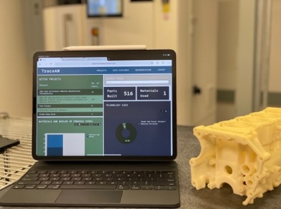
TraceAM
Smart and effective technical data management for 3D Printing
3D Printing technical data has become unmanageable due to the quantity, speed, and variety of information coming through the AM workflow.
Research, production improvements and technology adoption are limited by disparate data sources, little coordination, no reproducibility
Centralizing the collection and storage of this data improves data reliability and frees up engineers time for higher impact activities
We want to enable rapid qualification for small and medium sized companies

Slide 5
TraceAM tracks hundreds of manufacturing variables every time a part is made with step by step directions and analysis tools.
Project/Customer Information
Project Name, Lead Investigator, Organizations, Completion Date, Final Report, Project Number
Build Information
File and Design Information, Materials Feedstock, Process Details, Post-Process, Inspection
Part Information
Process Parameters, Non-Destructive and Destructive Testing
Notes:
Replacing hu

Slide 6
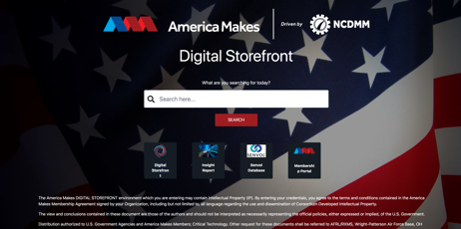
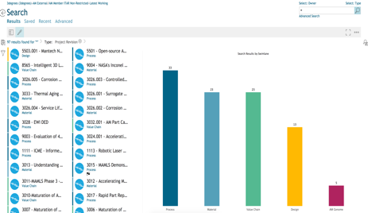
TraceAM for America Makes
Problem Statement:
Currently, when users log into the America Makes Digital Storefront they see a text-heavy dashboard listing historical projects, with project data is stored in a variety of formats (e.g., Word, Excel, PDF). Although this is perfectly suitable for accessing certain types of data (e.g., project final reports, TRX PPT presentations), it makes it difficult for a member to see comparative data or trend analysis.
Objectives:
We proposed to build a functional database utilizing 3Degrees’ TraceAM software, which is specifically designed to collate 3D Printing data according to the workflows of the 3D Printing process
Team:
Notes:
12 billion dollar industry
The covid pandemic shed a bright light on the challenges that the American supply chain faces. Technologies like 3D Printing are a promising track for US manufactures to bring high tech products back. But at the moment, the machines are only part of the solution, our product Trace will provide a foundation for manufactures of all sizes be more competitive in a wide range of critical industries.
Entrepreneurship opportunity in the 3D Printing space – won’t be an industry that requires a four year degree. We’re putting our money where our mouth is and running this summer program

Slide 7
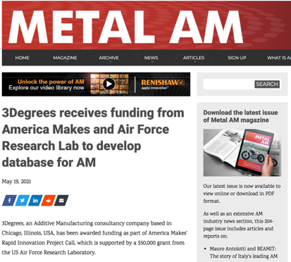
Multiple use cases and customers including research, data warehousing, and technical data package dissemination
TraceAM already has thousands of 3D Printing data points in the system
Notes:
Building out clients in government, commercial, and academic sectors

Slide 8
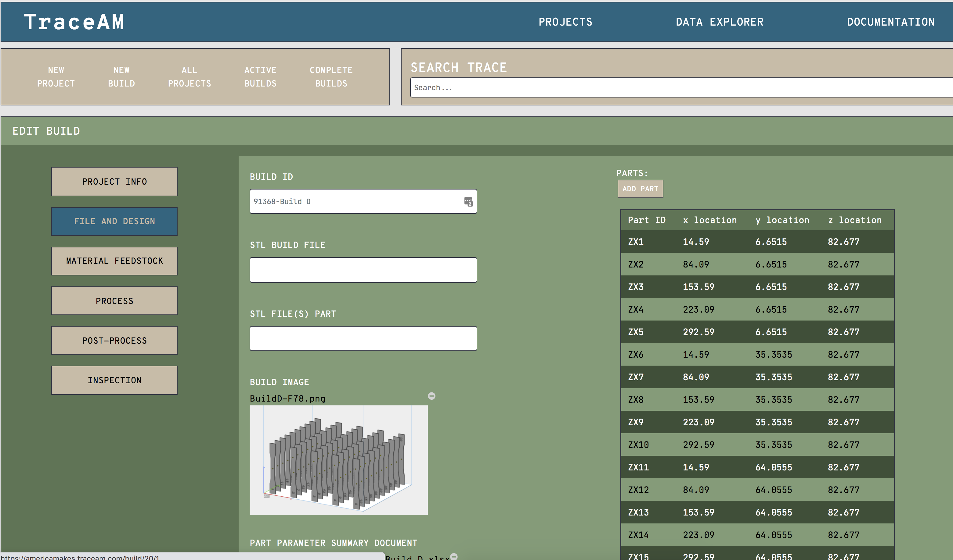
Ongoing Activities
Partners on multiple America Makes projects ranging on material allowables and characterizing the mechanical properties of lattice structures
Pending SBIR Direct to Phase II with AFWERX
Engaged with the Common Data Model Working Group
Members of the SAE Additive Manufacturing Data Consortium
Notes:
Building out clients in government, commercial, and academic sectors

Slide 9
Contact
Mike Vasquez, PhD
Email: mike@3degreescompany.com
Phone: +1.651.503.9085
Website: www.3Degreescompany.com
Trace: www.traceam.com

Slide 10
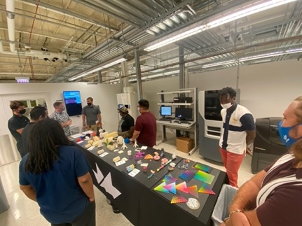
AMx
Advanced Manufacturing Experience
Closing the workforce gap in 3D Printing
Practical skills and advanced content for Advanced Manufacturing in underserved areas
Training, mentorship, and funding through a 4-week intensive additive training program, students will gain a comprehensive understanding of machine operation, build prep, post processing, software, and more.
Cohort 1 focused on the West Side of Chicago in 2021

