Slide 1
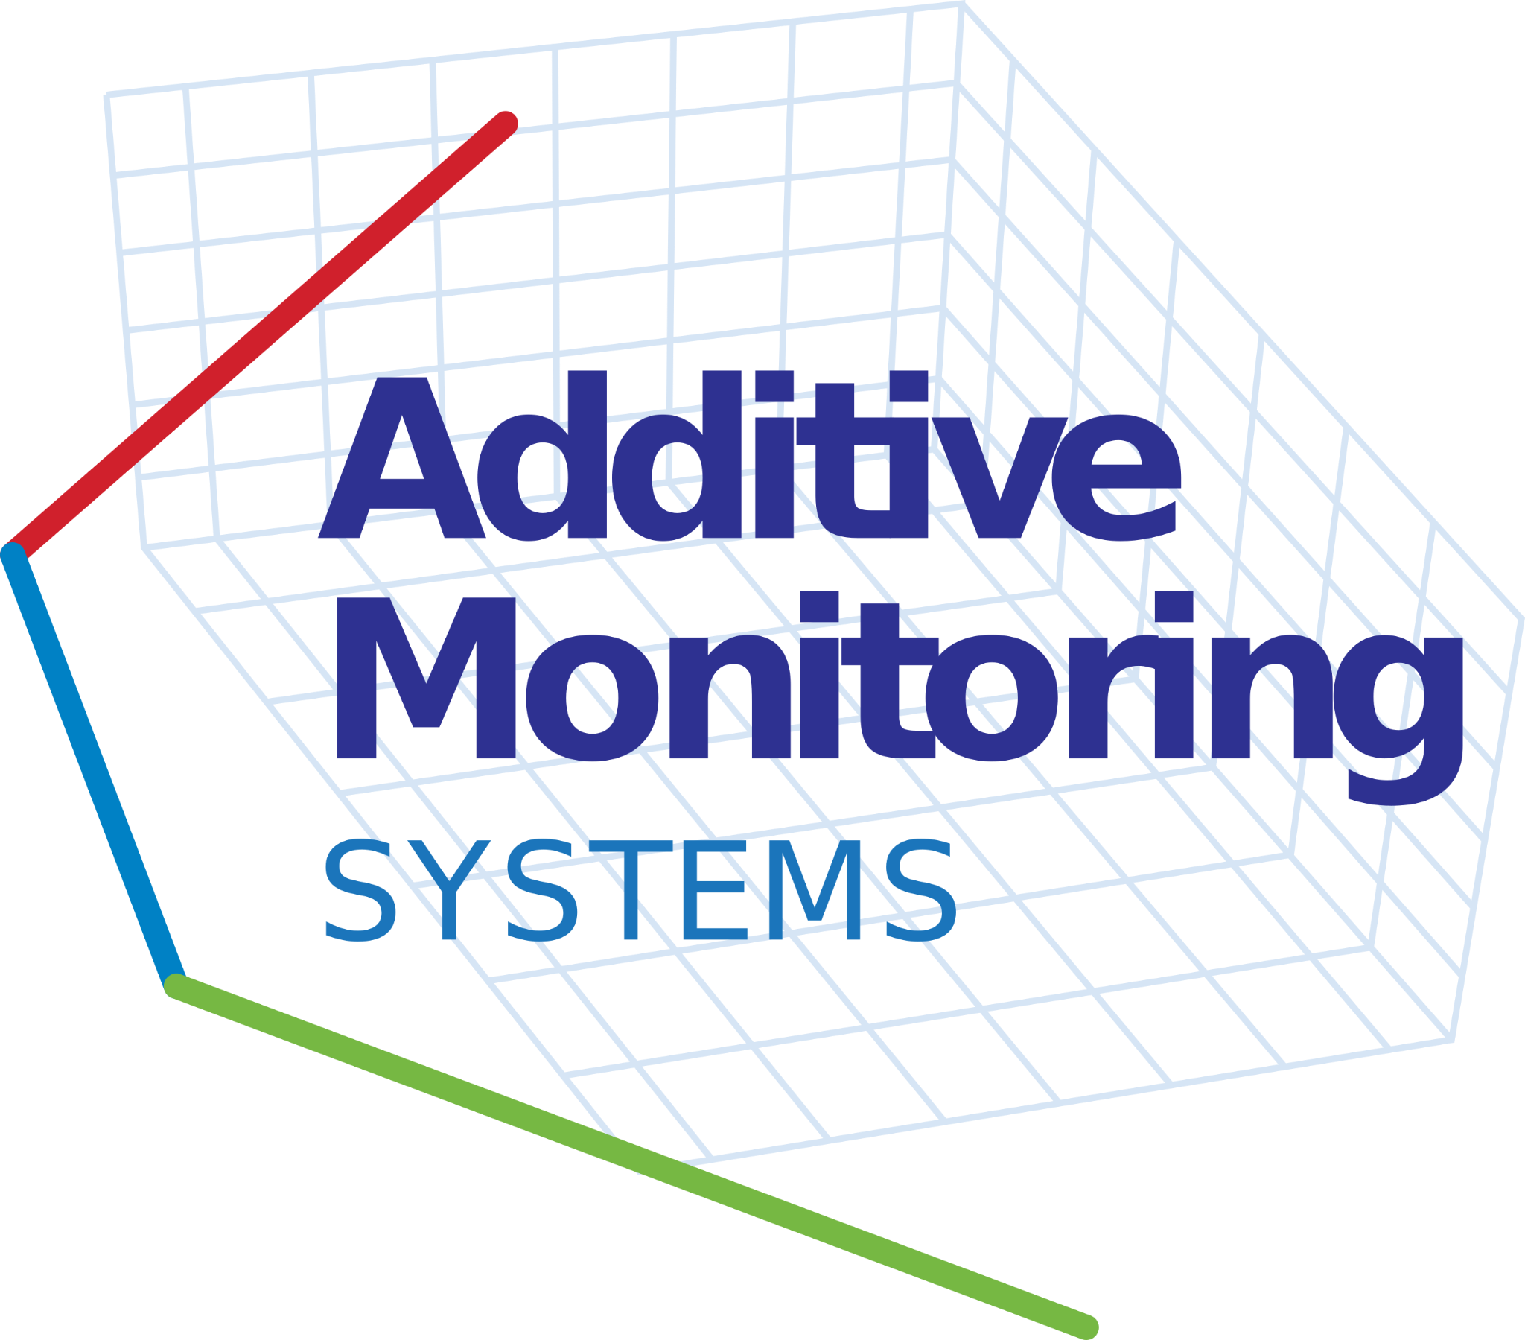
Additive Monitoring Systems Niall O’Dowd, Founder & CEO
2-year funded clean-tech startup runway

Slide 2
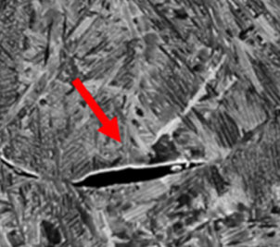
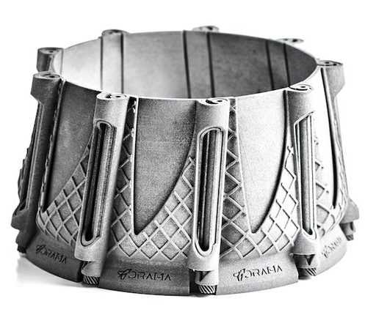
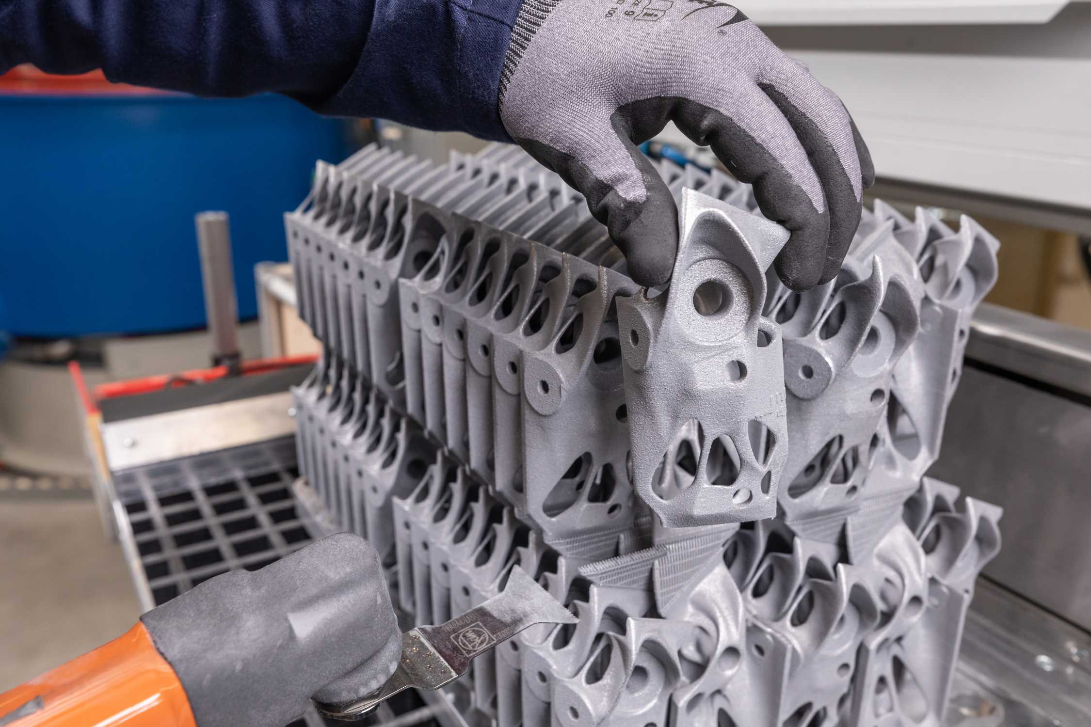
Problem: Astronomical cost of part rejection
Industry: Industrial 3-D printing (Add. Mfg.)
Solid Layer
Industry scrap rate: 15% - 35%
Part reliability issues
Post-inspection failure
Lack of process control
No standardized process qualification
Find defects month+ after parts printed
$180M+/year in wasted energy & material (US)
Thousands of hours of lost part lead time for every production facility
Powder Bed
Porosity
[1]
[2]

Slide 3
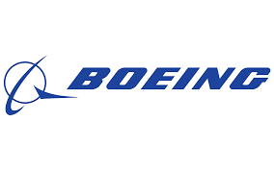
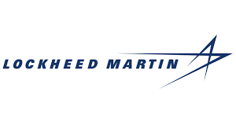
Defined by Private Companies
Concept and Significance of Problem/Opportunity
Problem definition (iterated from 160+ customer interviews):
Unanimous: Lost lead time is AM’s biggest pain
Major defense contractors & part shops struggle with AM part quality
Multiple customer interviews with each customer
“Part quality reliability is the primary pain while using additive in-house; we scrap over 20% of parts”
-Honeywell

Slide 4
Defined by Private Companies
Concept and Significance of Problem/Opportunity
Problem definition (iterated from 160+ customer interviews):
Unanimous: Lost lead time is AM’s biggest pain
Multiple customer interviews with each customer
“Part quality reliability is the primary pain while using additive in-house; we scrap over 20% of parts”
-Honeywell
DoD customers
Concept and Significance of Problem/Opportunity
Air Force Research Lab March 2021: Invests $7M in AM process monitoring “expected to save the air force millions of dollars in qualification and certification” [1]
Rapid Sustainment Office October 2020: RSO holds AM Olympics, US innovation to deploy solutions, invests $1M including process control techniques

Slide 5
Defined by Private Companies
Concept and Significance of Problem/Opportunity
Problem definition (iterated from 160+ customer interviews):
Unanimous: Lost lead time is AM’s biggest pain
Multiple customer interviews with each customer
“Part quality reliability is the primary pain while using additive in-house; we scrap over 20% of parts”
-Honeywell
DoD customers
Concept and Significance of Problem/Opportunity
Air Force Research Lab March 2021: Invests $7M in AM process monitoring “expected to save the air force millions of dollars in qualification and certification” [1]
Rapid Sustainment Office October 2020: RSO holds AM Olympics, US innovation to deploy solutions, invests $1M including process control techniques
Primary impact on part lead time?
Out-of-house post-build inspection (x-ray, CT, density, visual)

Slide 6
Solution: Find Defects Earlier
Proprietary! Patent Pending
Novel In-Process Monitoring System
PhD research funded by Los Alamos Lab & UCSD
Instantly notify technicians of defect
Eliminate post inspection
Reduce lost lead time, factor of 3
Patented measurement model (2020)
Quantified accuracy of each measured point
Provisonally patented hardware and software (2021)
Optimal operational mode (trade-secret)
Camera
Projector
processor
+ UI/UX
z
Powder bed fusion, binder jetting, SLS polymer, Multi-jet fusion

Slide 7
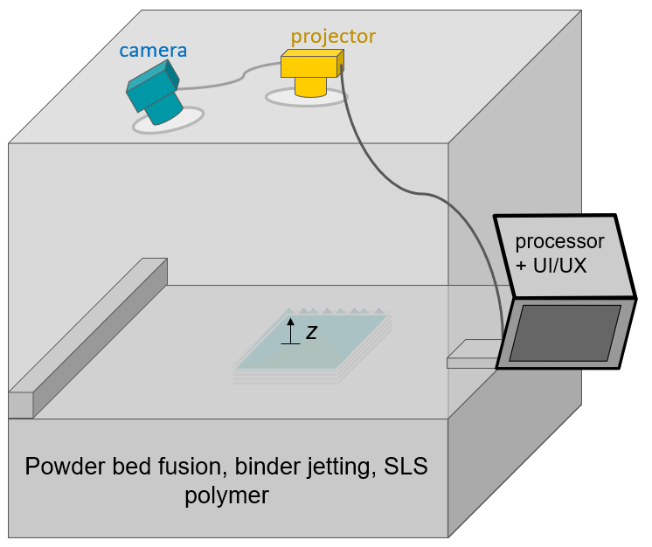
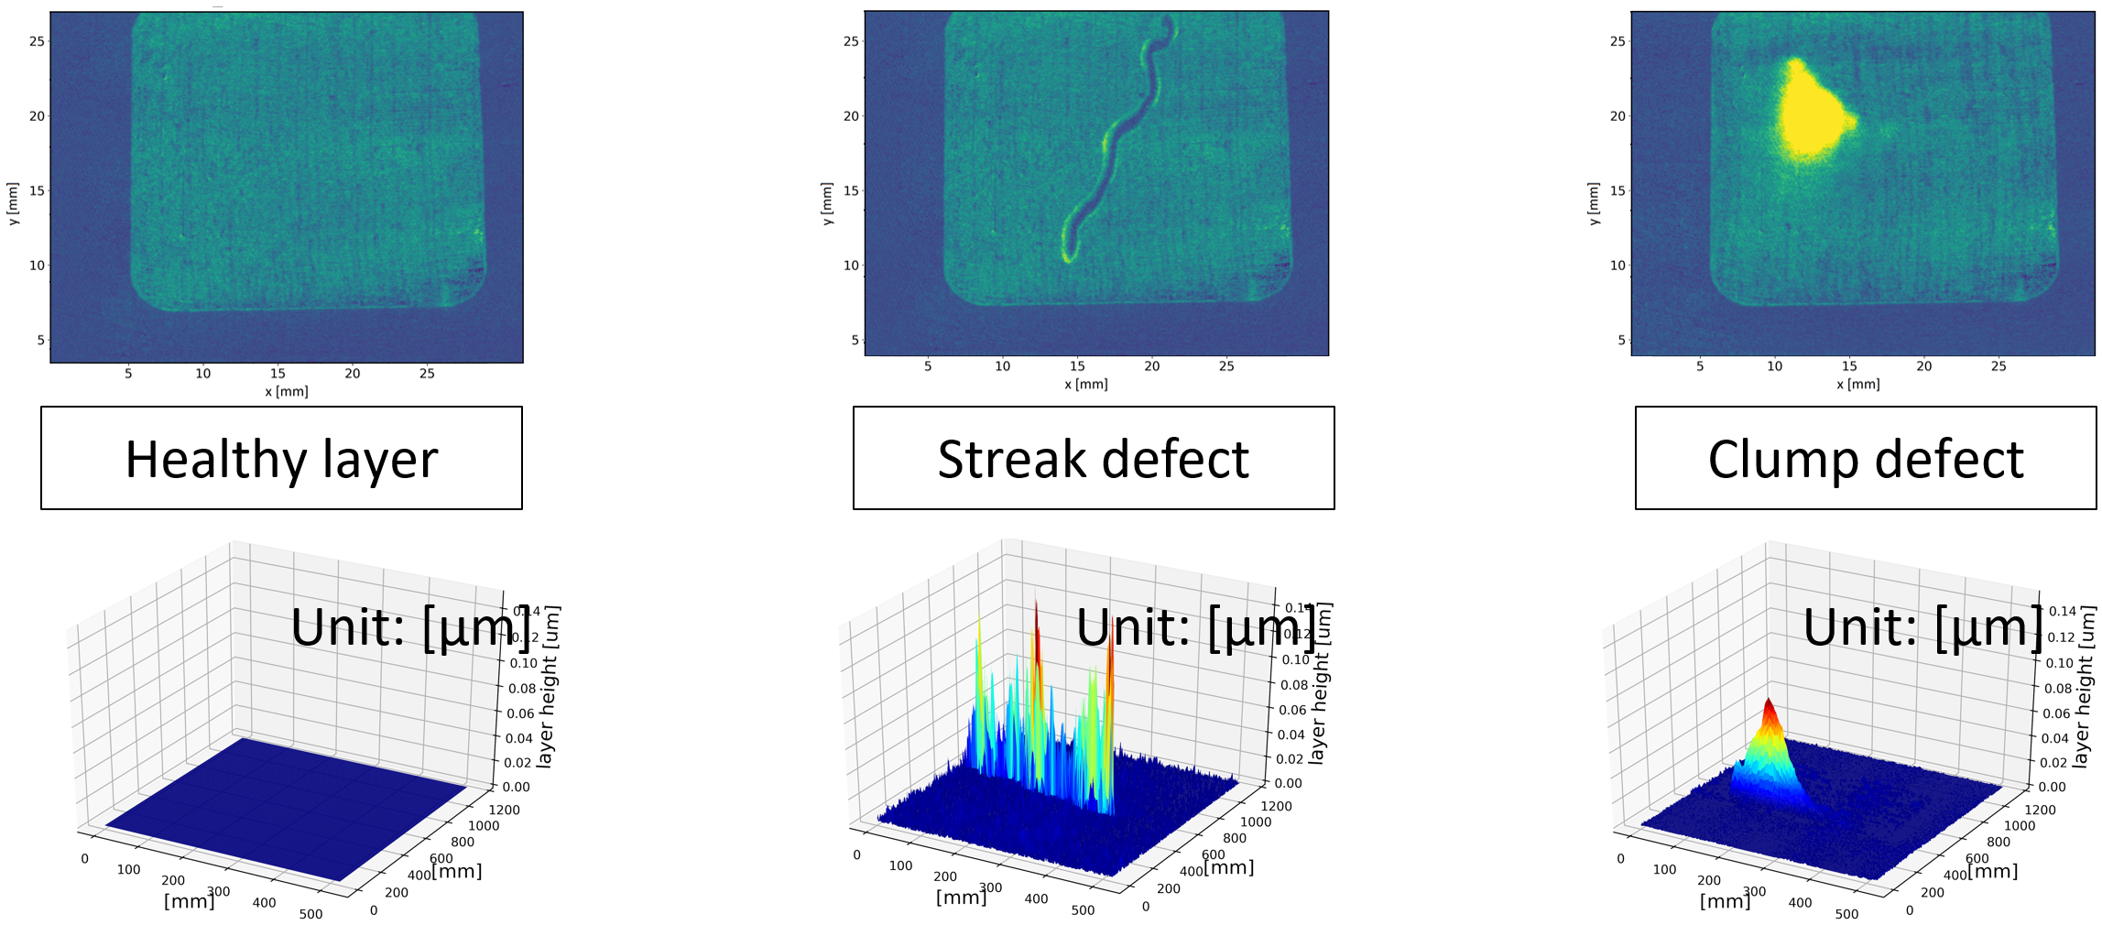
Overview: Layer-wise height monitoring
Real-time monitoring: Full-field height of powder + sintered layer
illumination + Camera + processor
Proprietary! Patent Pending
2. More technical details
Resolution
Modular spatial density: demonstrated (40 µm pixel patch spacing)
Demonstrated 20µm $\hat{z}$ resolution
Decision Speed
No time variable dependence
Each heightmap is <5 megabytes
Low Cost
Visible light camera
+
Objective Measurement
Quantified uncertainty
No AI training data
Light source agnostic (no shadow analysis)
Material Agnostic
Geometrical features
Features show multiple failure mechanisms
Patented Hardware + Software
Statistical analysis (2020)
Hardware/methods (in-progress 2021)
Discussion and materials protected do not disseminate
Notes:
Sigma is spot size
V is velocity
P is laser power

Slide 8
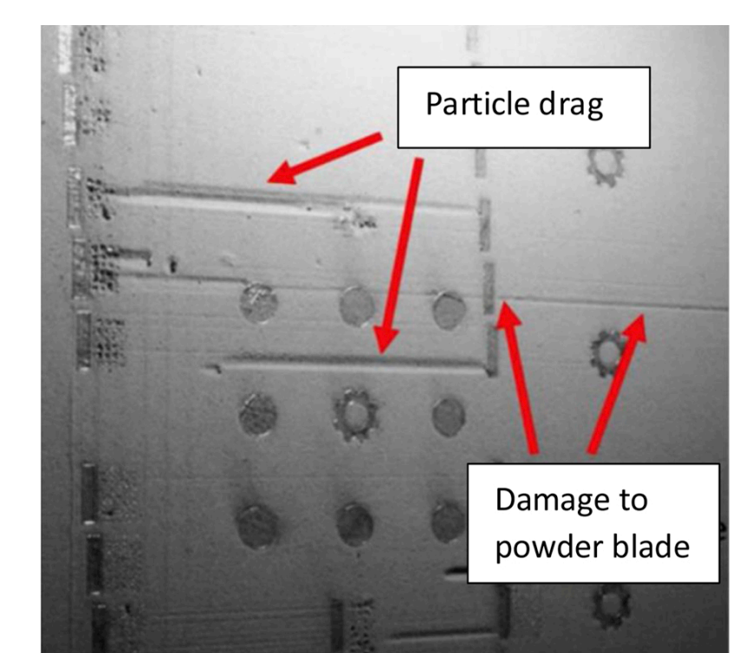
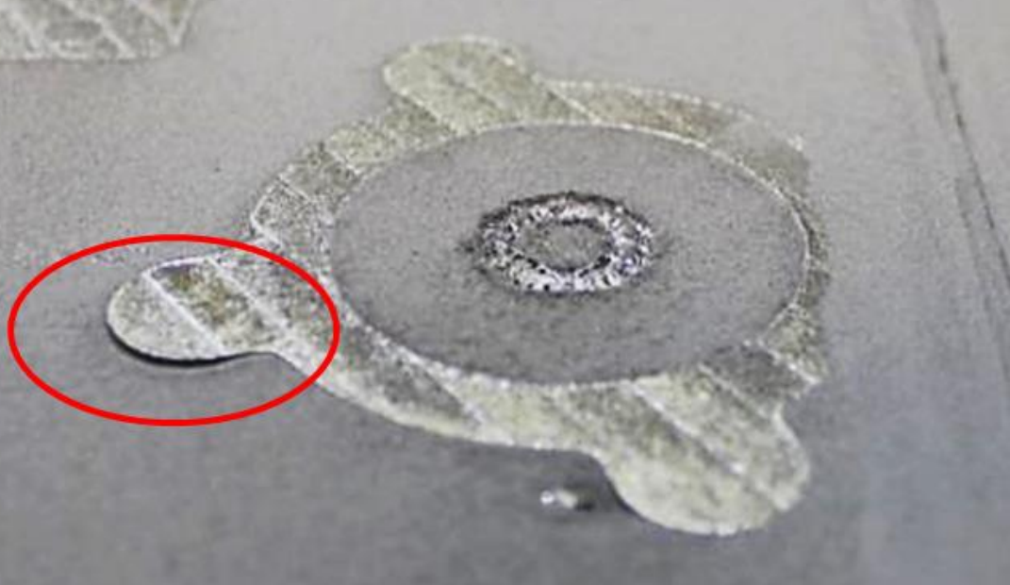
Part Quality Sensitive to Layer Height
Layer heights indicative of multiple defect mechanisms
Powder recoat layer height
Powder short feed[1]
Particle drag
Damage to recoater blade [2]
Essential to ensure part quality [3] [4]
Sintered layer height
Support structure failure
Lack of fusion defects [5]
Over melting [6]
Build plate skew
Hatching errors
Thermal swelling
[2]
Powder bed defects
[4]
Discussion and materials protected do not disseminate

Slide 9
Value Proposition
Save Lead Time
Save Cost
24-168 build time
$100-$500 / kg
powder cost
Immediately alerting technicians of defect
Reducing 75% of wasted time and cost of failed build
Customers:
AM contract manufacturers
In-house AM production
AM printer OEM

Slide 10
Value Proposition
Save Lead Time
Save Cost
Faster AM parameter Development
24-168 build time
$100-$500 / kg
powder cost
1000s of parameters
Immediately alerting technicians of defect
Reducing 75% of wasted time and cost of failed build
Provide real-time data: defects, powder, thickness
Customers:
AM contract manufacturers
In-house AM production
AM printer OEM
National & Fed Labs
Commercial AM Labs

Slide 11
Competitive Matrix
 | Additive Monitoring Systems | Image only (industry standard) | Image + neural network (Addiguru) | Melt-pool analysis (SigmaLabs) | Laser profilometry
Current layer decisions | ✔️ | ❌ | ✔️ | ✔️ | ✔️
Speed Requirement | ✔️ | ✔️ | ✔️ | ❌ | ❌
Full Field (whole design area) | ✔️ | ✔️ | ✔️ | ❌ | ❌
Real units | ✔️ | ❌ | ❌ | ❌ | ❌
Quantified uncertainty | ✔️ | ❌ | ❌ | ✔️ | ✔️
Robust to lighting & part geometry | ✔️ | ❌ | ❌ | ✔️ | ✔️

Slide 12
Current Funding Status
Awarded: $815,000
(non-dilutive)
Chain Reaction Innovation: $750,000
R&D: $220,000
Salaries: $176,000
Customer Discovery: $30,000
Administrative support and facility access $223,000
NSF National i-corps: $50,000
R&D: $5,000
Salaries: $35,000
Customer Discovery: $10,000
NSF SBIR Phase 0: $15,000
Customer Discovery: $15,000

Slide 13
Current Funding Status
Awarded: $815,000
(non-dilutive)
Pending: $50,000
(non-dilutive)
Chain Reaction Innovation: $750,000
R&D: $220,000
Salaries: $176,000
Customer Discovery: $30,000
Administrative support and facility access $223,000
NSF SBIR phase 1: $256,000
Application In-process: $429,000
(non-dilutive)
NSF National i-corps: $50,000
R&D: $5,000
Salaries: $35,000
Customer Discovery: $10,000
DoD AFWERX Phase 2: $800,000
NSF SBIR Phase 0: $15,000
Customer Discovery: $15,000

Slide 14
Market Traction
Verbal SOWs from Each Customer Segment!
3-D Printer manufacturer
Need dimensional monitoring systems
SOW negotiation

Slide 15
Market Traction
Verbal SOWs from Each Customer Segment!
3-D Printer manufacturer
Need dimensional monitoring systems
SOW negotiation
Aerospace Service Bureau
Improve part lead time
Provide dimensional certification
Anticipated SOW

Slide 16
Market Traction
Verbal SOWs from Each Customer Segment!
3-D Printer manufacturer
Need dimensional monitoring systems
SOW negotiation
Argonne National Lab
Oakridge National Lab
Lawrence Livermore Lab
Los Alamos National Lab
Faster material development with monitoring data
Currently embedded
Aerospace Service Bureaus
Improve part lead time
Provide dimensional certification
Anticipated SOW

Slide 17
Market Traction
Verbal SOWs from Each Customer Segment!
3-D Printer manufacturer
Need dimensional monitoring systems
SOW negotiation
Argonne National Lab
Oakridge National Lab
Lawrence Livermore Lab
Los Alamos National Lab
Faster material development with monitoring data
Currently embedded
Aerospace Service Bureaus
Improve part lead time
Provide dimensional certification
Anticipated SOW
AM Sensor Company
Our data synergizes with current systems
SOW negotiation

Slide 18
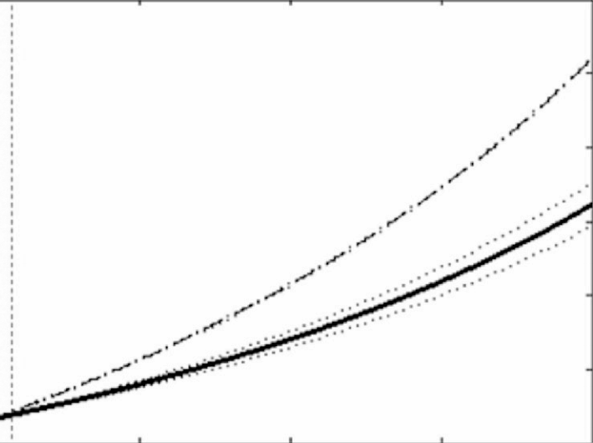
Monitoring System Impact
Value Prop 1: Improve Part Lead Time
Value Prop 2: Reduce Material and Energy[1]
$1600 -
$1400 -
$1200 -
$1000 -
“as is” part production
15% savings per part with monitoring system
+
Production Part Cost
0 .1 .2 .3 .4
Scrap rate
common scrap rate
Common scrap rate
At 30% scrap rate, increase profit by 35%
Equates to net savings of $350K/year/printer*
*@$500/hr, 50% duty

Slide 19
Monitoring System Impact
Value Prop 1: Improve Part Lead Time
Value Prop 2: Reduce Material and Energy[1]
$1600 -
$1400 -
$1200 -
$1000 -
“as is” part production
15% savings per part with monitoring system
+
Production Part Cost
0 .1 .2 .3 .4
Scrap rate
common scrap rate
Common scrap rate
At 30% scrap rate, increase profit by 35%
Equates to net savings of $350K/year/printer*
Subsciption Business Model: $5K - $10K/month system
Includes: installation, support, upgrades
*@$500/hr, 50% duty

Slide 20
Asks: 1. Intros to AM staff @ USAF Depots, Offices (Tinker, Porter Robinson, Hill) 2. Intros to AM nuclear component production (Westinghouse, GE, ?)

Slide 21
ASK 1: Introductions to End-Users in USAF
Our AFWERX SBIR requires End-User Memorandum
We need zoom calls with Tinker, Porter Robinson, and Hill Depots
$1.25M grant towards demonstrating feasibility of monitoring for USAF
Require customer (purchaser) and end-user support
“free development”

Slide 22
ASK 2: Introductions to AM nuclear prod.
Our affiliation with:
Argonne National Lab’s Nuclear Science Engineering
Los Alamos National Lab’s weapon AM mfg.
Nuclear Engineering Institute
We have federal connections to research for nuclear, but need commercial sponsors
Westinghouse, GE, etc

Slide 23
AWARDED OCT. 2021: AFWERX STTR Open Topic : Open Topic – Searching for TPOC, customer, & end-user
TECH OVERVIEW – CURRENT STATE
STTR OBJECTIVES
INNOVATION
AMS has invented Project Fringe, a hardware+software monitoring system which inspects parts as they are printed in industrial metal 3d printers
Find: a TPOC, customer, & end-user to sign a memorandum of interest in our technology
TPOCs include: subject matter experts in the field of additive manufacturing
Customers include: divisions and groups within the USAF (within AFRL, within RSO, within Logistics, etc.)
End users include: managers of projects which utilize metal add. Mfg. for component fabrication
Using 3D measurement, AMS geometrically measures the surface height of exposed parts in <5 seconds
Surface height is a feature indicative of Powder defects, short feeding, recoater streaking, recoater hopping, recoater damage, lack-of-fusion, keyhole porosity, + more
2 Patents protect the hardware and software operation of Project Fringe
Physical and AI models estimate final part defects from in-process measured features
TECHNICAL APPROACH – EXECUTIVE SUMMARY
This is an AFWERX STTR, the main goal is to find players in the USAF ecosystem to sign a memorandum of interest for the proposed technology (TPOCs, Customer, End-users who use add. Mfg.)
Very little technical development will be performed under the grant
Parallel development demonstrating feasibility of Project Fringe will conducted via pilot testing with contract manufacturers (3 SOWs in negotiation) and a PBF AM machine OEM
White paper describing technical specifications of Project Fringe can be found via this dropbox link
Overall Innovation can be found via this dropbox link
Project Fringe
processor
+ UI/UX
z
Powder bed fusion, binder jetting, SLS polymer, Multi-jet fusion

Slide 24
Forecast
New Customers | 35
New Installs | 105
Growth Potential (Revenue/OpEx)
1.3% market
New Customers | 20
New Installs | 60
1.1% market
2.4% market
0.4% market
New Customers | 15
New Installs | 45
0.1% market
New Customers | 6
New Installs | 12
New Customers | 4
New Installs | 8
Add team and facility as needed
On-board
Software Developer,
Project Manager
On-board
Optics Specialist,
Installation Tech
On-board
Sales Team
(end of CRI support)
New Production Facility
On-board
R&D Team

Slide 25
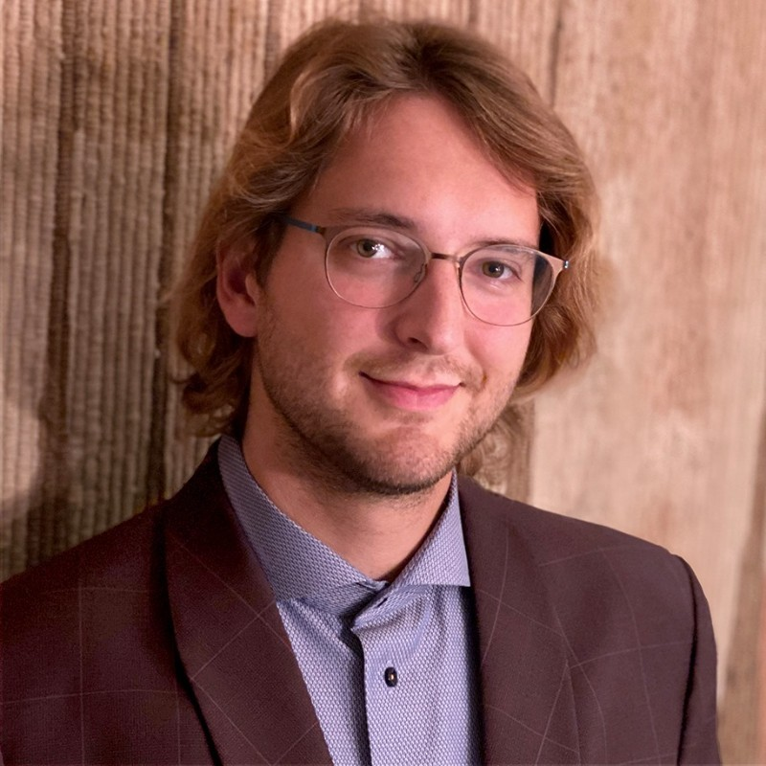
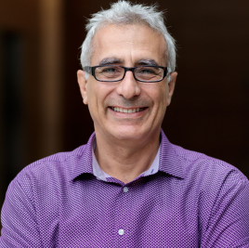
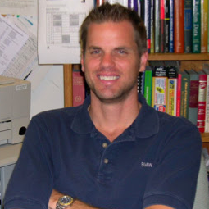
Team
Dr. Niall O’Dowd
Charles Zahl
Mus Chagal
CEO/CTO inventor of IP
CFO/COO
Mfg. / Bus. Dev. Advisor
Chain Reaction Innovation Cohort 5
U. of California San Diego
Structural Engineering PhD, MS,
CFO, Serial Founder
DigiPrep Dental, Amplify Surgical,
MBA, Santa Clara
University of Chicago Adjunct Professor
Entrepreneur in residence
MBA, U. of Chicago
Dr. Michael Todd
Dr. Xuan Zhang Li
Structural Health Monitoring Expert,
Professor of Engineering
PhD, MS Duke U.
ANL Principal Materials Scientist
U. of IL at Urbana-Champaign
PhD, Nuclear Engineering
Co-inventor of IP
Add. Mfg. Advisor

Slide 26
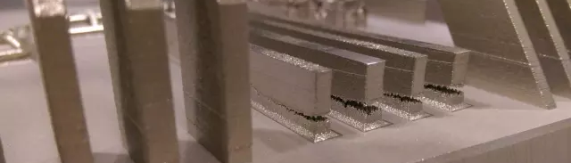
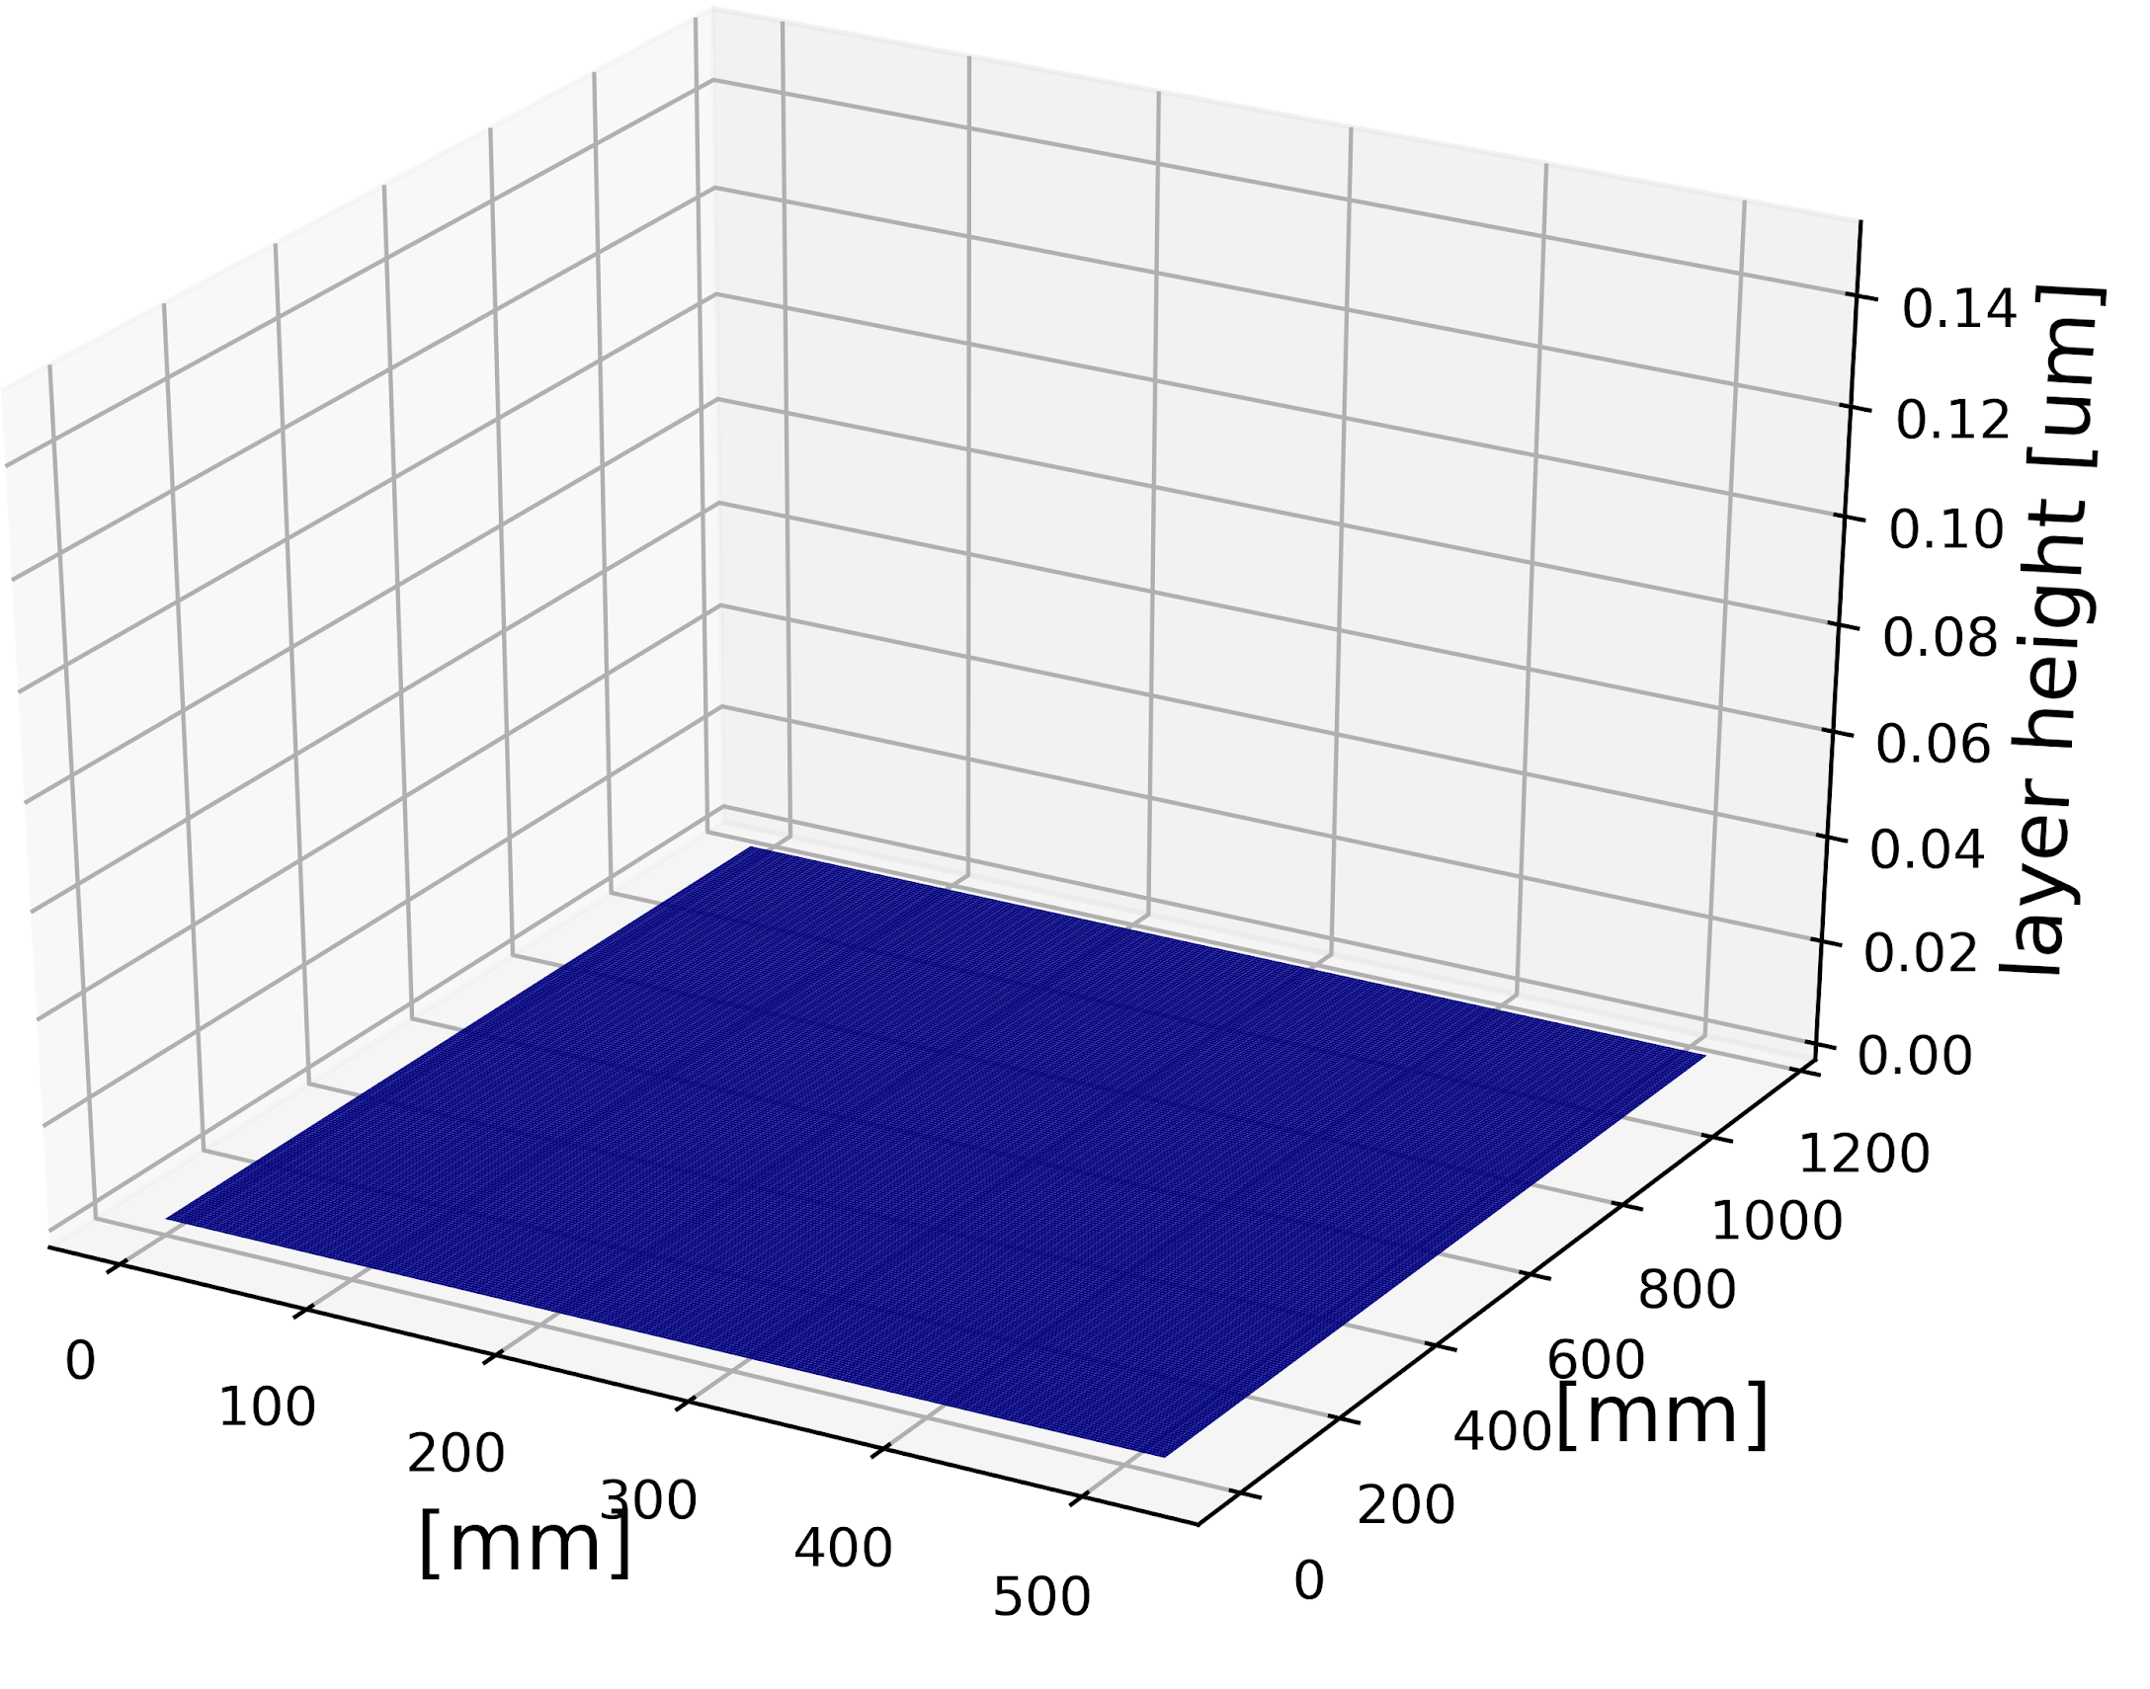
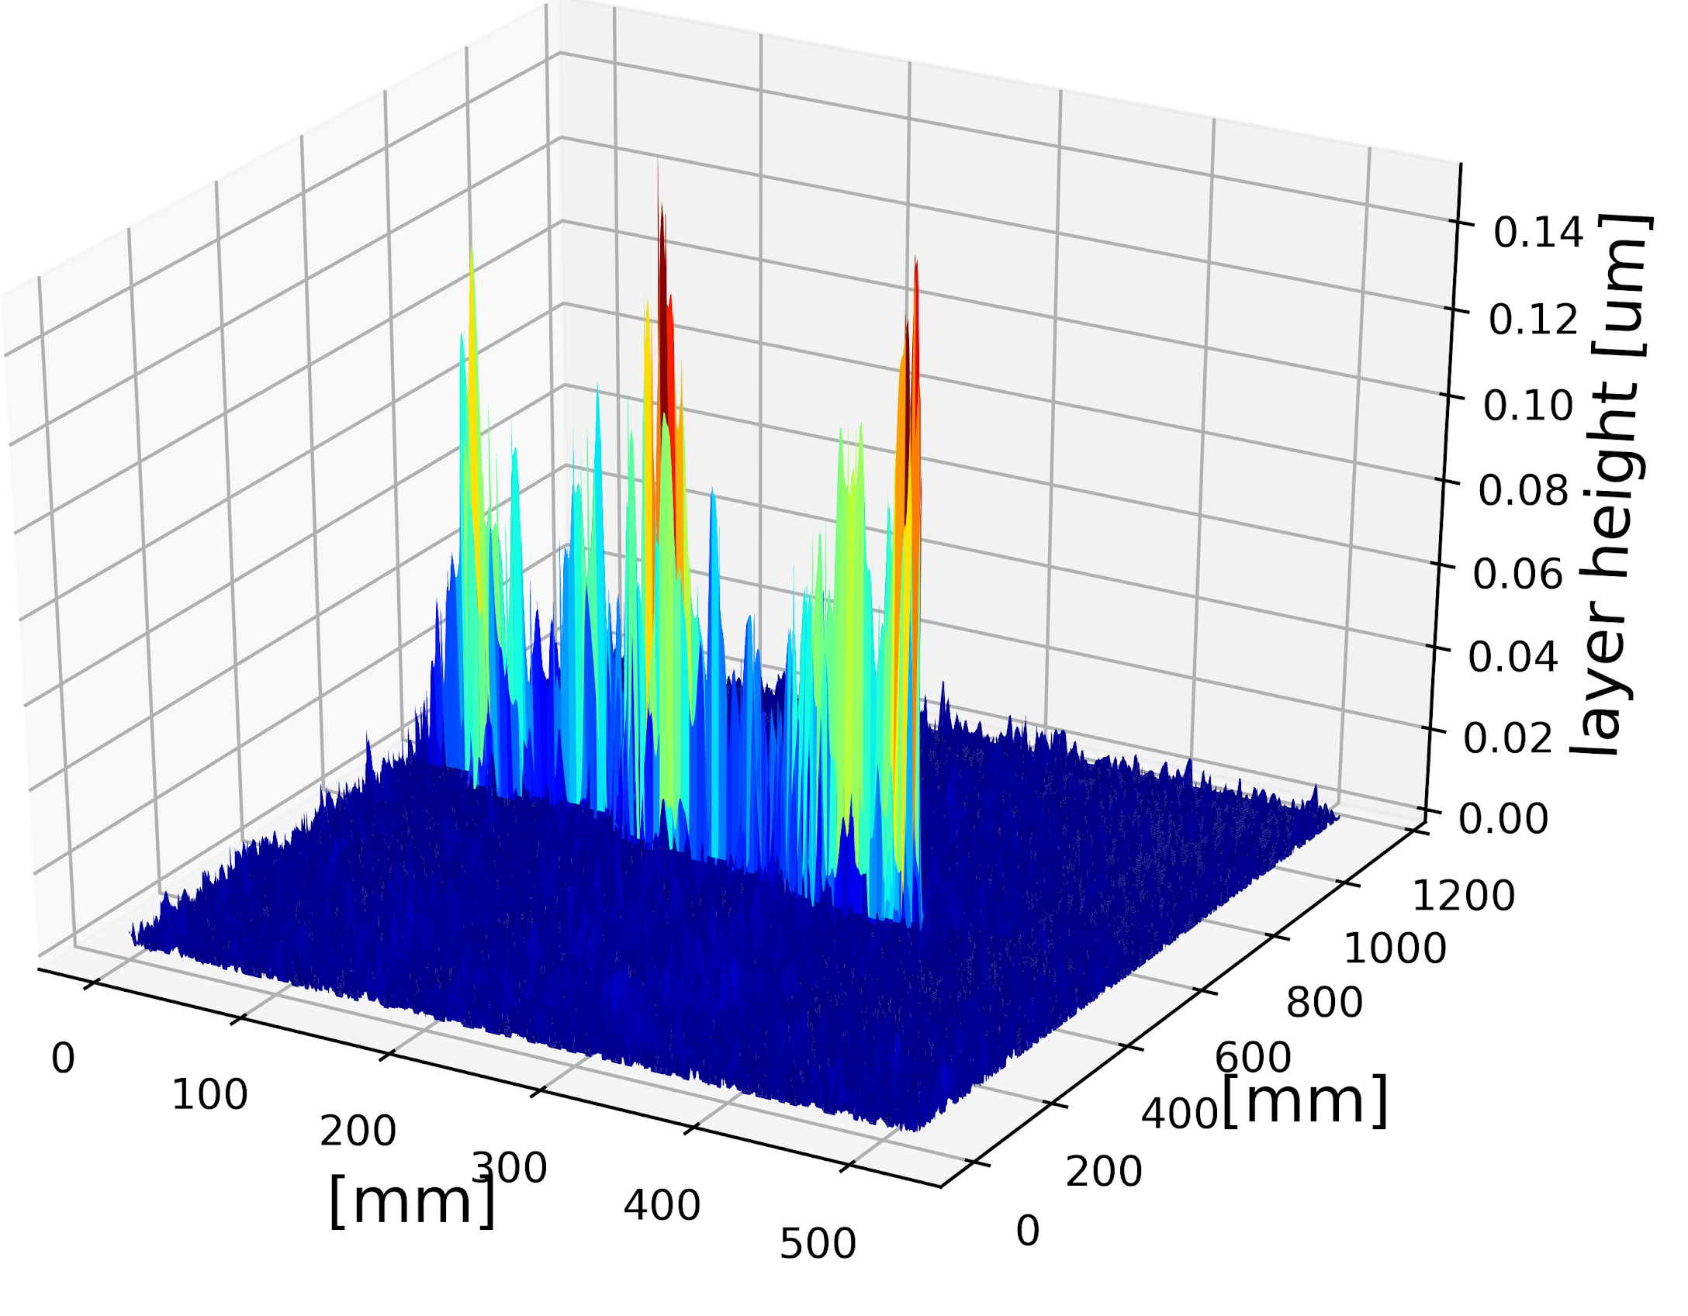
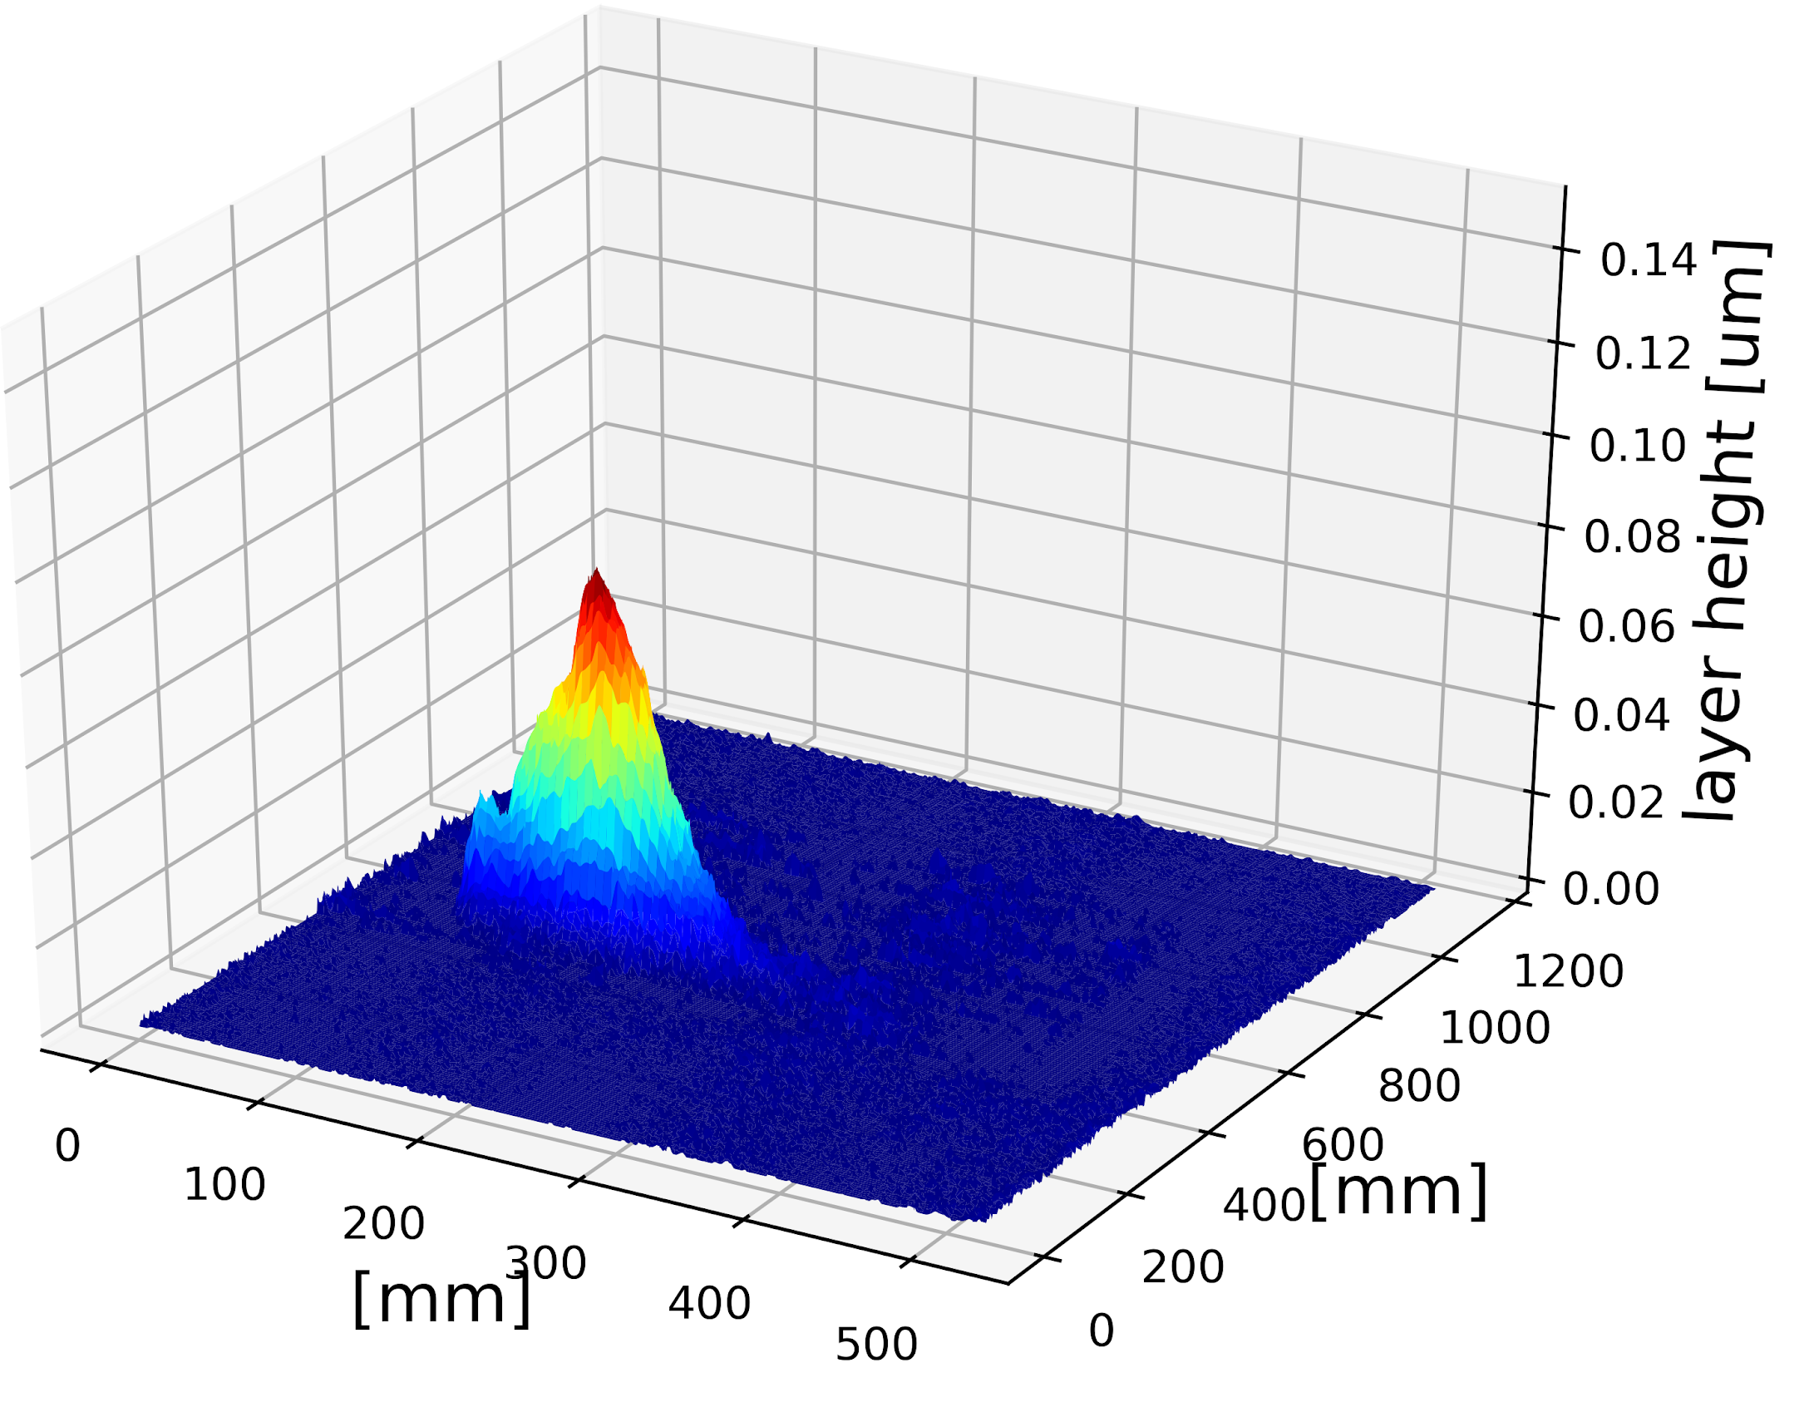
Executive Summary
Problem: costly part failure in AM
Product: A hardware and software monitoring system which provides part qualification data
For: Industrial 3d printing service bureau & in-house managers to reduce part lead time, scrap, and energy
Retrofits industrial 3D printers to provide real-time part quality
What this means for the DoD:
AM Alignment to DoD Mission
Modernize National Defense Systems
Increase Material Readiness
Enhance Warfighter Innovation & Capability
Substantial AM supply chain improvement
Reduce average lead time by 23%*
Reduce AM material cost by > 15%
Healthy layer
Streak defect
Clump defect
Founder, CEO: Niall O’Dowd, niall@additivemonitoring.com
* 30% scrap rate, 75% supply chain improvement

Slide 27
Thank you!
Questions:
Niall O’Dowd
niall@additivemonitoring.com
Charles Zahl
Charles@additivemonitoring.com

Slide 28
Appendix

Slide 29
Use Cases for Aerospace Examples
Reduce Lead Time
Example scenario:
Lockheed Martin quotes for turbines, estimates 6 month project
Small defect embedded in blades, but all pass visual inspection. Blades fail post-inspection, pushes delivery +3 months
With monitoring system, defect is detected during build,
Save Cost
Example scenario:
Honeywell starts printing engine nozzles, with 7 day build time, quotes at $150K/nozzle
A print fails on day 3, but continues to deposit; $40K material and energy waste
With monitoring system, build is canceled immediately,
saving $40K material & energy
Provide Data
Example scenario:
Air Force Research Lab is developing new alloys for add. mfg. project.
New material parameter study usually takes ~1,000 specimens over 1,000h
With monitoring system, more material data is recorded, specimens are reduced by 10x
reducing development & validation time up to 10x
mitigates part delays by 3 months

