Slide 1
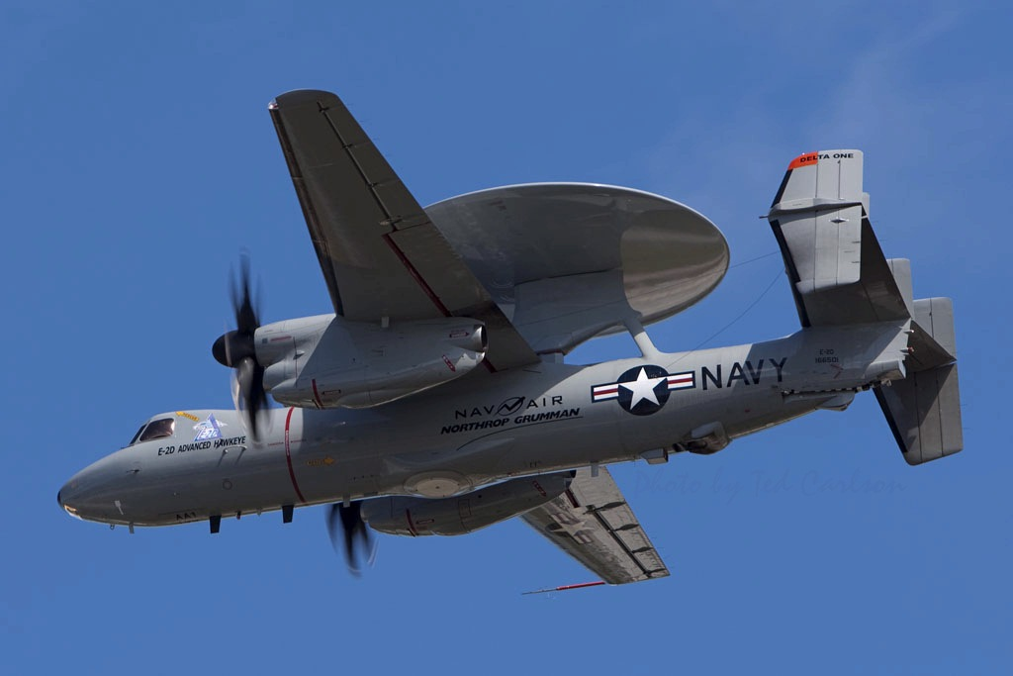
AM Contracting Guide Proposal
CAPT Armen Kurdian
Director
Code N2

Slide 2
BLUF
Much work has been done in business model development
IP issues have been addressed with several avenues to manage
Value streams for both Government and Industry are identified
Information is not consolidated
There needs to be a singular source that lays out the various business models and methods of acquisition for AM – related products and services that can be leveraged by the Navy and Marine Corps

Slide 3
Purpose of the Guide
Contract language
Main body and attached Sections
Statement of Work best practices
How to address new areas or issues unique to AM
Licensing
Liability
Just-in-time inventory
On-demand services
Data rights, access, protection of IP
And more…

Slide 4
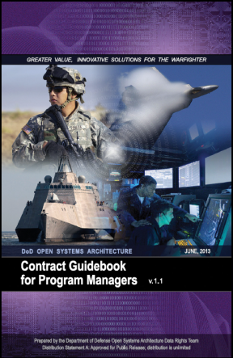
Historical Development of Similar Guide
DoD Open Systems Architecture Contract Guidebook for Program Managers (June 2013)
Started as a Navy – only effort
Originated as push from ASN RDA and Senate Staffer (S. Stackley)
Centered at NAVSEA – Ship Combat Systems
First version 2007
Expanded to all SYSCOMs in 2011
Managed out of DASN RDT&E office
Best practices added, other practices deleted
PMA-281 Common Control System MAC/IDIQ for UAS software services
Expanded to all DoD in 2013
Direction of USD AT&L (then Dr. Carter)
Doubled size of document
The interest and need for the guide is here, now. We have the advocacy. Now we need to stand up an organizational structure to manage this effort with some small amount of funding

Slide 5
Construct
A funding source will be needed
Mix of OMN & RDT&E, maybe NWCF, APN, WPN
Most of the substantive language development will be done by government personnel
Emulate the same process as was done w/the OA Guide
Will need CSS to help manage the effort
Working to identify potential existing contract vehicle
Total funding for OA guide was < $500K
Expect this effort probably double over a two year period, plus expected travel

Slide 6
Construct (contd.)
DASN RDT&E is the Lead for the Effort
NAVSUP WSS will begin initial coordination and get the effort running
Dozens of attorneys, contracts specialists, engineers, finance personnel have already been involved in business model and process development
Multiple articles, artifacts, available to draw from
All will be made members of the working group
Collaborative effort across the Navy / USMC team
Government personnel develop the substance. Contractor support develop the document.

Slide 7
Existing Material
OSD AM Wargame I & II reports
2017 NAMTI Report
“Implications of AM for the Navy Supply Chain” – AT&L Magazine Nov/Dec 2016 & other articles published in issue
“Additive Manufacturing Technology: Potential Implications for U.S. Manufacturing Competitiveness” – US International Trade Commission, Sep 2014
Multiple other published works from industry and academia
Plus, the wealth of corporate knowledge from within the Navy – Marine Corps team

Slide 8
Existing Contract
Evaluating Available Contracts
NAVSUP will coordinate
J&A required?
Proposal cost?
Services required?
NAVSUP will do the legwork including obtaining funding commitments from stakeholders
SOW drafted and in review
Scope adequately covered

Slide 9
Recommended Actions
Each participating SYSCOM / activity identify primary POC for WG
E-mail to be sent out this week.
1-2 months to award Task Order
Timeline
EOFY18 – Draft document complete
EOFY19 – Guide ready for publishing
Identify funding source or obtain funding from each activity
Maybe can start with partial funding
Develop and distribute charter (DASN RDT&E)
Emulate as much as possible the very successful effort in developing the OA Contracting Guide and execute.

Slide 10
Target of Opportunity
BRILLIANT IDEA FOR NEXT WARGAME!!!
Incorporate a white cell, much like a real wargame. Create a scenario, inject new information, generate new information and data based on questions, keep track of it, share with other teams only if they ask. i.e., government trying to make a BCA, or pulling more engineering data, industry does a FOIA, etc.

Slide 11
Treat the wargame as if you’re going to fight a real war?

