Slide 1

DMG MORI Federal Services
Mark Mohr, President
DMG MORI Federal Services
Turning, Milling, Advanced Technologies, Grinding, Automation
Additive, Subtractive and Hybrid Manufacturing
Federal Regulation Compliance, Cybersecurity Preparedness
DMG MORI Federal Services

Slide 2
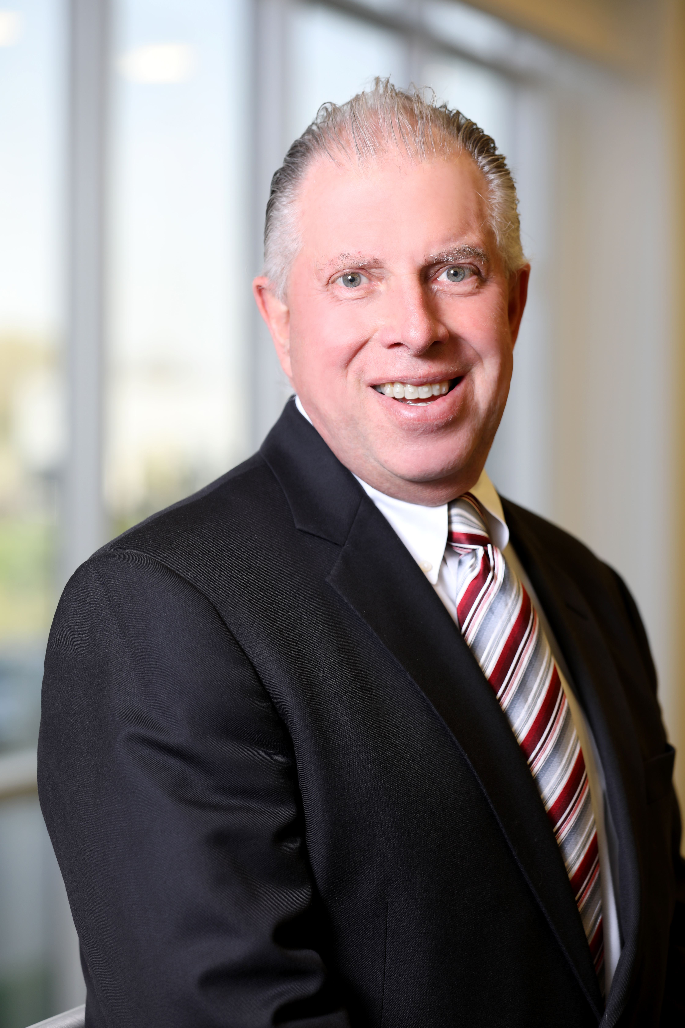
When Additive manufacturing makes sense
Mark Mohr
President - DMG MORI Federal Services
DMG MORI Federal Services
Additive Manufacturing Best Practices

Slide 3
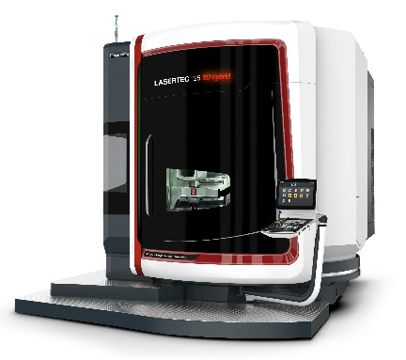
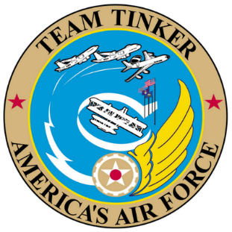
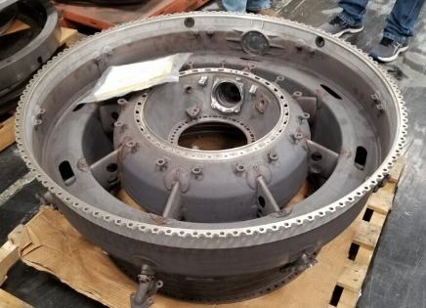
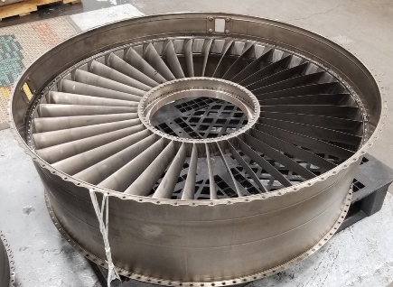
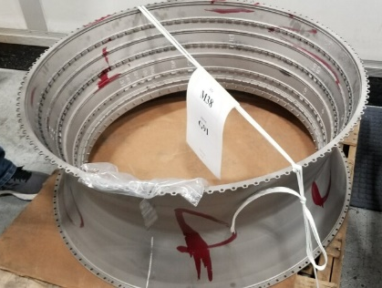
aerospace hardware Repair at Tinker AFB
Additive Manufacturing can change the way the supply chain can answer supply chain needs or demands by reducing repair time by 40%
(Glen Drebes, Engineering Branch Chief, Repair and Technologies Development)
Repair of engine casings on LASERTEC 125 DED hybrid
Customer Benefits
Shorter repair time and shorter lead time
Repair of super alloys (Ni based), stainless steels and other weldable metals
Replacement of castings
Use of scanning system for semi-automated repair and quality inspection

Slide 4
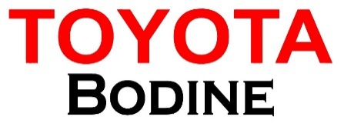
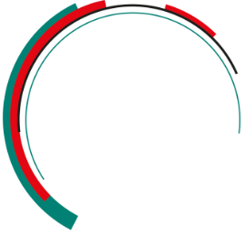
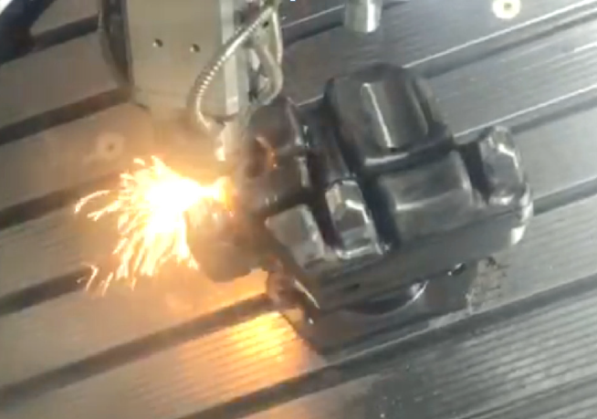
DED: Repair of a die cast mould
Toyota Bodine - USA
1. Die condition before repair
2. Target areas for repair
3. Machined die before deposition
Lifetime
300%
Key facts:
3 times the tool life compared to a TIG welded repair
Better repeatability of the repair process → Right 1st Time
Reduced costs due to excellent repair quality and a reduced processing time
→ See customer report: https://manufacturingscience.asmedigitalcollection.asme.org/article.aspx?articleid=2716936
Repair of engine casings on LASERTEC 125DED hybrid
4. Repair in process (LASERTEC 65 DED hybrid)
5. Repaired die

Slide 5
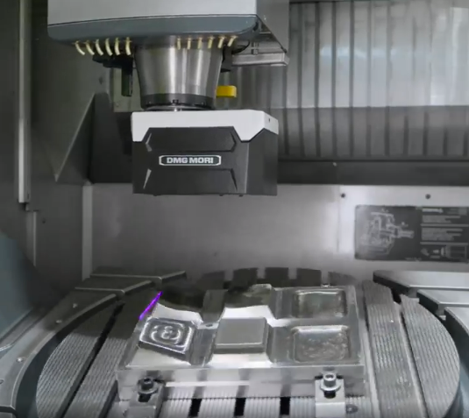
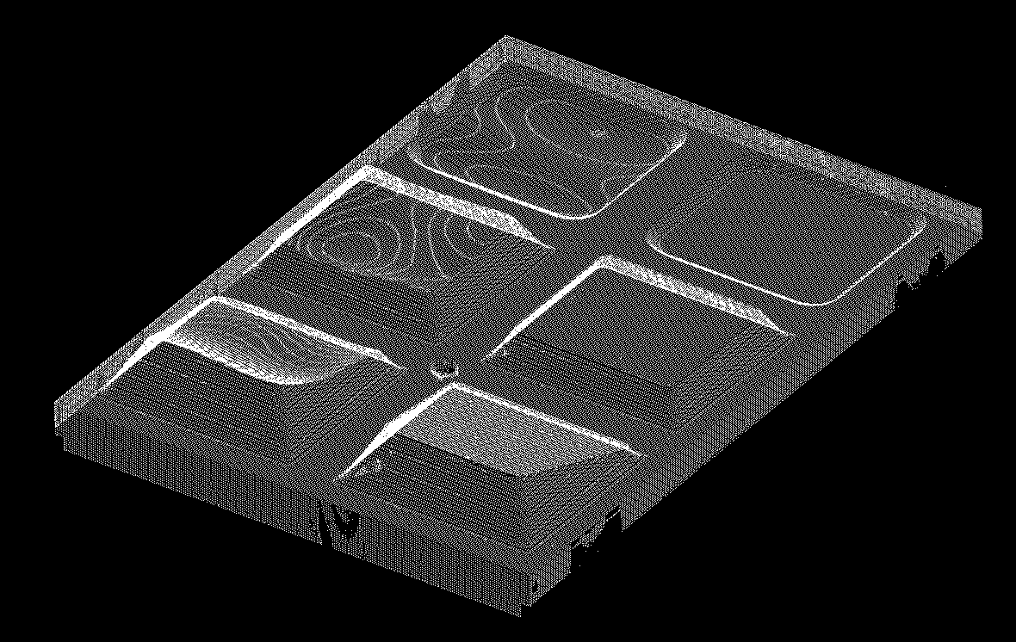
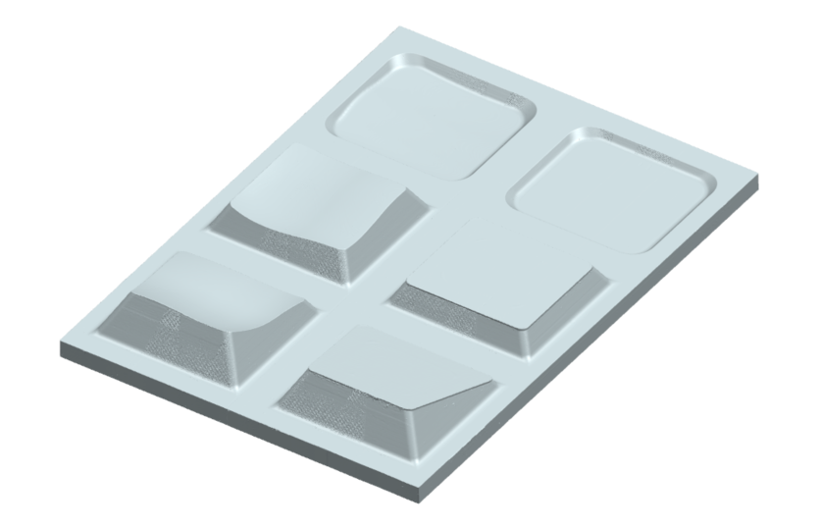
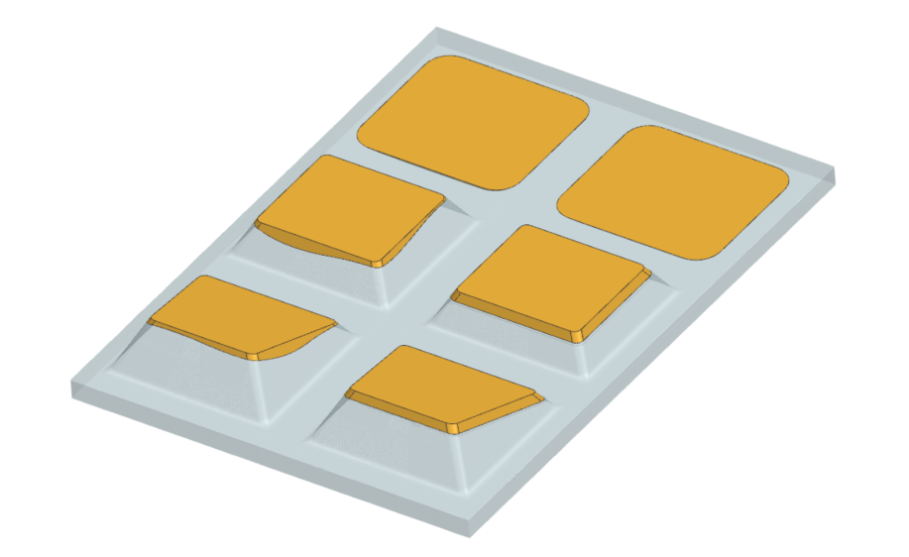
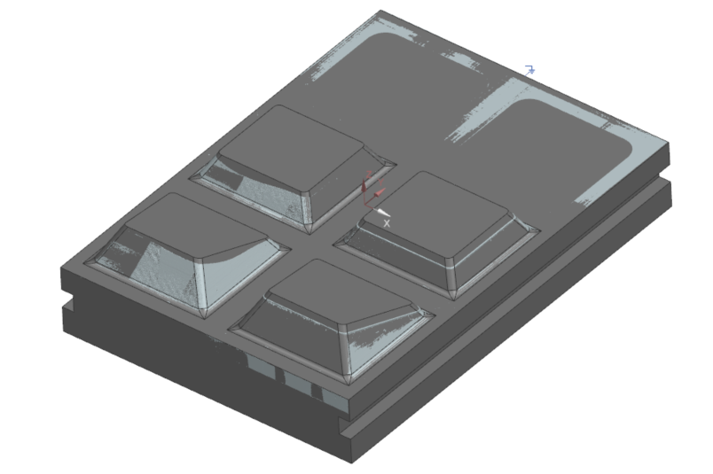
Next step in hybrid repair
3D scanning in machine
Workflow from scan to solid model
1
2
Scan and edit point cloud
Generate and
process STL
Repair of engine casings on LASERTEC 125DED hybrid
4
3
Calculate difference volume
Calculate difference volume
Align STL and target body

Slide 6
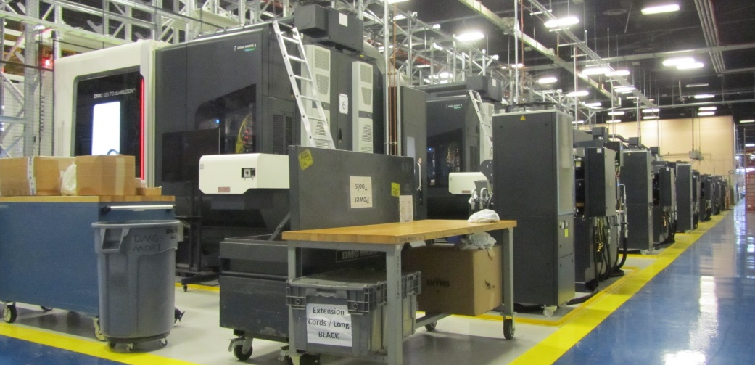
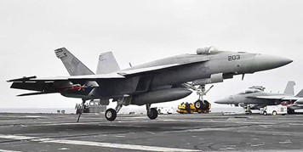
L.O.E. #1 Demonstrated Performance: US Navy Fleet Readiness SW
BUILDING 472
(6) machines occupying 7,000 square feet of floor space
Replaces a total of 12 machines
Decrease turnaround for repair time from 8 weeks to 4 hours
For repair and refurbishment of aircraft parts and components made of aluminum, steel and titanium.
First of its kind system installed in all of Department of Defense
Projected to save FRCSW $2.5 million annually in set-up time within the command’s manufacturing and component’s programs.
ONGOING REPAIR
DMG MORI manufacturing cell to be used in
repairing and refurbishing parts:
F18 Hornet Landing Gear
E2 Hawkeye Landing Gear
C2(A) Greyhound
LM2500 Turbine components

Slide 7
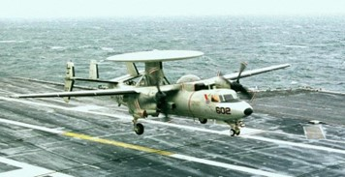
L.O.E. #1 Demonstrated Performance: US Navy Fleet Readiness SW
ONGOING REPAIR
EA-18G Growler Repair
While performing operations in the South China Sea aboard the aircraft carrier USS Carl Vinson (CVN 70), an F35C Joint Fighter aircraft struck the fire deck, slid and caught fire. Debris damaged the Growler’s fuselage.
Estimated repair time 50% sooner than purchasing the Growler’s components from the aircraft’s original manufacturer Boeing.
First Growler part to be made on the DMG MORI/Fastems Flexible Manufacturing Cell
Estimated manufacturing time of 3 weeks and cost of $208,000

Slide 8
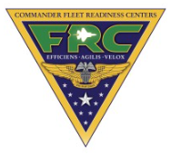
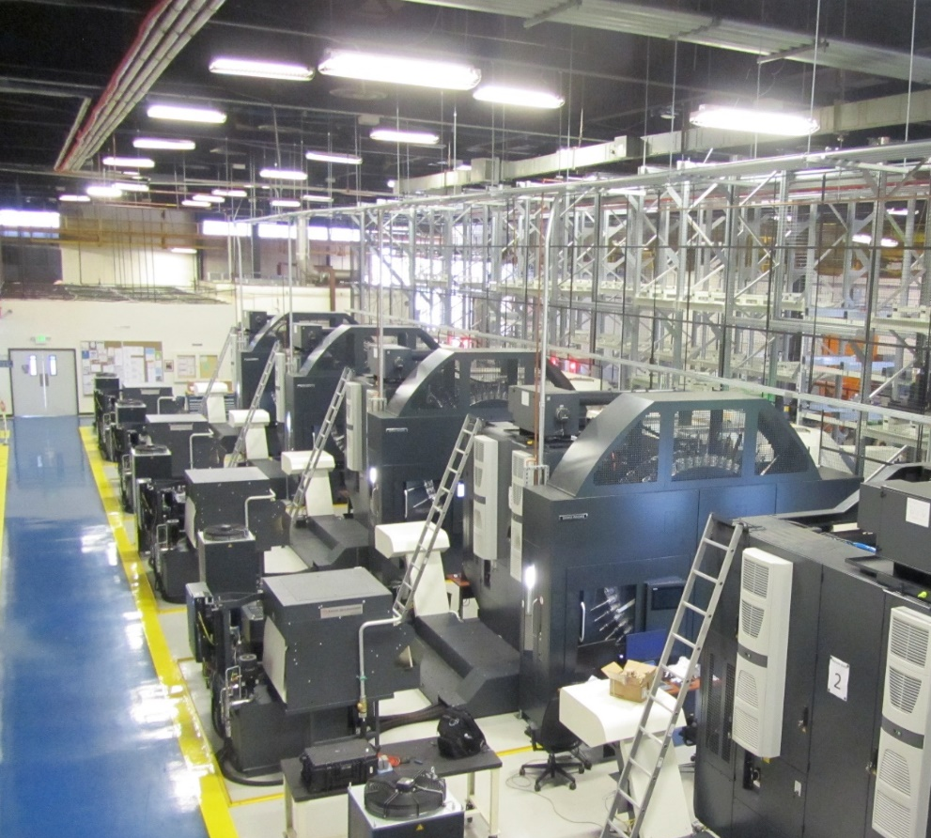
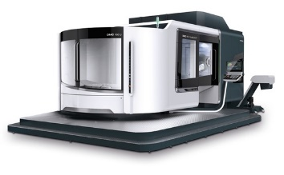
L.O.E. #1 Demonstrated Performance: US Navy Fleet Readiness SW
DMG MORI/Fastems Manufacturing Cell
Fleet Readiness Center Southwest
DMC 125 duoBLOCK
4 Identical machines removing single point of failure
Mill material part size: 48 x 24 x 26
Lathe material part size: 40 Diameter x 26
Graining capability for both mill and lathe features.
Capability to manufacture both ferrous and non-ferrous materials
i.e., Steel, Titanium, Inconel, Aluminum, Brass, Copper, Gold.
High Speed Machining capabilities. Max rapid feed of over
2000 inch per minute (IPM) and Mill Head Spindle Speed of
12000 rpm with 95.9 ft./lbs. of torque and 46.9 hp. and
lathe table of 500 rpm.
123 Tool magazine which gives us the ability to standardized tools,
by which we will be able to have faster setup times.
Automatic high-speed pallet changer
Probing for automatic positioning
Full CAD/CAM Machine Simulation
DMU 160 FD duoBLOCK
2 Identical machines removing single point of failure
Mill material part size: 62 x 30 x 30
Lathe material part size: 55 Diameter x 32
Graining capability for both mill and lathe features.
Capability to manufacture both ferrous and non-ferrous materials i.e. Steel, Titanium, Inconel, Aluminum, Brass, Copper, Gold.
High Speed Machining capabilities. Max rapid feed of over 2000 inch per minute (IPM) and Mill Head Spindle Speed of 12000 rpm with 95.9 ft./lbs. of torque and 46.9 hp. and lathe table of 400 rpm.
123 Tool magazine which gives us the ability to standardized tools, by which we will be able to have faster setup times.
Automatic high-speed pallet changer
Probing for automatic positioning
Full CAD/CAM Machine Simulation

Slide 9

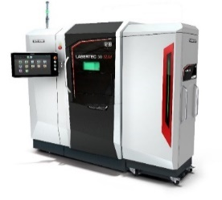
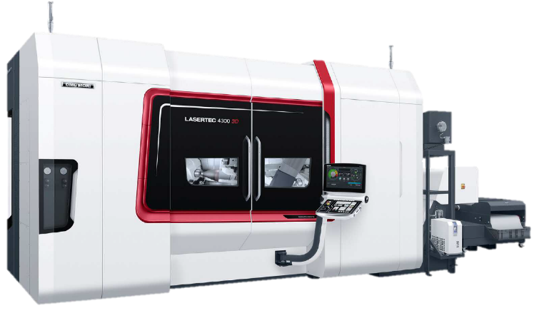
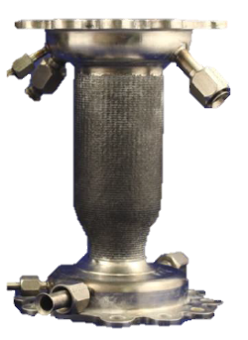
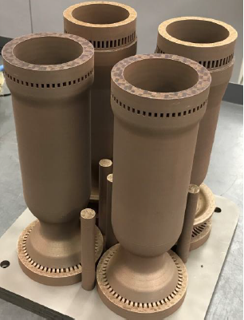
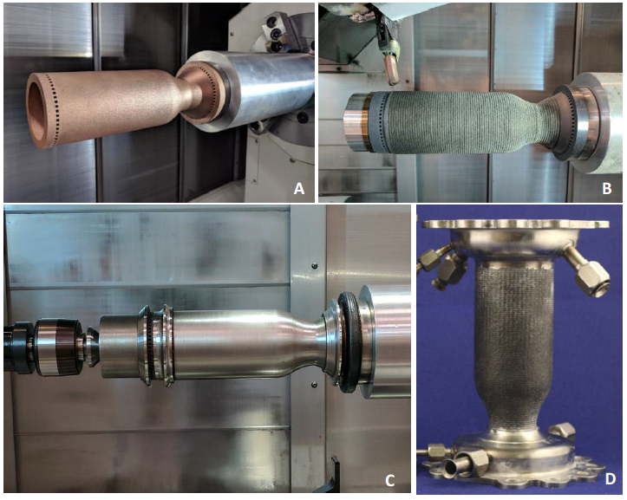
Additive manufacturing - Aerospace
Best Practice: Bi-Metallic Liners (GRCop-84 – Inconel 625)
Hybrid Additive Manufacturing of Liners and Jacket
End-to-end process chain incl. final machining
CUSTOMER BENEFITS
90% lead time reduction
Functional integration
Direct handover of data with CELOS
Perfect process chain for bi-metallic parts
Hot fire tested for 880 sec
LASERTEC 30 SLM 2nd generation
LASERTEC 4300 3D
Bi-metallic liner
PROCESS DETAILS
CUSTOMER DETAILS
Location: USA
Installed Base: 1x LASERTEC 30 SLM 1x LASERTEC 4300 3D
1
2
3
4
5
As built
Setup on LASERTEC 4300 3D
After cladding
After machining
Finish part

Slide 10
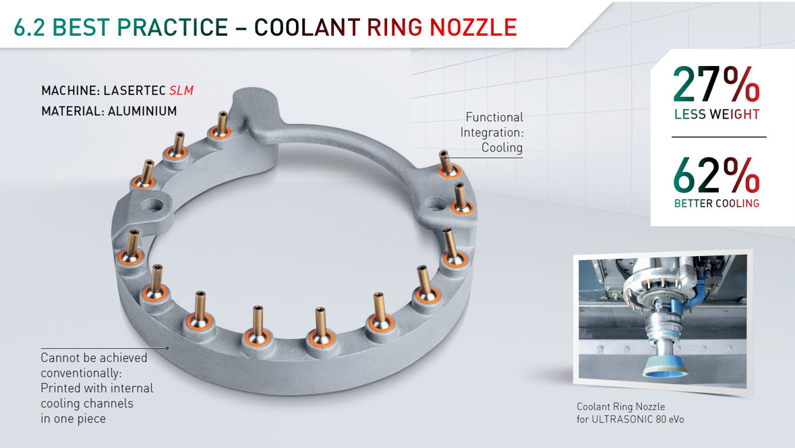
Slm: best practice

Slide 11
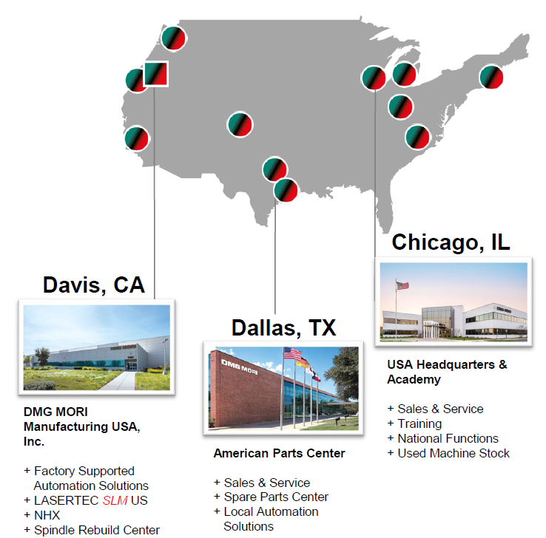
DMG MORI Federal Services
DMG MORI Federal Services, Inc.
(DMFS) is DMG MORI Group’s focused initiative in growing US Federal Contracting opportunities in Advanced Manufacturing.
WORLD’S LARGEST MACHINE TOOL MANUFACTURER
  Industry’s only total solutions provider that supports additive and subtractive manufacturing.
TURNKEY SUPPORT
  World’s largest machine tool builder with direct support and direct access from the customer to the builder
SUPERIOR TECHNICAL SUPPORT AND TRAINING
  Through our NIMS accredited academy and online courses, we help train your force on how to make parts using DMG equipment.
CYBER SECURITY COMPLIANCE
  We are NIST complaint, CMMC 2.0 ready, and we operate on Microsoft GCC High

Slide 12
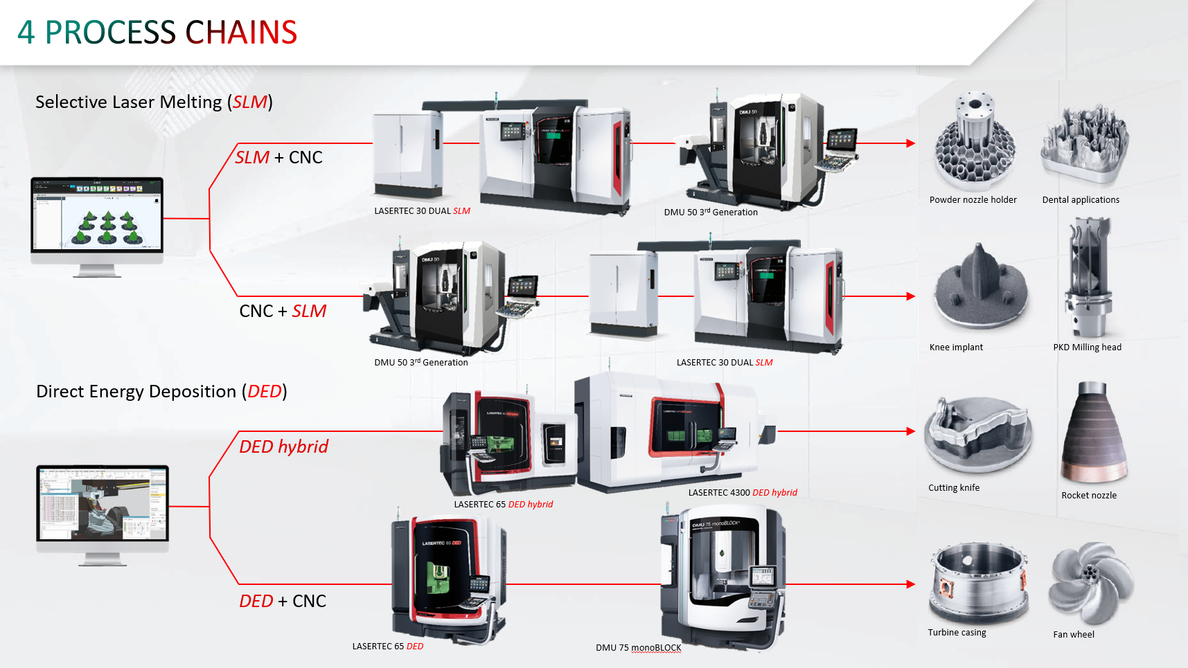
Additive Manufacturing – Process Chains
Slide 2 – Slide with NT, DMU, new SLM

Slide 13
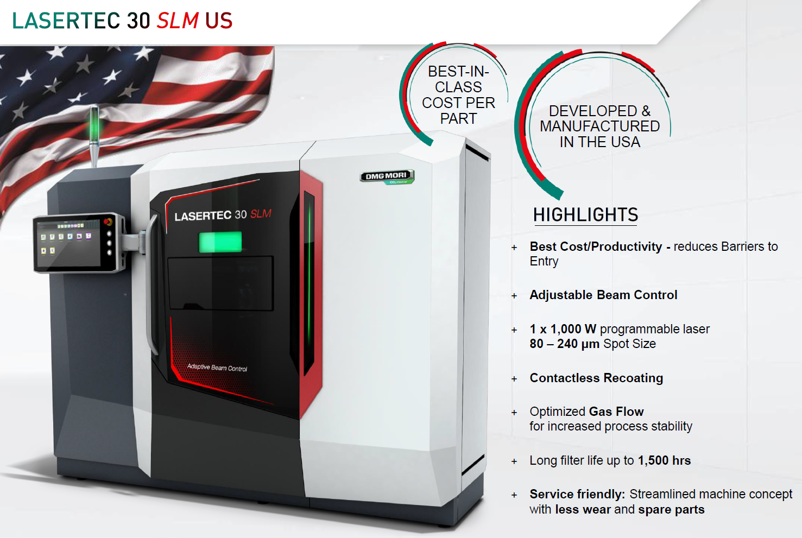
Lasertec 30 SLM - built in USA
Slide 3 – SLM built in Davis, subtractive

Slide 14

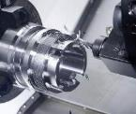
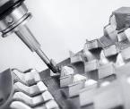
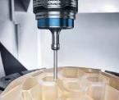
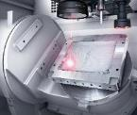
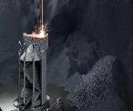
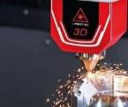


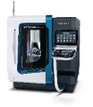
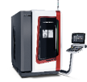
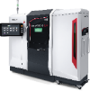
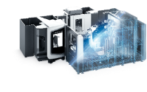







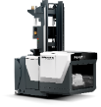





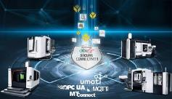
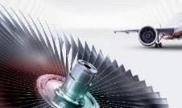
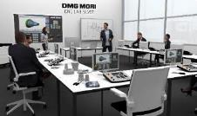
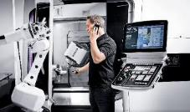
Technologies & MACHINES
TURNING TECHNOLOGY
MILLING TECHNOLOGY
ULTRASONIC
LASERTEC
ADDITIVE
MANUFACTURING
AUTOMATION
Drive
shaft
Turbine
vane
Driverless
pallet transport system
Compressor
disk
Gyro-
compass
Blow mould
Hydraulic
component
Landing
gear
Watch
case
Steering
wheel
cap mould
Drillbit
INTEGRATED DIGITIZATION
TECHNOLOGY EXCELLENCE
TRAINING
SERVICE

Slide 15
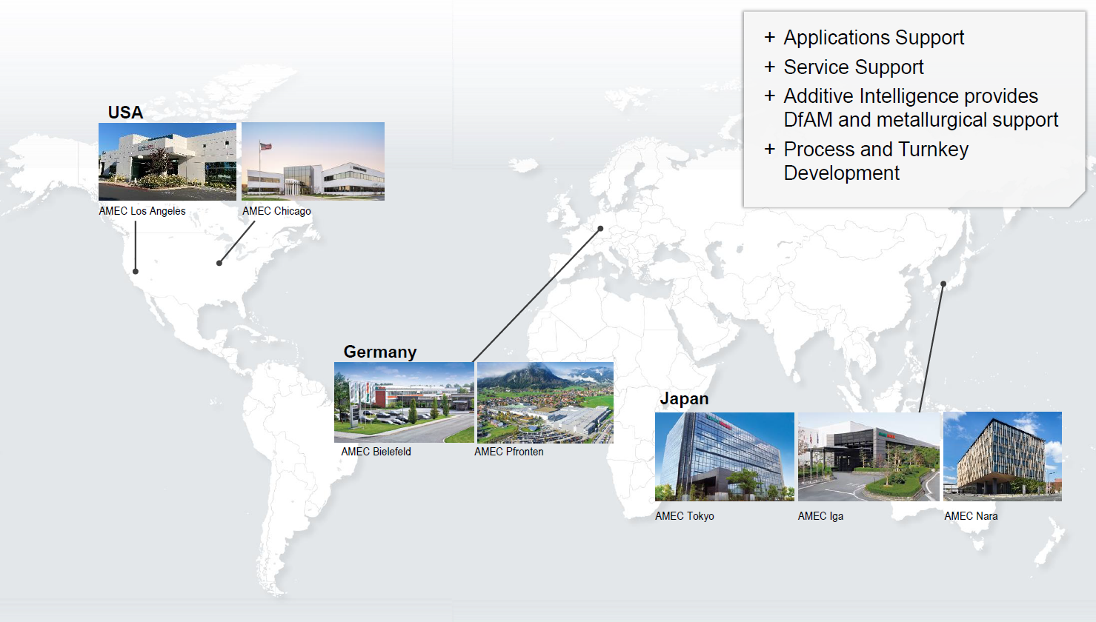
DMG MORI Global Additive facilities
Slide 3 – SLM built in Davis, subtractive

Slide 16
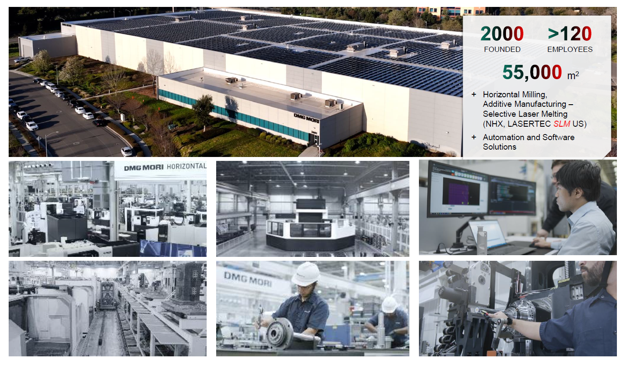
Davis, CA - DMG MORI Manufacturing USA
Slide 3 – SLM built in Davis, subtractive

Slide 17
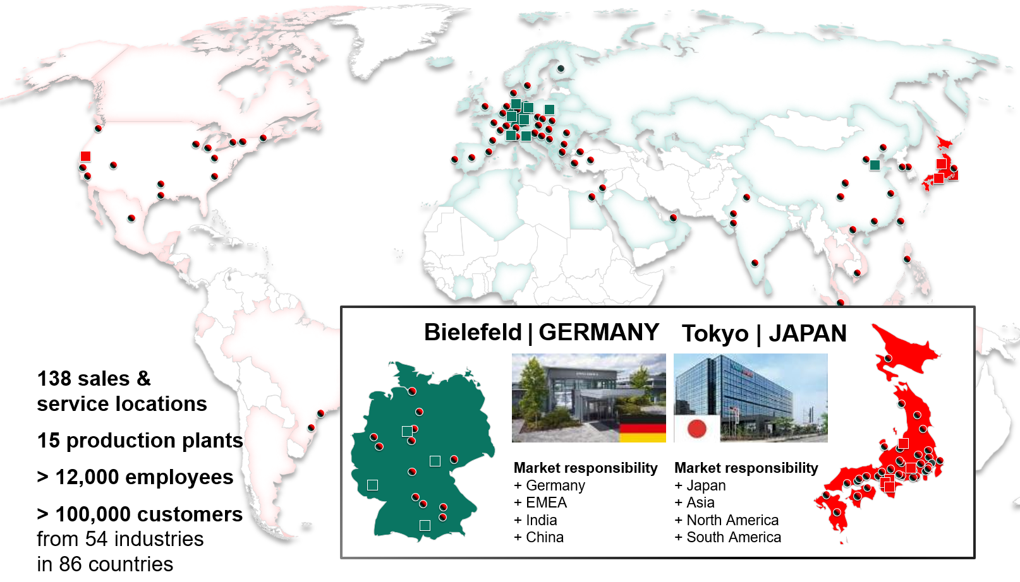
DMG MORI Global Group

Slide 18
Back UP

Slide 19
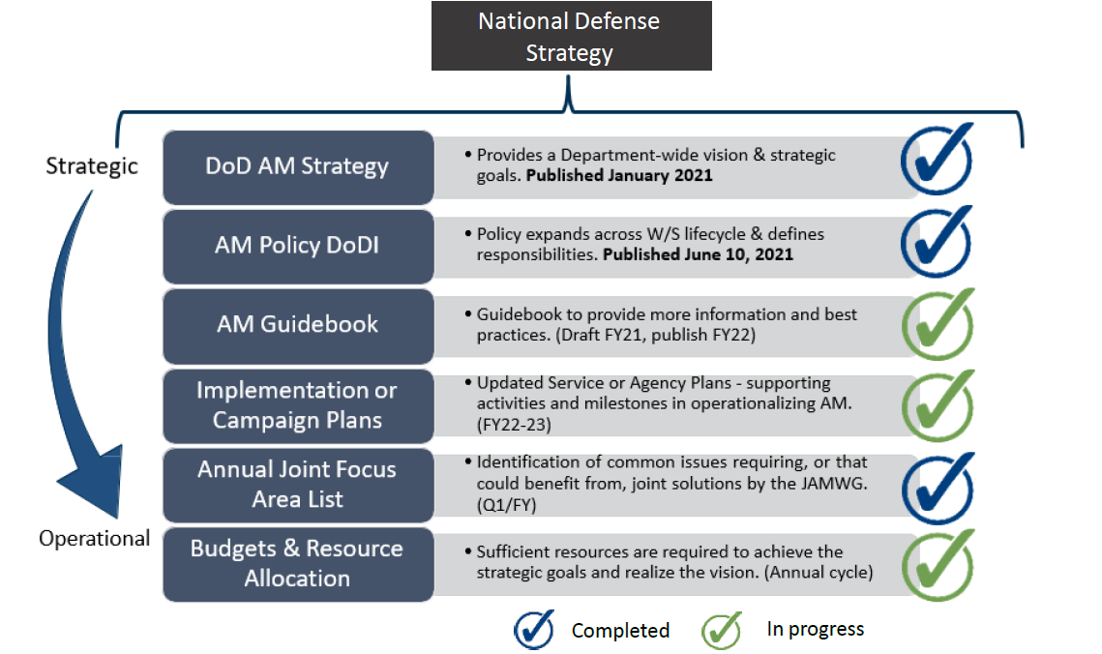
Additive Vision
STRATEGIC VISION
Additive Manufacturing to be widely accepted manufacturing technology
New technologies to transition more rapidly from research and development to fielded capabilities
Slide 2 – Slide with NT, DMU, new SLM

Slide 20
DMG MORI Federal Services BIO
DMFS is DMG MORI Group’s focused initiative in growing US Federal Contracting opportunities in Advanced Manufacturing.
Lean structure to manage heightened regulatory and compliance risks that are associated with government contracts
Targeted sales strategy to capture market share in federal contracting
Procurement advocacy to create new pipeline of business through advanced manufacturing within the US Government
Focus in regulatory compliance to position DMG MORI Group as a credible partner to top prime government contractors
COMPANY PROFILE
100% owned subsidiary of DMG MORI Co. Ltd.
Incorporated on May 21, 2021 in Delaware
Headquartered in Chicago, Illinois
Registered to do business in States all across the US
DDTC (ITAR) Registration: M45880
ITAR Empowered Official: James V. Nudo
Joint Certification Program of Canada’s DoD and USA DoD Registered

