Slide 1
Additive Manufacturing Course @ CEET – NIU
Federico Sciammarella PhD
Interim Chair & Associate Professor Mechanical Engineering
College of Engineering & Engineering Technology

Slide 2
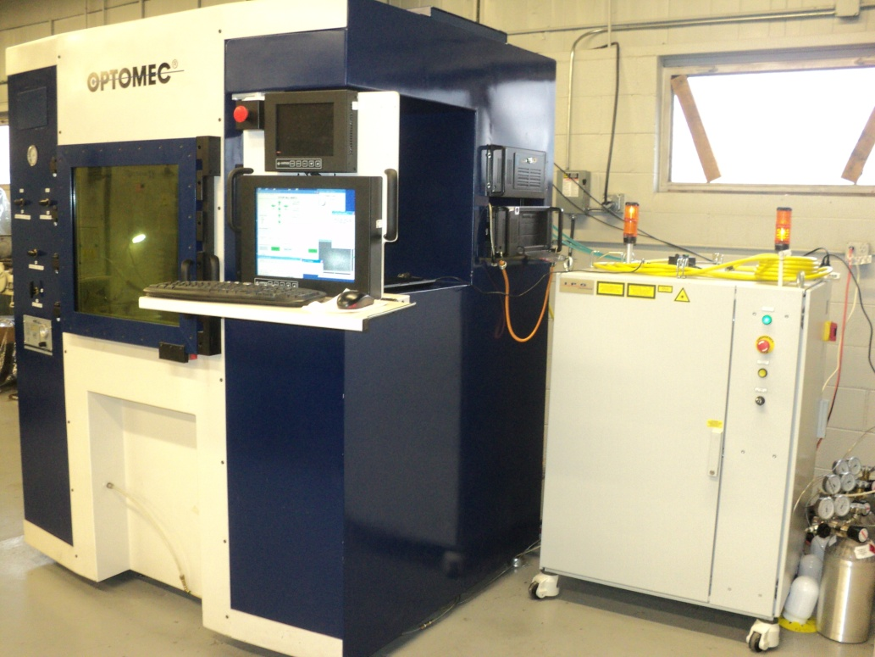
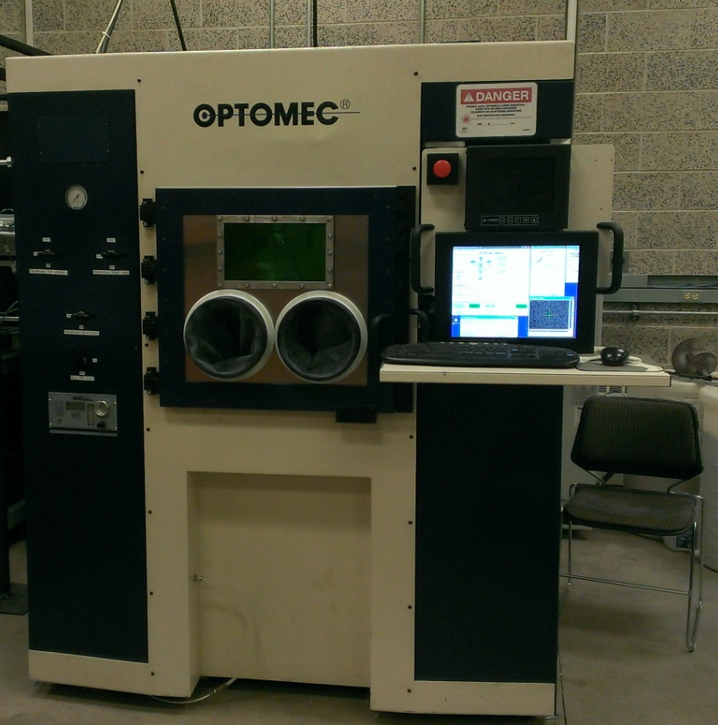
NIU ARMM Lab – LENS 850M
http://niu.edu/ceet/about/laboratories/armm.shtml
Objectives:
Create world class laboratory in metal additive manufacturing (MAM) for research and to support local industry using AM
Ensure MAM exposure to all CEET students

Slide 3
Northern Illinois University – NIST MSAM Physics-Based Additive Mfg. Models For Process Control & Quality Assurance
http://niu.edu/ceet/departments/mechanical-engineering/msam/index.shtml
Project Objectives
A comprehensive suite of integrated tools for process control and Additive Manufacturing part qualification
Devise and test models that enable predictive process adjustments during the layer-by-layer, three-dimensional manufacturing method
Guide development of customized engineered materials tailored to the capabilities of specific AM technologies, eliminating much trial-and-error testing
Collaborators:
Northwestern University, Evanston, Ill.
Quad City Manufacturing Laboratory, Rock Island, Ill.
Illinois Manufacturing Excellence Center, Peoria, Ill.
Fabricators & Manufacturers Association, International, Rockford, Ill.
ASM International
Outcomes:
Over 250 students learned about metal AM and project outcomes
15-20 undergraduates directly worked in program
3 M.S. Degrees
1 M.S. employed at NIST
1 M.S. employed at Argonne
Two potential patents
3

Slide 4
MEE 434/534 - Additive Manufacturing and Applications
Preparing the future workface to understand capabilities of AM
This will be a hands on course in which concepts will be discussed and then carried out in the lab
Design topics include:
Tolerances
Directional Strength
Thickness/Warpage
Materials include:
Polymers (ABS, Nylon etc..)
Metals (Stainless, Ti alloys, PH48S)
Lab Challenges
Design X – for cost/space used to print and or support materials consumed/ time
Looking for hands on applications….that may combine some or all of these items

