Slide 1

TEAM NAME
Additive Manufacturing
Business Model
Workshop
Day 2 Outbrief
31 May 2018

Slide 4
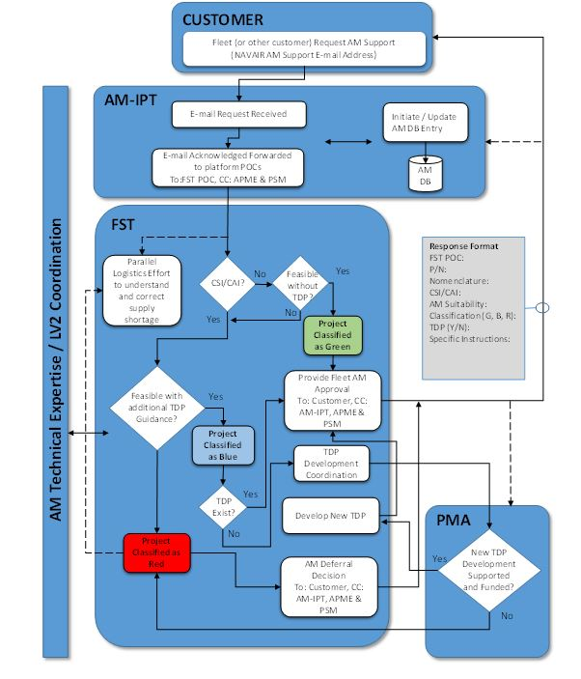

Slide 5
Engineering Process (include all users)
System Level Design
  Exhaust Logistics options, look at conventional approaches
  Services Engineering (PMA / PEO) provide historical data
  Go back to prime (Drawings, Design Notebooks, Test reports, etc)
  Determine Loads and Environmental Conditions (Conditional)
  Engineering Assessment – Model and Test (Engineering Review)
    Evaluate for materials impact
    Special conditions for Additive Manufacturing
    Evaluate for conventional alternatives
    Air Worthiness (Ground / Flight test)
    Engineering Process has Not Changed

Slide 6
Manufacturing & Quality
  Manufacturing process development (Engineering Review)
    Proof of manufacturing
  Verification & Validation
    Approval of the manufacturing process
    Material qualification / specification
    Quality Plan / Acceptance
    AM process control (machine calibration, training, prevent maintenance) – lock down
    Machine Qualification / Reliability / Repeatability
    Process control on dimensions (4 sigma)
Manufacturing & Quality Processes Unchanged

Slide 7
Supply Chain Management
Appropriately catalog
Seek concurrence if multiple users
Standard Procurement Activity
  Digital data - Digital definition (1D, 2D and 3D digital)
    Design, Modeling & Sim, Production
  Licensing options
Manufacturing Schedule
Delivery
Supply Chain Management is Unchanged

Slide 8
Key Takeaways (Day 2): (Blue Box)
Working AM technology with the current processes in place
  Same engineering processes
  Similar procurement
  Similar qualification and testing

Slide 9
GAPS
Material Allowable / Material Specifications
Allocation of IP concerns
Digital thread definition with minimal data schema
  Data repository
  Cybersecurity
Communicating need to industry
Standardizing the AM process
  Industry standards
Distributed AM printing network
  Lack of government equipment, skills and knowledge
  Industrial equipment
Funding for NRE / part cost

Slide 10
Backup

Slide 11
Digital Network
Define a framework for a qualification process for government / supplier and part.
A comparable supply chain management system
…. All within the context of a digital network with interoperable capability

Slide 14
Mask Valve (Green Valve)
Requirements:
  Functional performance document provided
    Design interfaces and functional requirements
    Use of Non- qualified materials of COTS parts / ASTM & SAE standards required
  300 assy, 800 total, 2 AM, 2 Non-AM parts
  100% Quality Assurance
  Total Time: 15 days (Design to Delivery)
    Ground Test, Flight Test
    30 to 60 days of use
  $250 unit cost
  Build schedule, time line for test.

Slide 15
Request
Request came in from PMA 202
Need to bridge DOD need to industry
  DLA Internet Bid Board System (DIBBS) / GSA
  Network of service bureaus
Multiple members of network (tiered)
  AM designers
  AM producers
  Testing / Qualification
    Quick First Article Inspection
Funding: 1. USG, 2. Vendor Off-shelf, 3. Hybrid

Slide 16
Parking lot
Design downselect
Configuration / data management of non-winners
Bid vs contract design
Intellectual property – limited rights Government Purpose, license as needed
  T/C’s agreed to ahead of time
  Credit Card / Purchase Card
Data Transfer/ Data Management- Interface defined here
  Update / Feedback user experience
  In scale with Quick Reaction Time, immediate
Component delivery- Acceptance
  Program office determines – Transportation method, destination inspection, customer direct.
  Payment strategy (vendor tier)

Slide 17
CSI Part- UH-1 Engine Apex Fitting (Blue Box)
Requirements:
  Redesign allowed- Meet Form, Fit Function
    Part Consolidation ?
  Material change allowed (criteria provided)
  Functional performance document provided
    Design interfaces and functional requirements
    Performance Requirements (Structural, fatique)
    Have report, no load data- system level analysis required
  Navy has GPR to data accepted
    PGI 217.7504 Acquisition of parts (when data is not available)

Slide 18
Request
Request came in from PMA 202
Need to bridge DOD need to industry
  DLA Internet Bid Board System (DIBBS) / GSA
  Network of service bureaus
Multiple members of network (tiered)
  AM designers
  AM producers
  Testing / Qualification
    Quick First Article Inspection
Funding: 1. USG, 2. Vendor Off-shelf, 3. Hybrid

Slide 19
Parking lot
Design downselect
Configuration / data management of non-winners
Bid vs contract design
Intellectual property – limited rights Government Purpose, license as needed
  T/C’s agreed to ahead of time
  Credit Card / Purchase Card
Data Transfer/ Data Management- Interface defined here
  Update / Feedback user experience
  In scale with Quick Reaction Time, immediate
Component delivery- Acceptance
  Program office determines – Transportation method, destination inspection, customer direct.
  Payment strategy (vendor tier)
Counterfeit
Standardization across services on criticality or air worthiness (Function Driven) – missing category
Identify opportunities for upgrades
How do prime solicit AM support - VECP

Slide 20
TEAM NAME
Objectives (Day 1):
Solve mask valve problem with in industry (Green Box)

Slide 21
TEAM NAME
Steps to Achieve Day 1 Objectives:

Slide 22
TEAM NAME
Challenges / Gaps Identified (Day 1):

Slide 23
TEAM NAME
Goals for Day 2:

