Slide 1
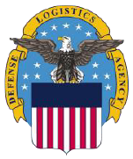

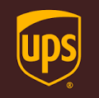


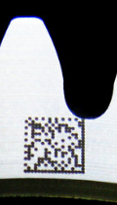
Moog VeriPart®: Secure, Authentic Parts for On-Demand Supply Chains
With industry and gov’t partners, Moog has been developing a technology solution for digital enabled parts supporting up to the most critical, regulated applications. This solution provides:
  Provenance with Traceability on a per part basis
    History of a part through the design-manufacture-use cycle per part (digital twin)
  Secure data transport
  Digital rights management, licensable transactions
  Authenticity of printed goods, assemblies
Leverages blockchain shared distributed ledger technology
Move away from selling end items (through licensing production) to technical data packages
  No inventory
  No shipping costs
  Eliminates “no value added” services
Peer-to-Peer Distributed Ledger
Patent Pending
Part Query
Transaction
Records
Transaction
Records
Transaction
Records
AM Part
Design
Manufacturing
In-Service

