Slide 1
complete
experienced
innovative
connected
trusted
driven
impartial
proven
award-winning
global
secure
A world leader in cross-industry collaboration
network
neutral creative
membership
expert
ultimate
thought
visionary
objective
progress
recognized
Notes:
MAIN POINTS:
NCMS basics
Collaborative focus
Invented modern collaborative management

Slide 2
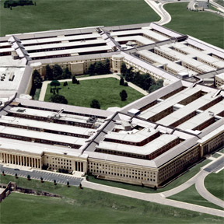
NCMS Overview Providing Collaborative R&D Solutions Improving North America Manufacturing Since 1987
Collaboration that Works
Access to
R&D Projects
Corporate Networking
Government Contracting
Business Growth
Focus Areas:
Cross-industry private/government partnerships (DOD, DOE, DOT)
Advanced Robotics (NAMC)
Sustainable Manufacturing (EPA)
Digital Manufacturing

Slide 3
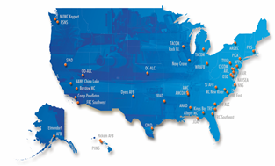
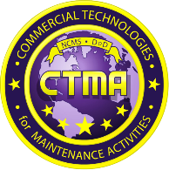
CTMA Overview Developing and Transitioning Technology to DoD Maintenance Activities Since 1998
over 240
Multi-participant projects by YE 2014
17
Awards for innovation
$75M
Applied in OSD & Congressional funds
$70M
Service-directed
funds applied
$144M
Industry cost
share contributed
$450M
Cost savings
to date
$6B
Total projected
savings by 2023
92%
Technology transition
rate since 2005
CTMA is the only DoD-wide program focused solely on Mx improvements
Established relationships
with 90+ DoD Entities
Notes:
THIS SLIDE: Introducing the program – how, why, results.
Awards Received to date
Ten Defense Manufacturing Excellence Awards
Two “Great Ideas” Award Winners
Two R&D 100 Awards
NAVAIR Innovation Award
American Helicopter Society Jensen Award
Air Force Chief of Staff Team Excellence Award

Slide 4
NCMS/CTMA Track Record
Notes:
Look and feel of slide looks good.
Tony – Greg needs talking points for the deployment rates graph. Need to speak to % of CTMA projects and the % of dollars applied…….how the data was calculated.
Talking Points – Deployment Rates:
Deployment is defined as the case where the subject technology of an initiative remained in use in the sponsoring depot after the end of the initiative, regardless of further adoption by other depots and/or services. Percentages were calculated by identifying transitioned projects and the funding required for them, then dividing by project and funding totals.
Prior to 2005, initiatives focused on applied development or demonstration and the transition rate was low.
In 2005, emphasis was shifter to technology demonstration and transition and the transition rate subsequently more than doubled. The transition rate is low for active projects because transition cannot be determined until the initiative is finished. All active projects are expected to successfully transition.
There are cases, such as Cold Spray, where demonstrated technology from a specific provider was not transitioned but similar technology from other providers is now ubiquitously deployed across the depot community.

Slide 5
RARE -- Rapid Access to Readiness Essential Parts through Additive Manufacturing
Overview
Showcase CTMA project initiated in 1991
Mission -- evaluate, pilot and share knowledge of promising AM technologies
36 industry (aerospace, medical, automotive, AM SMEs) and Government organizations represented
State of the art machines/materials evaluated; 100+ systems
126 production parts and repair applications demonstrated
50 AM systems purchased and installed resulting from RARE project
Results/Benefits
DoD annual cost savings or avoidance over $7.1M per year, 6.2:1 return
90% cost savings per part experienced ; time savings 1,500 weeks on just 40% of AM applications documented
Played a foundational role in establishing ASTM/ISO F-42 Standards Committee on AM
CAD files available for AM parts produced/repaired through RARE project

Slide 6
MBE -- Model Based Enterprise
Overview
MBE is founded on 3D product definition shared across the enterprise, enabling rapid, seamless, and affordable deployment of products from concept to disposal
Mission -- identify challenges, issues, and lessons learned in manufacturing where a digital 3D model is the authoritative information source for all activities in the product's lifecycle.
Four focus areas: Model Based Definition (MBD), Verification/Validation of Model data, Model-Based Inspection and Model-Based Work Instructions
Results/Benefits
Several MBE field projects are underway, each with slightly different goals, mostly related to Technical Data Packages and Data Rights
PLM tools (including Team Center) being used to optimize end-to-end processes
PLM technology deployed at FRC-SW, FRC-SE, and FRC-E

Slide 7
MBE Imperative for AM Part-Process Qualification
“Use of digital data, at least in the Army, is not recognized as being official data”
Migration of data from 2D Legacy Systems
File format incompatibility to be addressed (lack of standardization between MBE platforms)
Massive amounts of AM data to be systematically developed, stored in accurately retrievable form
Standard Cross-service Conventions for Maintenance & Updating Information
Quality Control of Pedigreed AM Data; Need Review Body(s)
Governance & Control of Data

Slide 8
Forming and Executing Collaborative Projects
NCMS has a well-honed, documented project management process in place
Fully supporting contract and accounting staff
Well-qualified, experienced PMs; 270 combined years in manufacturing; 70 years working with DoD sustainment community; 50+ years in project management
Streamlined business process; 45 days from cradle to execution
Consecutive Cooperative Agreements between DoD and NCMS for over 17 years

Slide 9
NCMS/CTMA Sub-Awardee Selection Process
Documented, rigorous process to select best-value Technology Providers/Sub-Awardees for each project
Evaluations use weighted, pertinent criteria that best satisfy project objectives
Based on DoD Source Selection and 501c(3) Procedures
DCAA-approved accounting and procurement system
Well respected procedures protecting Sub-Awarded IP rights
Ability to outreach to perspective Technology Providers through NCMS extensive cross-industry network (5,000+)
Established process to get selected Sub-Awardees on contract (Cooperative Agreement) rapidly

Slide 10
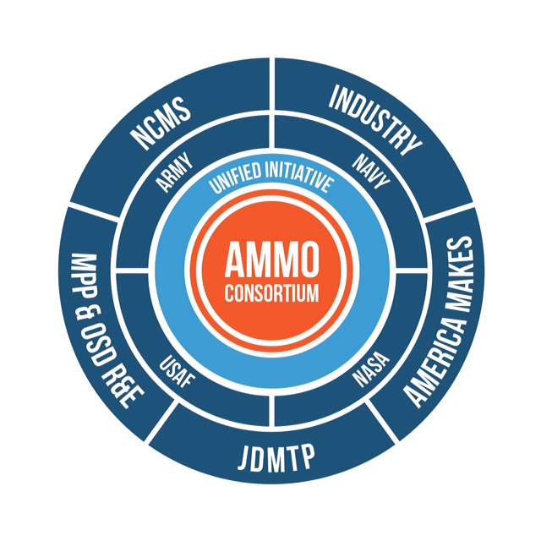
AMMO Concept
Additive Manufacturing Maintenance Operations
Real Parts Real Repairs Real Time
CTMA Model – Service Generated Initiatives Meeting Maintainer-User Needs
Levering Knowledge, Research, Application Development, Qualification of Process-Materials Across All Services
Co-developing Policy and Legislation Proposals
Cross-service, cross-Government Training, Apprenticeships & Guidance
Developing Sharable AM Resources, Capabilities, Decision-making Tools and Test Protocols

Slide 11
AMMO Fast Track Proposal Action Plan New Parts
Establish Cross-Services team to define, oversee, monitor Fast Track Process
Select four ‘critical’ part candidates for AM across Services
Evaluate existing Technical Data Package elements for AM and 3D data needed from 2D data
Generate 3D Model, prototyped, optimized, build file prepared for AM
Build part via AM using materials suitable for Form, Fit, Function; test coupons built with part
Test part and test coupons to appropriate testing to validate properties
Perform functional tests on the part as appropriate to its criticality
Compare part cost and time to standard part acquisition or production
Create 3D file to maintain MBE history for AM build by specific application
Fully qualify select parts for AM

Slide 12
AMMO Fast Track Proposal Action Plan Repair Processes
Establish Cross-Services team to define, oversee, monitor Fast Track Process
Select four key repair processes across Services where mature AM repair has been demonstrated
Focus on specific DoD MP&P applications of AM
Develop standardized AM repair process specifications
Input digital process data into a standardized, well archived model based enterprise of AM processes
Most likely candidate processes: surface finish/feature repair, casting core/mold repair, tooling repair (forming/composite forming)
Issue Fast Track Approvals for select repair processes in shared database
Establish Storage/Retrieval resource for associated CAD/CAM files

Slide 13
AMMO Additional Initiatives
Roadmapping for MO
Evaluate MO components & systems for repair suitability
Validate AM repair processes
Standard Qualification and Certification Processes
Capability Catalogue
AM Decision Making Tools
Establish the MBE approach and Models (Tech Data)
MBE Standards
Establish Data Management System
Data Sharing Capability (MO wide)
Guidance and Training
Material Standards
Evaluate/validate NDE systems for AM repairs
Evaluate/validate NDE systems for part/material substitution
Common Test Protocols
Develop Policy and Legislation Proposals
Notes:
I would also add getting Keyport’s casting capabilities using AM molds and patterns set up as a MO Center of Excellence and promote usage across all branches of service.
Another repair process that could be documented right up front, validated and recommended across branches of service is the use of AM masks for plating, etc. as recommended by David Price, NAVAIR. (We have more history of this within RARE too.)

Slide 14
Takeaways
NCMS can execute AMMO, like no one else can
Solid, well-established collaboration processes in place
Strong Cross-Services relationships
Long, successful history with AM within DoD and industry
AMMO Fast Track Proposal will show quick results: four real AM parts, four real AM repair processes, fully qualified

